Slide 1
Welcome Back

Slide 2
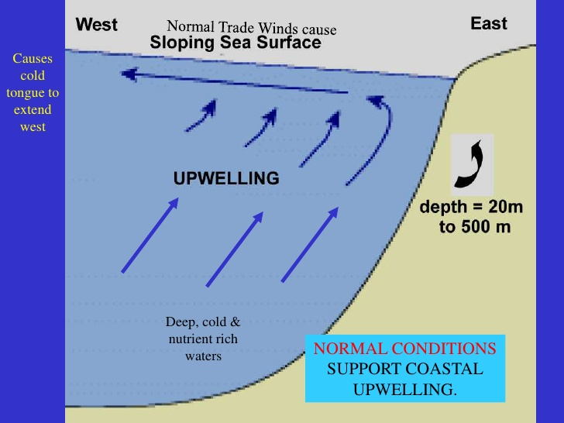
Monday, Jan. 7
Sketch on your catalyst sheet
Fact: 40% of couples fight over how to load the dishwasher

Slide 3
Monday, Jan. 7
Using your phone, define the following words:
Soluble
Insoluble
Precipitate

Slide 4
Tuesday, Jan. 8
How could a diminished upwelling affect the economy of peru?

Slide 5
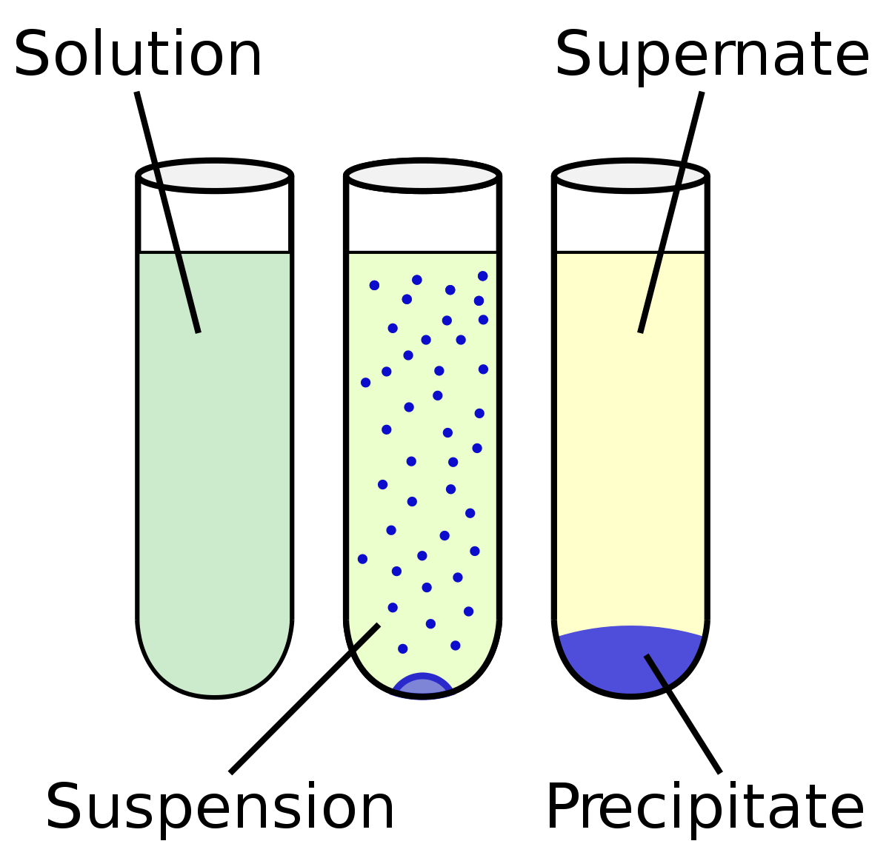
Tuesday, Jan. 8
Explain the difference between a precipitate and aqueous solution.

Slide 6
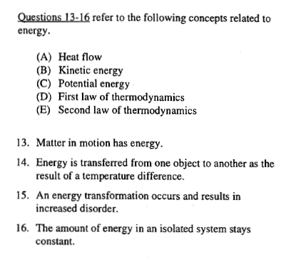
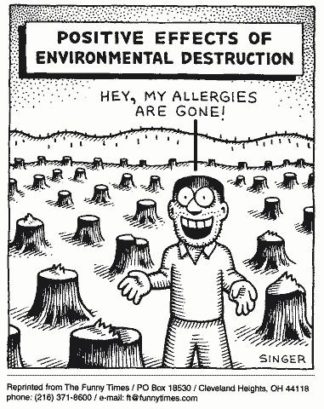
Wednesday, Jan. 9

Slide 7
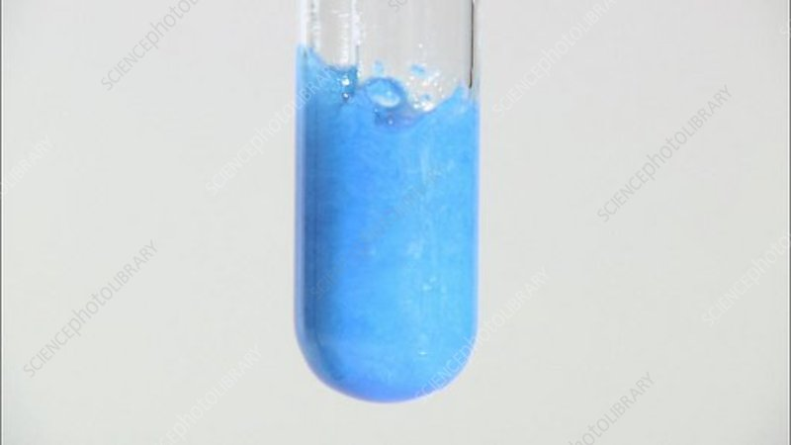
Wednesday, Jan. 9
Write the molecular, complete net & net ionic for the following equation
A solution of copper ii sulfate is added to a solution of barium hydroxide

Slide 8
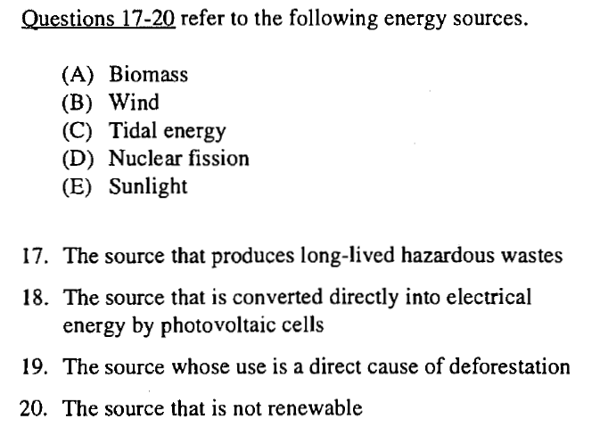
thursday, Jan. 10

Slide 9
thursday, Jan. 10
What are the spectator ions in this reaction:
AgNO₃(aq) + NaBr(aq) AgBr + NaNO₃

Slide 10
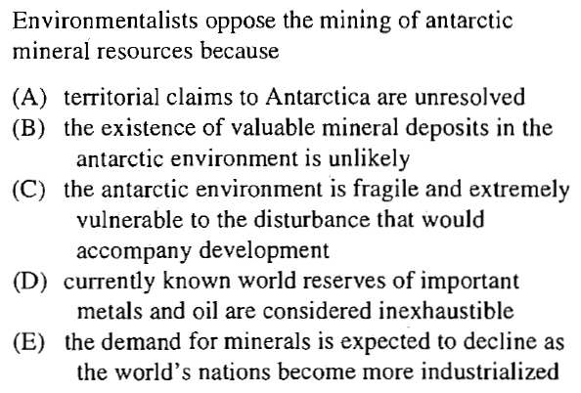
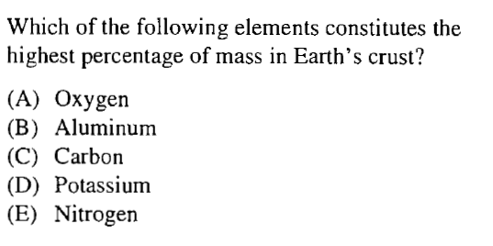
Friday, Jan. 11

Slide 11
Friday, Jan. 11
Hydrochloric acid reacts with lead II nitrate
Hydrochloric acid reacts with fluorine gas

Slide 12
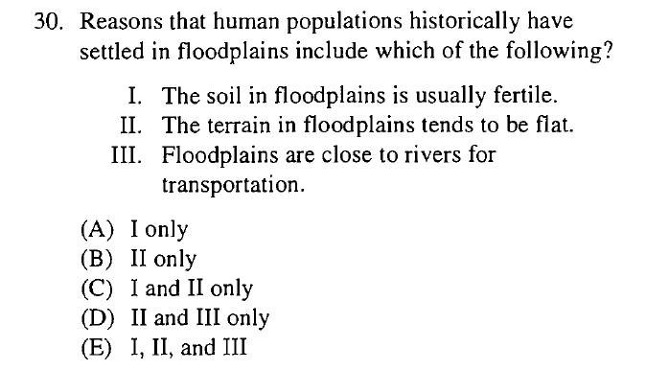
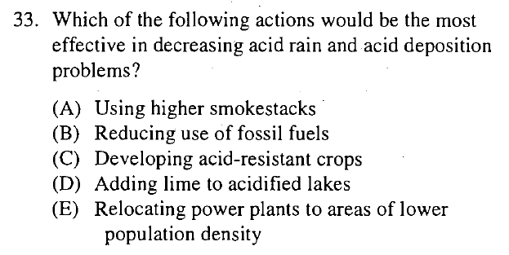
monday, Jan. 14

Slide 13
monday, Jan. 14
Chlorine gas is bubbled through a solution of sodium bromide

Slide 14
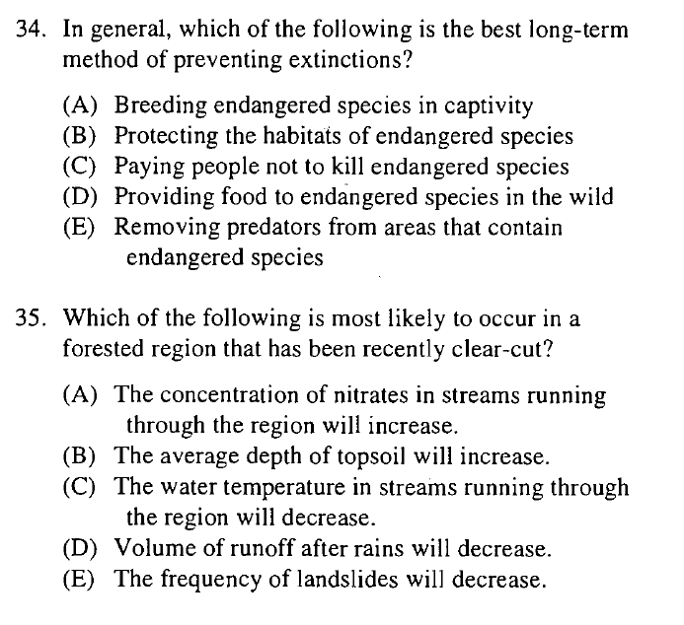
tuesday, Jan. 15

Slide 15
tuesday, Jan. 15
How many moles are in 5.69 g phosphoric acid?
How many grams are in .698 moles of sodium sulfate?

Slide 16
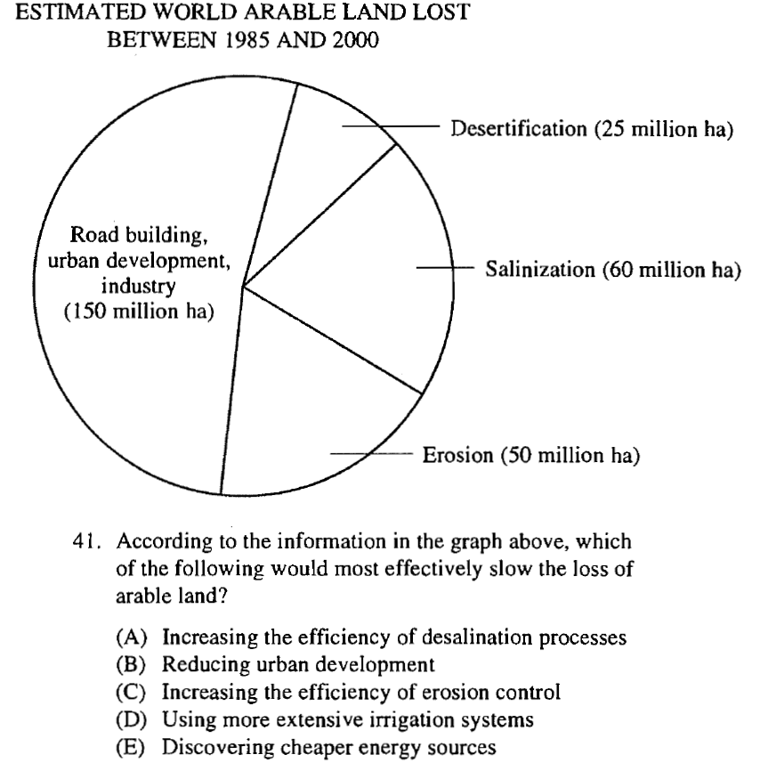
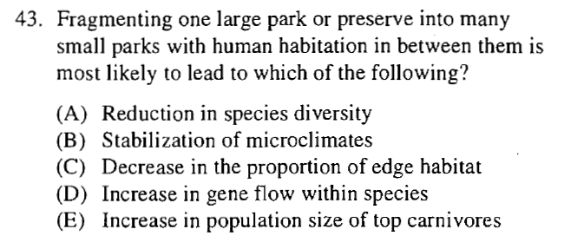
wednesday, Jan. 16

Slide 17
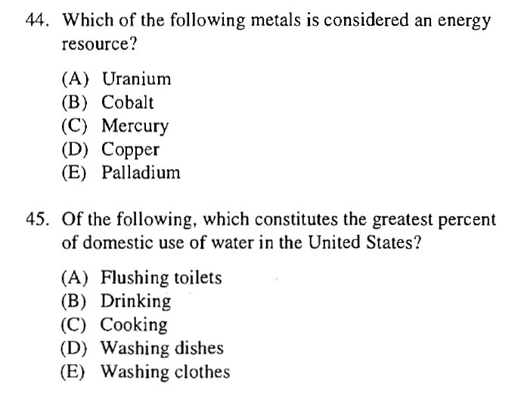
thursday, Jan. 17

Slide 18
thursday, Jan. 17

Slide 19
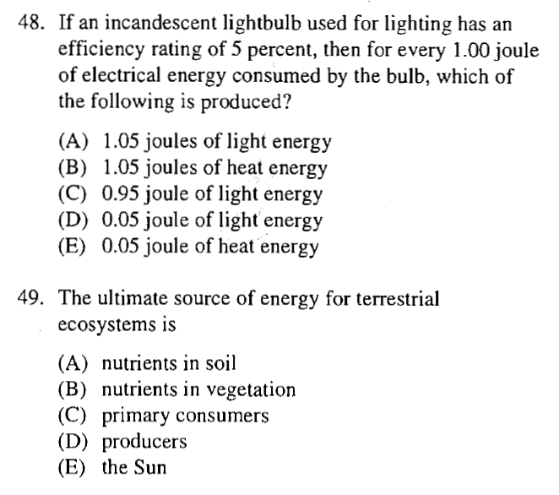
friday, Jan. 18

Slide 20
friday, Jan. 18
N₂ + 3H₂ → 2NH₃
How many grams of hydrogen, H₂, are necessary to react completely with 50.0 L of nitrogen, N₂?

Slide 21
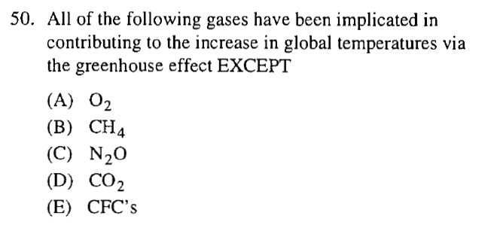
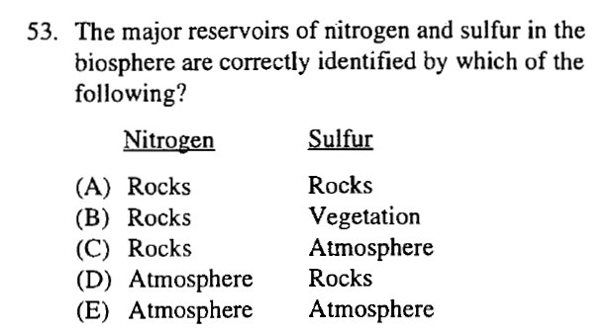
tuesday, Jan. 22

