Slide 1
Unit 3: Human Population Natural Populations

Slide 3
1) What are 2 biotic and 2 abiotic factors that naturally (with no people around) keep the population of deer from growing out of control? Be specific.
2) When humans move into an area the population of deer tends to explode upwards. How do you think humans change the population limits of the deer?

Slide 4
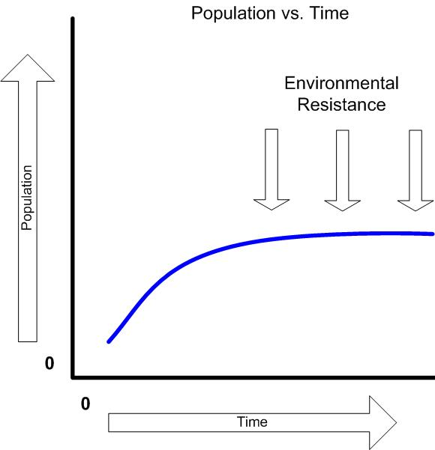
Environmental Resistance
Population explosions seldom occur in nature
Biotic and abiotic factors cause mortality in populations
Biotic factors
Predators
Parasites
Competitors
Abiotic factors
Changes in temperatures
Moisture
Salinity
pH

Slide 5
Biotic Potential and Environmental Resistance
Biotic Potential
Reproductive rate
Ability to migrate (animals) or disperse (seeds)
Ability to invade new habitats
Defense mechanisms
Ability to cope with adverse conditions
Environmental resistance
Lack of food or nutrients
Lack of water
Lack of suitable habitat
Adverse weather
Predators
Disease
Parasites
Competitors

Slide 6
Density Dependence
Environmental resistance factors can be density dependent.
Example: Disease. Animals more animals means they’re closer together and spread disease more quickly.
Environmental factors that cause mortality can be density independent
A sudden deep freeze in spring
A fire that may kill all small mammals

Slide 7
Optimum, Zone of Stress, Limits of Tolerance
Optimum
Ideal habitat and factors for organisms to live the best
Zone of Stress
Organism experiences stress, with non-ideal factors
Limit of Tolerance
Usually is a range of tolerance for each organism
Limit is reached and the organism can no longer survive

Slide 8
Law of Limiting Factors
Any one of several factors being outside the optimal range that will cause stress and limit the growth, reproduction, or even death.

Slide 9
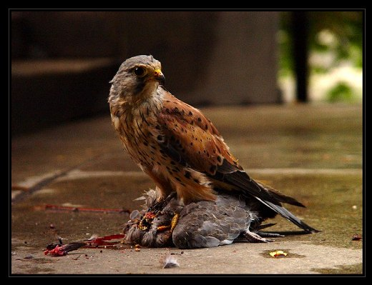
Dynamics of Natural Populations
Each species exists in a population
Over time most species remain more or less constant in size and geographic distribution
Deaths = Births
This balance is called Population equilibrium

Slide 10
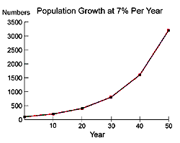
Growth Curves – Two Types: J or S
Exponential growth results in population explosion
Called a J-Curve

Slide 11
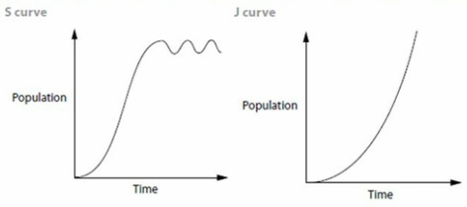
Dynamics of Natural Populations
If recruitment is at replacement level, then the population will remain constant.
Biotic Potential = Environmental Resistance
Growth to the equilibrium point is called an
S-Curve

Slide 12
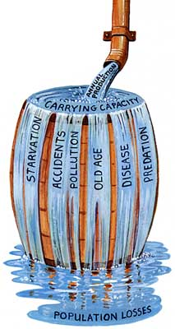
Carrying Capacity
Upper Limit to population number
Maximum population that a given habitat can support.

Slide 13
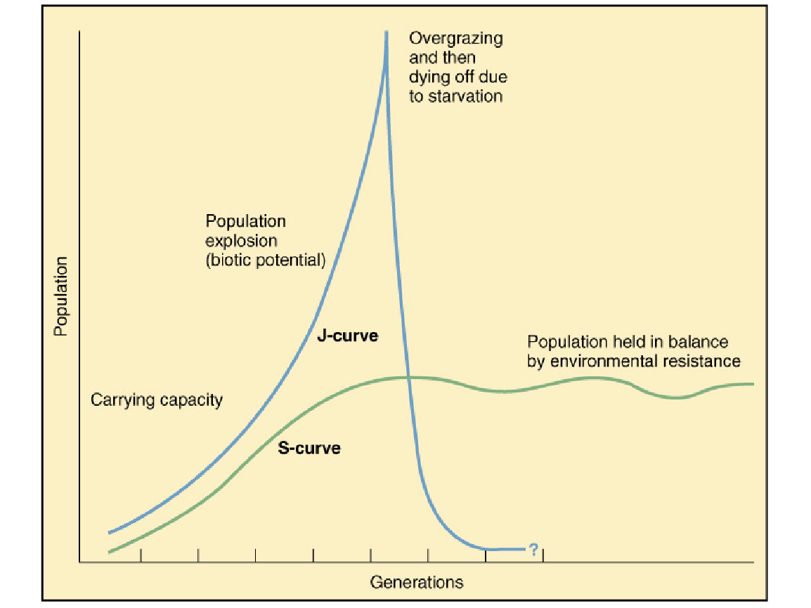

Slide 14
Case Study: Lynx & Snowshoe Rabbits
1) Lynx eat rabbits and have lots of baby lynx.
2) Rabbit population goes down (they got ate), lynx start to starve and die.
3) Lynx population goes down, (they starved) rabbits start having lots of babies.
4) Lynx eat the rabbits, and have lots of baby lynx….

Slide 15
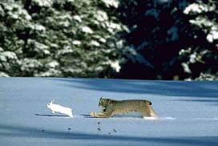
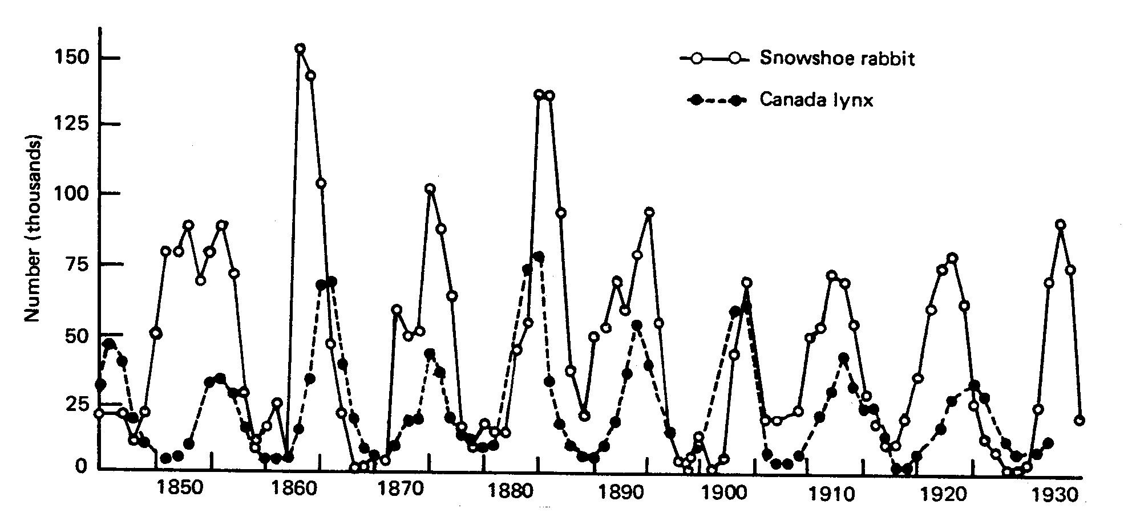

Slide 16
Based on what we talked about...
What would happen to the rabbit population if the lynx were killed off by hunters?
Could it go on forever? What would eventually happen?

Slide 17
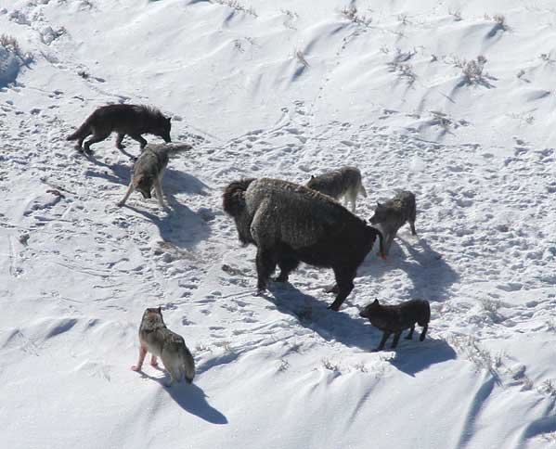
Role of Predators
Predators keep the population of herbivores from going to high.
When humans move into an area they often hunt and kill the top level predators.
This leads to an explosion in herbivore populations.
These herbivores quickly pass the carrying capacity of the ecosystem, consume the majority of the food, and experience a population crash.

Slide 18
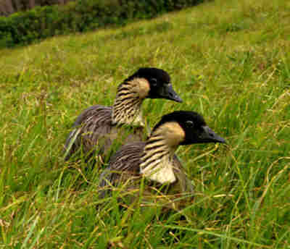
Critical number
The survival and recovery of a population depends on a certain minimum population base (critical number)
If population is below this number the species more vulnerable, breeding fails, and extinction is almost inevitable

Slide 19
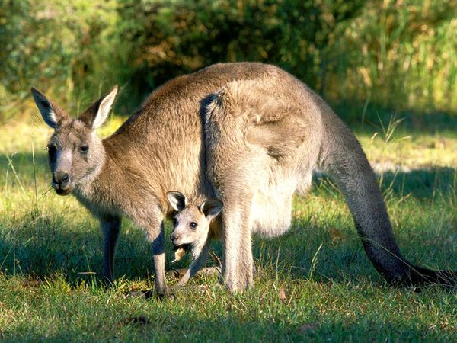
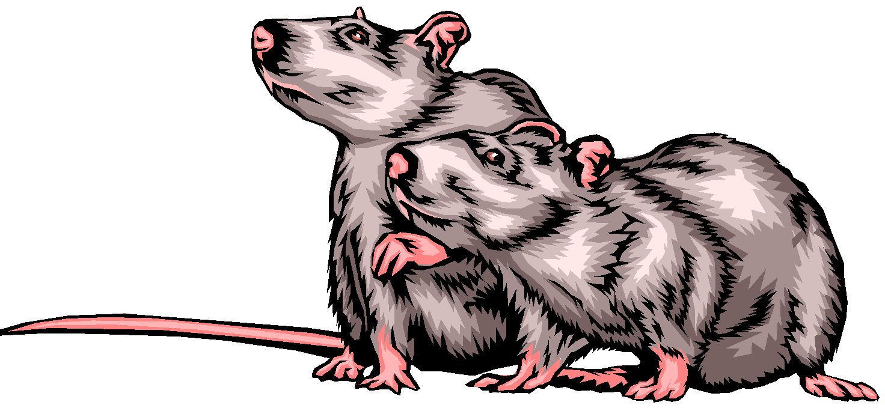
Reproductive Strategies
R-Strategist
Reproduce in massive quantities
Leave nature to raise the young
“low recruitment’ = high mortality rate
Favors quickly changing environments
Organisms are usually
Small
Rapid reproductive rate
Short life spans
J – curves
Instinct important
K-Strategist
Few offspring
Spend a lot of time nurturing their young
Organisms
Large
Long life spans
S – curves
Learned behavior

Slide 20
Slide Title
Make Effective Presentations
Using Awesome Backgrounds
Engage your Audience
Capture Audience Attention

Slide 21
Slide Title
Make Effective Presentations
Using Awesome Backgrounds
Engage your Audience
Capture Audience Attention

Slide 22
Slide Title
Product A
Product B
Feature 1
Feature 2
Feature 3
Feature 1
Feature 2
Feature 3

