Slide 1
Energy

Slide 2
There are large deposits of coal in the mountains of West Virginia.
What does this tell us about the ancient climate?

Slide 3
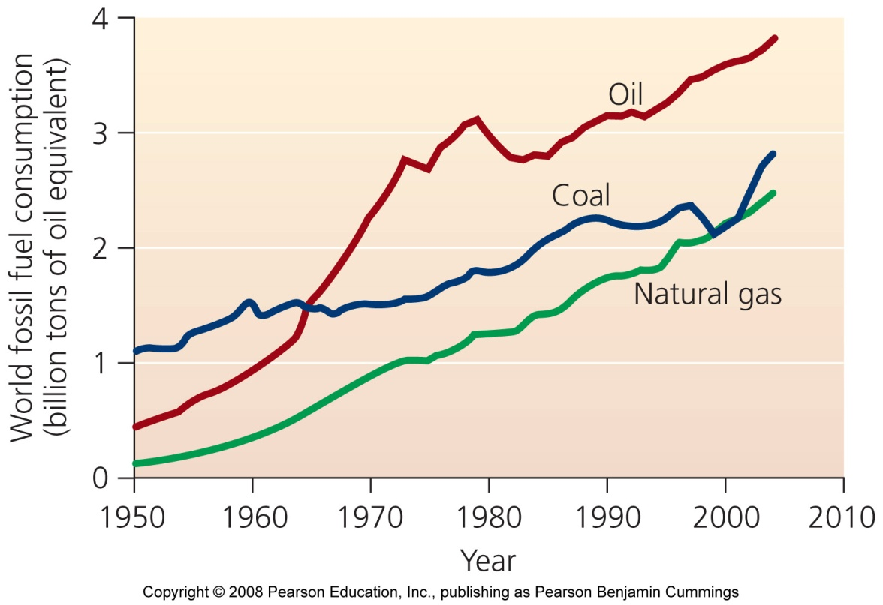
Fossil fuels are our dominant source of energy
Fossil fuels = highly combustible substances formed from the remains of organisms
oil, coal, and natural gas
The high-energy content of fossil fuels makes them efficient to burn, ship, and store

Slide 4
Renewable or Non-Renewable
Renewable energy = energy the will not be depleted by our use
Sunlight, geothermal energy, and tidal energy
Nonrenewable energy = energy that cannot be replaced at the rate of consumption
Oil, coal, natural gas, nuclear energy
To replenish the fossil fuels we have depleted so far would take millions of years!

Slide 5
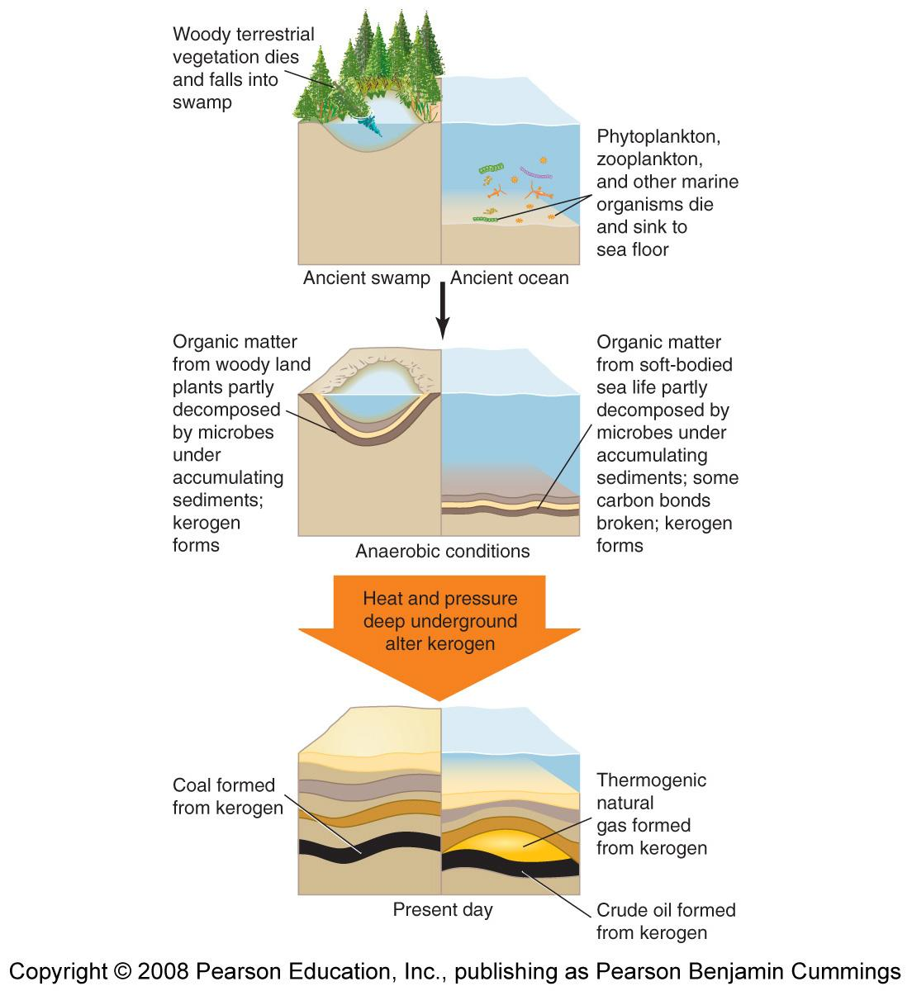
Fossil fuels are indeed created from fossils
Fuels we burn today were from organisms that lived 100-500 million years ago
Organic material is broken down in an anaerobic environment = one that has little or no oxygen
Bottoms of deep lakes, swamps, and shallow seas

Slide 6
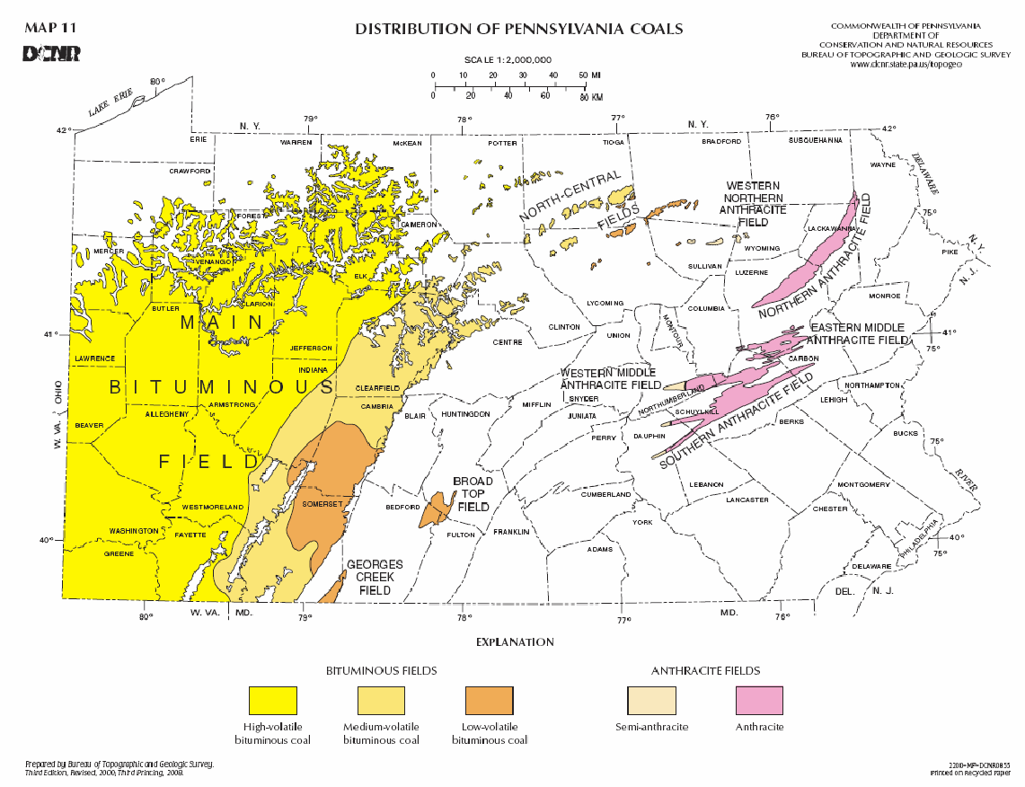
Fossil fuel reserves are unevenly distributed
67% of reserves of crude oil lie in the Middle East
The U.S. possesses more coal than any other country

Slide 7
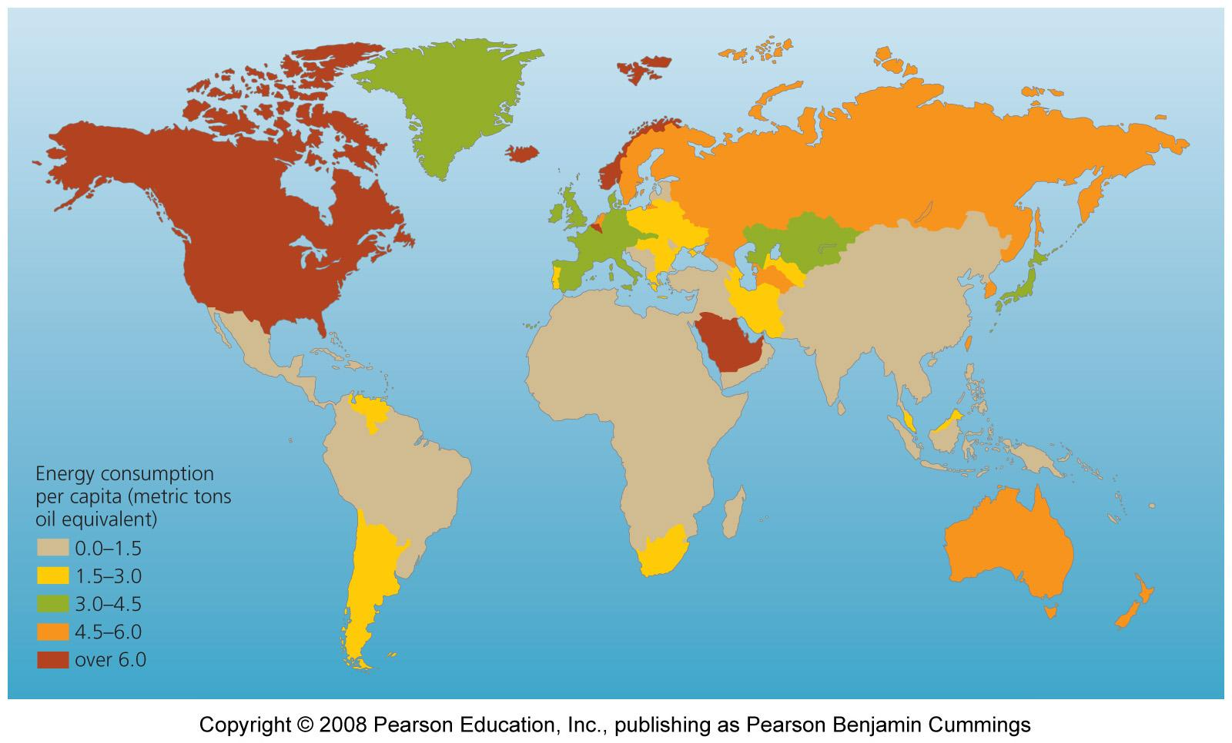
Energy Consumption

Slide 8
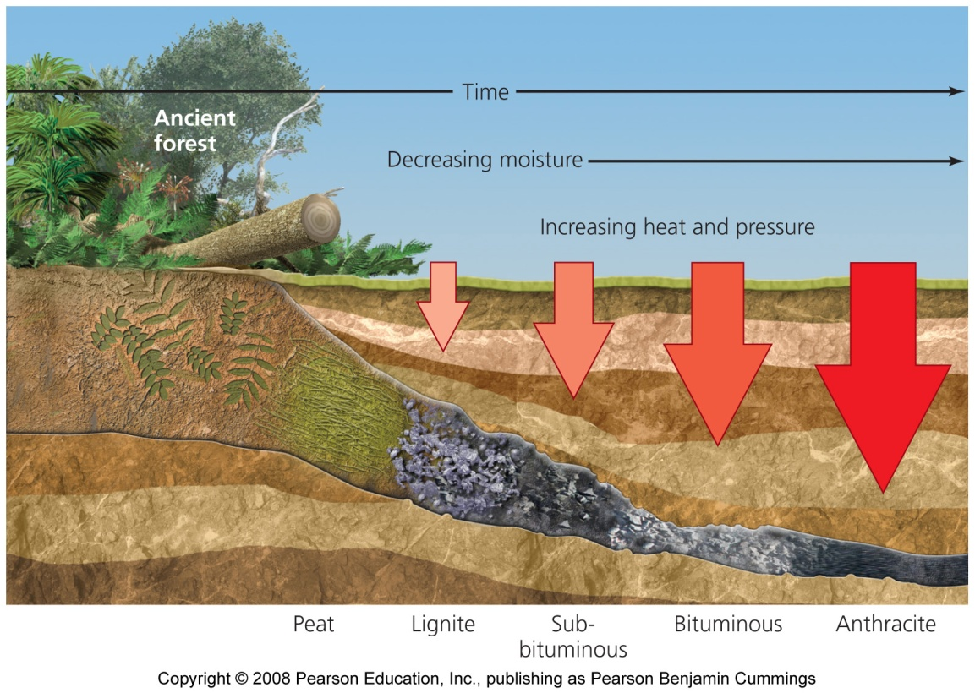
Coal
Coal = organic matter (woody plant material; peat) under very high pressure to form dense, solid carbon structures
The world’s most abundant fossil fuel

Slide 9
Coal varies in its qualities
Peat = organic material that is broken down anaerobically but remains wet, near the surface and not well compressed
Additional pressure turns peat into coal
Lignite = least compressed
Sub-bituminous and bituminous
Anthracite = most compressed; has the most energy

Slide 11
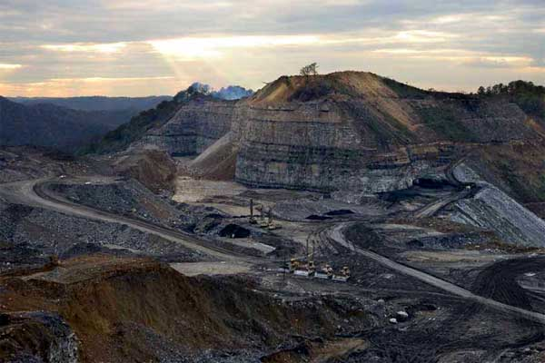
Coal Mining
Subsurface mining = underground deposits are reached by digging networks of tunnels deep underground
Strip mining = heavy machinery removes huge amounts of earth to expose and extract the coal
Mountaintop removal = in some cases, entire mountaintops are cut off to obtain the coal

Slide 12
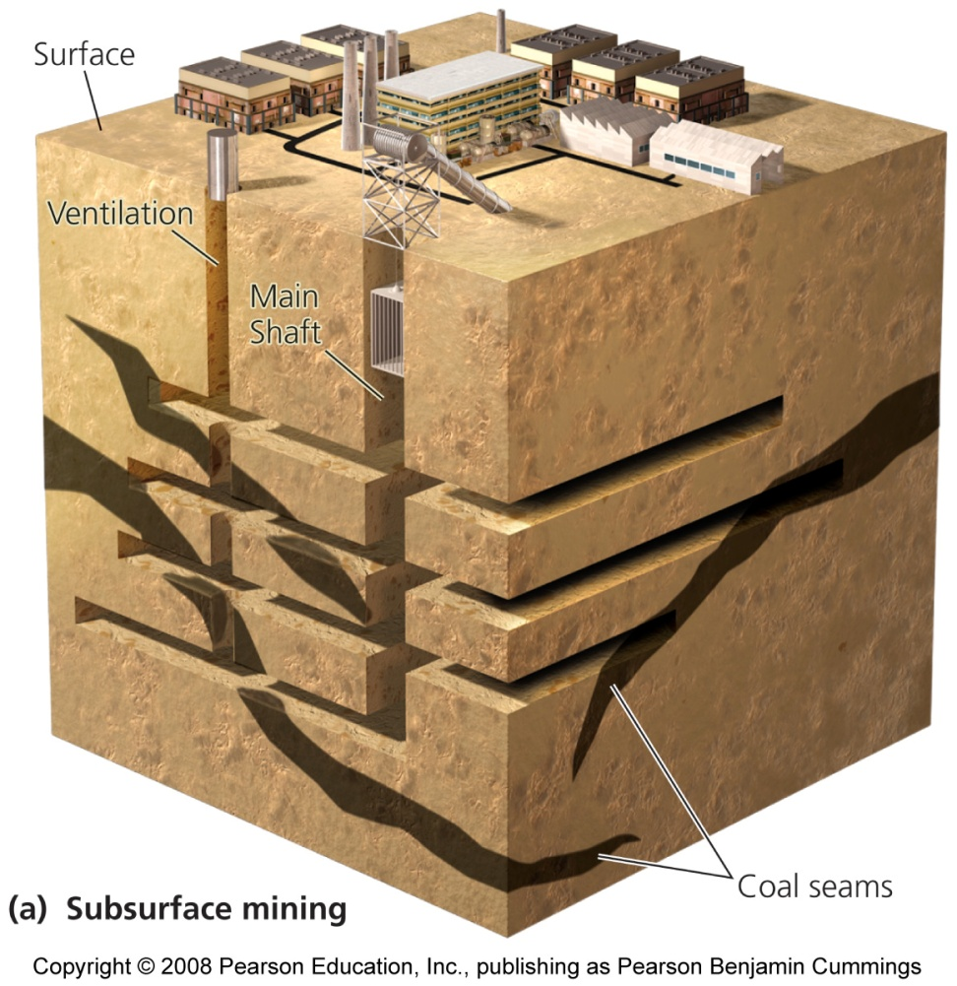
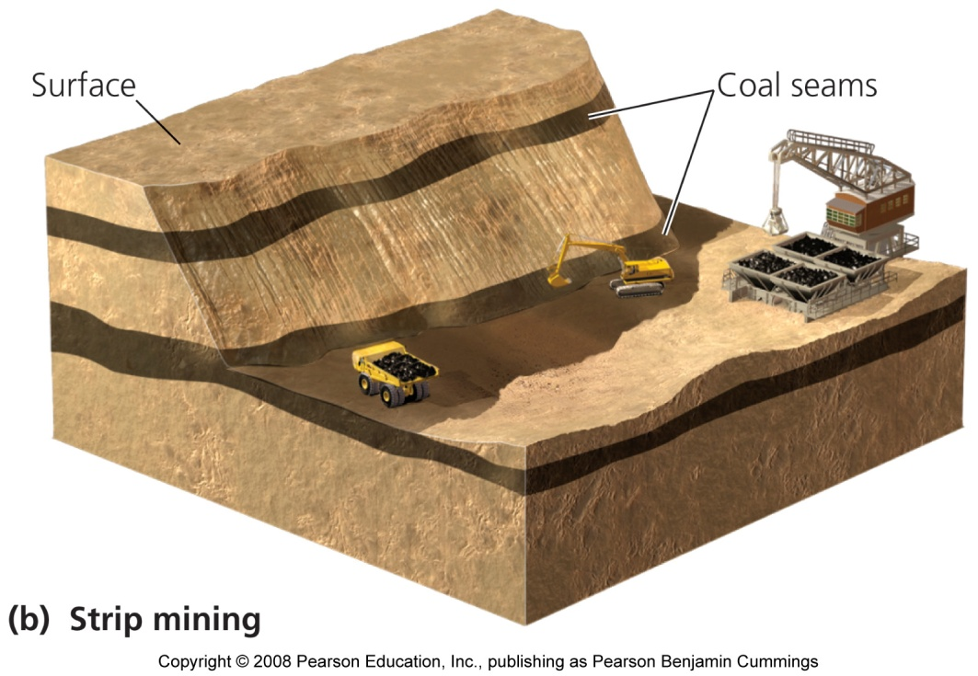
Two forms of coal mining

Slide 13
Coal mining harms human health
Subsurface mining is harmful to human health
Burial in mine shaft collapses
Inhalation of coal dust can lead to fatal black lung disease
Costs to repair damages of mining are very high
These costs are not included in the market prices of fossil fuels, which are kept inexpensive by government subsidies
Mining companies must restore landscapes, but the impacts are still severe
Looser restrictions in 2002 allowed companies to dump rock and soil into valleys, regardless of the consequences

Slide 14
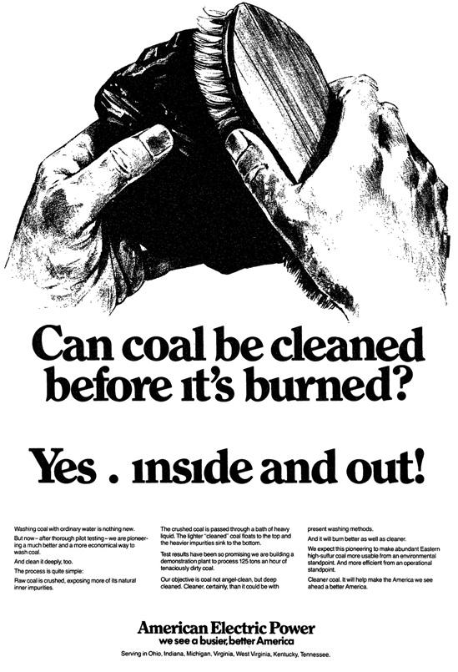
Coal contains impurities
Sulfur, mercury, arsenic, and trace radioactive metals
Coal in the eastern U.S. is high in sulfur
When high-sulfur coal is burned, it released sulfate air pollutants, which contribute to smog and acid deposition
Mercury can bioaccumulate

Slide 15
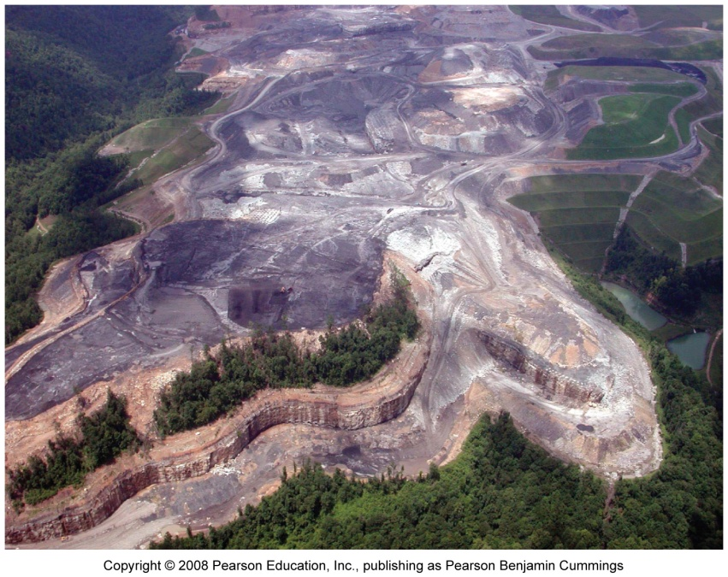
Coal mining affects the environment
Strip mining causes severe soil erosion and chemical runoff
Acid drainage = sulfide minerals on exposed rock surfaces react with oxygen and rainwater to produce sulfuric acid
Mountaintop removal causes enormous damage

