Slide 1
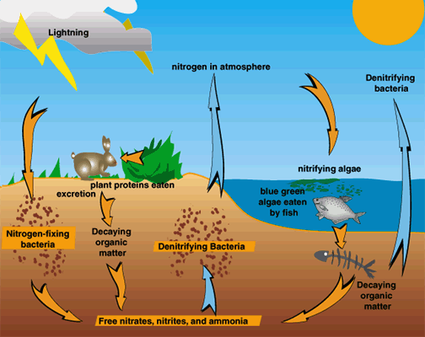
The Nitrogen Cycle
The most complex cycle
N₂ = 78% of the troposphere, chemically unreactive
Essential part of Protein and DNA
Cannot be easily absorbed from the air.
Notes:
*
The most complex of the cycles
N₂ = 78% of the troposphere, chemically unreactive, cannot be used or absorbed directly in this form by plants or animals.
Even though N2 is a large source of nitrogen, must be converted before it can be of use to living

Slide 2
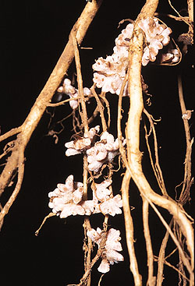
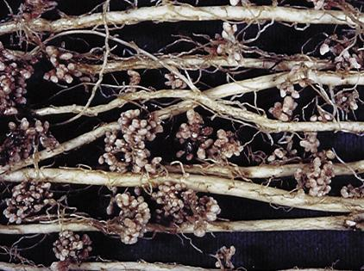
The Nitrogen Cycle
1. Nitrogen Fixation: N₂ from the air is converted to ammonia (NH₃) in the soil
  Can be done by bacteria in water & soil. On root nodules of legumes (peas, clover, beans, etc.)
Notes:
*

Slide 3
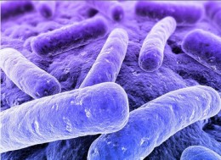
The Nitrogen Cycle
2. Nitrification: Ammonia (NH₃) converted to nitrite (NO₂⁻) and then nitrate (NO₃⁻), the most usable forms of nitrogen
  Both reactions carried out by bacteria in the soil
Notes:
*

Slide 4
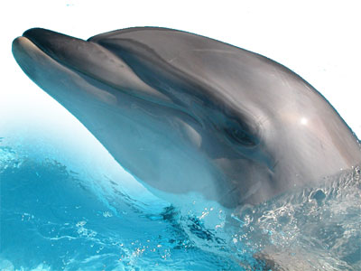
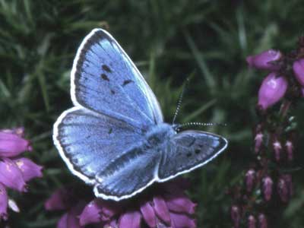
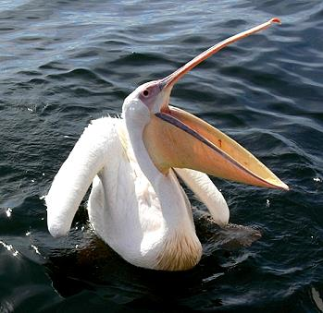

The Nitrogen Cycle
3. Assimilation: Plants absorb nitrogen from the soil and incorporate it into their protein and DNA.
Animals eat the plants and the nitrogen is passed through the ecosystem.
Notes:
*

Slide 5
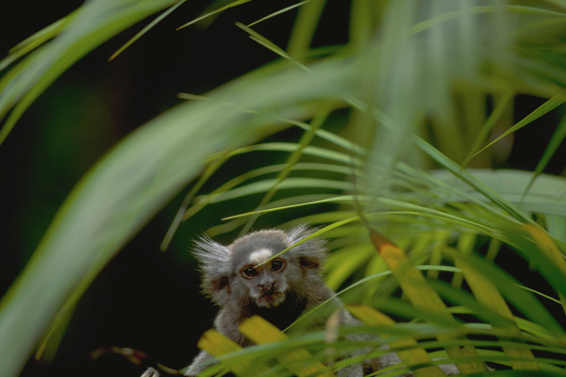

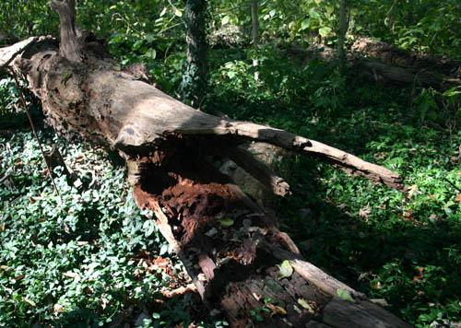
The Nitrogen Cycle
4. Ammonification: Body waste, cast-offs, and dead organisms are converted back into ammonia (NH₃) in the soil.
  By decomposer bacteria
Notes:
*

Slide 6
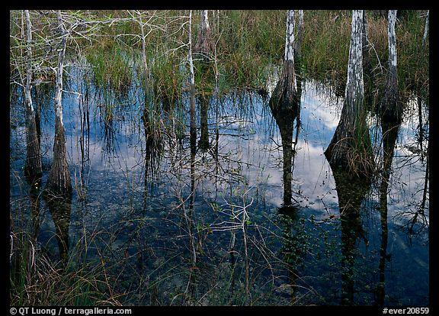
The Nitrogen Cycle
5. Denitrification: Ammonia (NH₃) is converted back to N₂
  Mostly by anaerobic bacteria in waterlogged soil, bottom sediments of lakes, swamps, bogs and oceans
Notes:
*

Slide 7
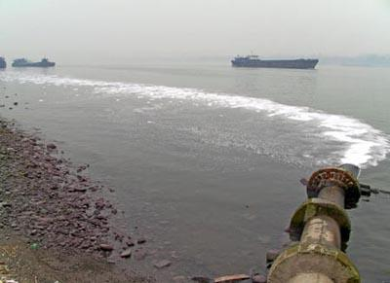
Significant Human Interventions (Part 1)
Farming, agriculture & cities
Nitrogen-rich fertilizers from farms and sewage from municipalities runs off into bodies of water
This stimulates the growth of algae which dies. When decomposers eat the dead bacteria they use all the oxygen in the water and the aquatic animals suffocate.

Slide 8
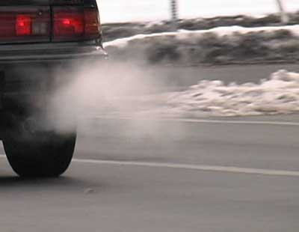
Significant Human Interventions (Part 2)
Internal combustion engine exhaust (i.e., fossil fuel burning)
Results in NO₂ being added to the atmosphere
Combining O₂ with atmospheric nitrogen results in nitric acid, a significant component of acid rain
Notes:
*

Slide 9
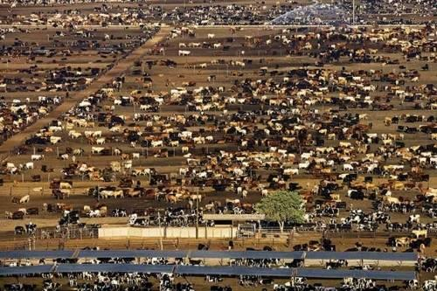
More Human Interventions
Nitrogen can be depleted from topsoil when we over-harvest or over-graze plants and then burn or clear grasslands and forests
Cattle waste and inorganic nitrogen-containing fertilizers are broken down by bacteria into nitrous oxide, which is a heat-trapping gas and can contribute to the warming of the atmosphere.

Slide 10
Solutions to the dead zone
The Harmful Algal Bloom and Hypoxia Research and Control Act (1998)
  Called for an assessment of hypoxia in the dead zone
Solutions outlined included:
  Reduce nitrogen fertilizer use in Midwestern farms
  Apply fertilizer at times which minimize runoff
  Use alternative crops and manage manure better
  Restore wetlands and create artificial ones
  Improve sewage treatment technologies
  Evaluate these approaches

Slide 11
Humans affect the carbon cycle
Burning fossil fuels moves carbon from the ground to the air
Cutting forests and burning fields moves carbon from vegetation to the air
Today’s atmospheric carbon dioxide reservoir is the largest in the past 800,000 years
  It is the driving force behind climate change
The missing carbon sink: 1-2 billion metric tons of carbon are unaccounted for
  It may be taken up by plants or soils of northern temperate and boreal forests

Slide 12
Human impacts on the hydrologic cycle
Removing forests and vegetation increases runoff and erosion, reduces transpiration and lowers water tables
Irrigating agricultural fields depletes rivers, lakes and streams and increases evaporation
Damming rivers increases evaporation and infiltration
Emitting pollutants changes the nature of precipitation
The most threatening impact: overdrawing groundwater for drinking, irrigation, and industrial use
  Water shortages create worldwide conflicts
Notes:
12
12

Slide 13
Humans affect the nitrogen cycle
Haber-Bosch process = production of fertilizers by combining nitrogen and hydrogen to synthesize ammonia
  Humans overcame the limits on crop productivity
Fixing atmospheric nitrogen with fertilizers
  Increases emissions of greenhouse gases and smog
  Washes calcium and potassium out of soil
  Acidifies water and soils
  Moves nitrogen into terrestrial systems and oceans
  Reduces diversity of plants adapted to low-nitrogen soils
  Changed estuaries and coastal ecosystems and fisheries

Slide 14
Humans affect the phosphorus cycle
Mining rocks for fertilizer moves phosphorus from the soil to water systems
Wastewater discharge also releases phosphorus
Runoff containing phosphorus causes eutrophication of aquatic systems
  Produces murkier waters
  Alters the structure and function of aquatic systems
  Do not buy detergents that contain phosphate

Slide 15
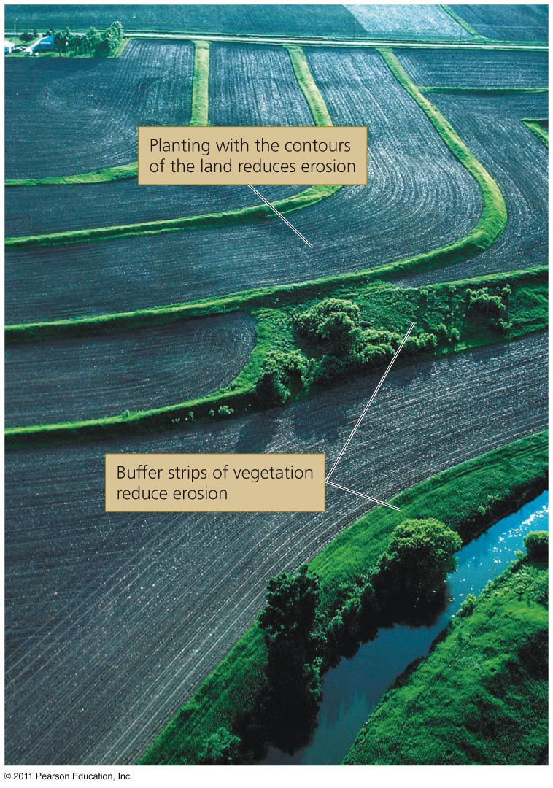
Decreasing pollution
Scientists, farmers and policymakers are encouraged to
  Decrease fertilizer use
  While safeguarding agriculture
Offering insurance and incentives
Using new farming methods
Planting cover crops
Maintaining wetlands
There have been some successes
  Despite a lack of funding

Slide 16
