Slide 1
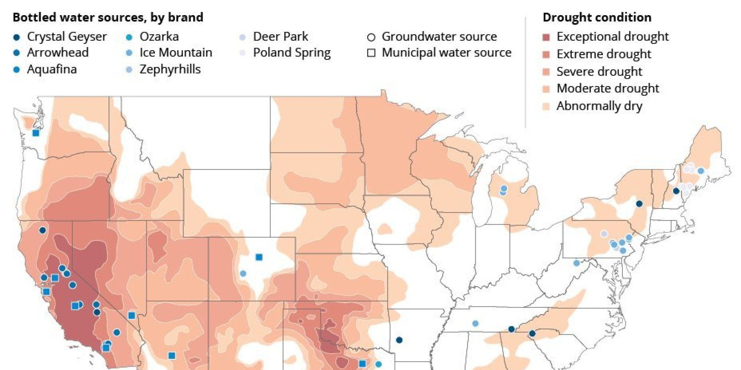
Where do you think most bottled water comes from in the United States?

Slide 2
Video Question Handout

Slide 3
Natural Gas
The fastest growing fossil fuel in use today
Provides 25% of global commercial energy consumption
World supplies are projected to last about 60 more years
Natural Gas = consists of methane (CH₄) and other volatile (easily evaporative) hydrocarbons

Slide 4
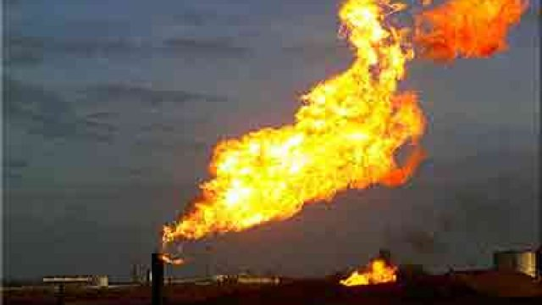
Natural gas is wasted!
Coalbed methane = from coal seams, leaks to the atmosphere during mining
In remote oil-drilling areas, natural gas is flared: simply burned off
In Alaska, gas captured during oil drilling is being reinjected into the ground for future use
Landfills produce biogenic natural gas
Operators are capturing and selling it
produced or brought about by living organisms.

Slide 5
Fracking
Much natural gas is trapped in small pockets in shale rocks.
The rocks must be broken and cracked to release the natural gas. This is called Hydraulic Fracturing or “Fracking”
High pressure water, sand and chemicals are pumped down into the rocks to split them and release the gas.
There are concerns about contaminating ground water with natural gas and the fracking chemicals.

Slide 6
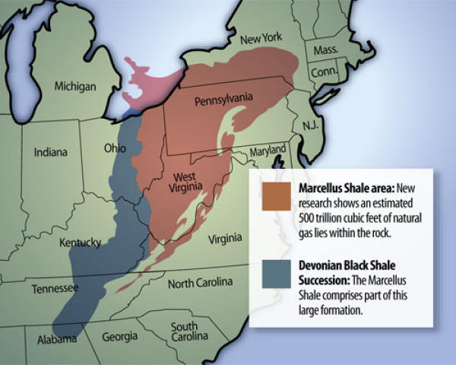

Slide 7
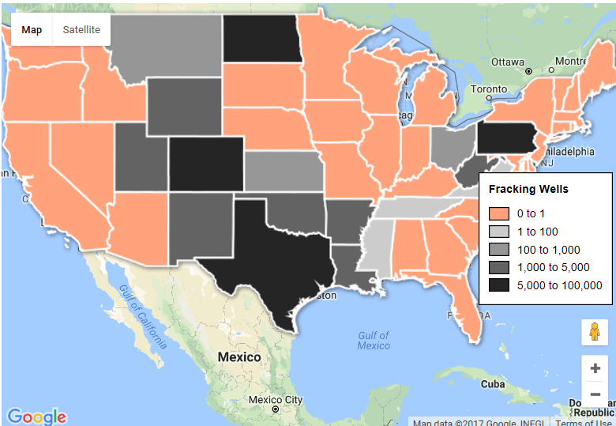
This is your presentation title

Slide 8
Fracking: friend or foe?

Slide 9
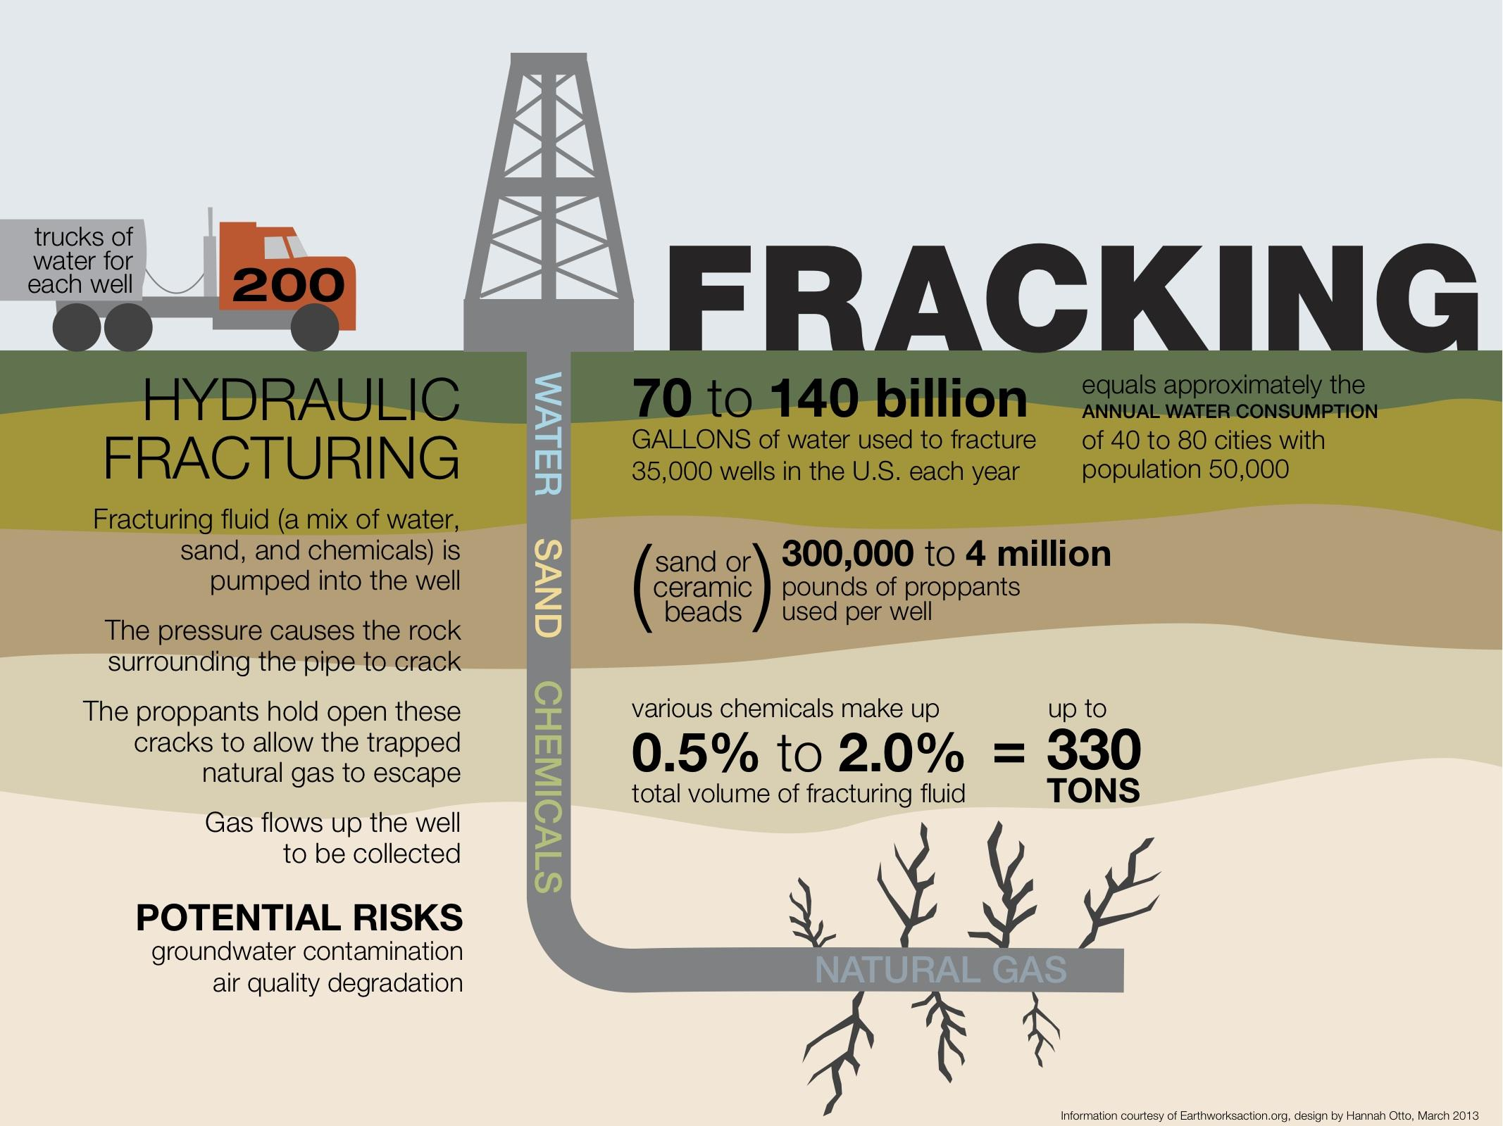

Slide 10
The age of oil
People have used solid forms of oil (i.e., tar) for thousands of years
Modern extraction and use began in the 1850s
First bottled and sold as a healing aid, but it is carcinogenic
This “rock oil” could be used lamps and as a lubricant
Edwin Drake drilled the world’s first oil well, in Titusville, Pennsylvania, in 1859
Today, the U.S. consumes 25% of the world’s oil
Consumption is still increasing

Slide 11
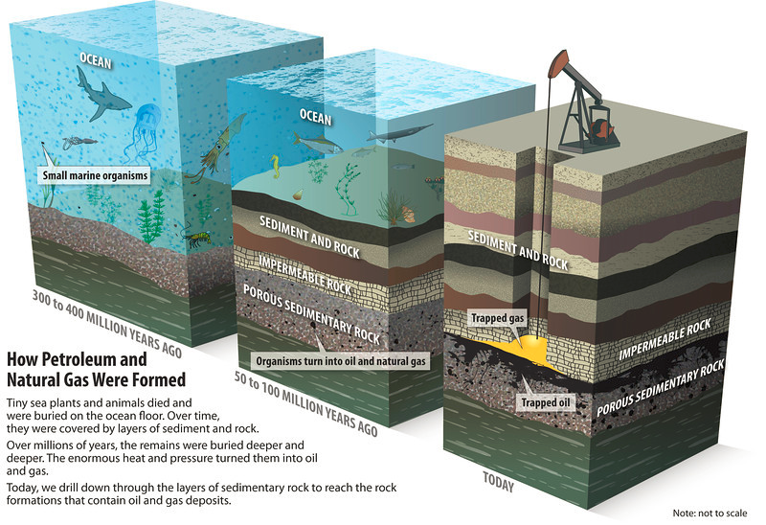
Heat and pressure forms petroleum

Slide 12
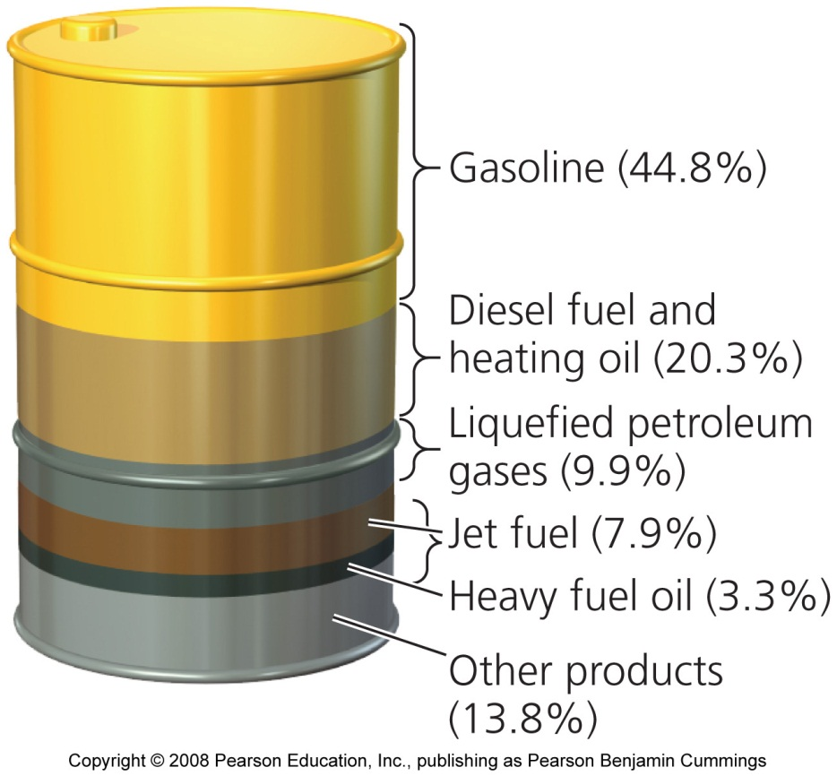
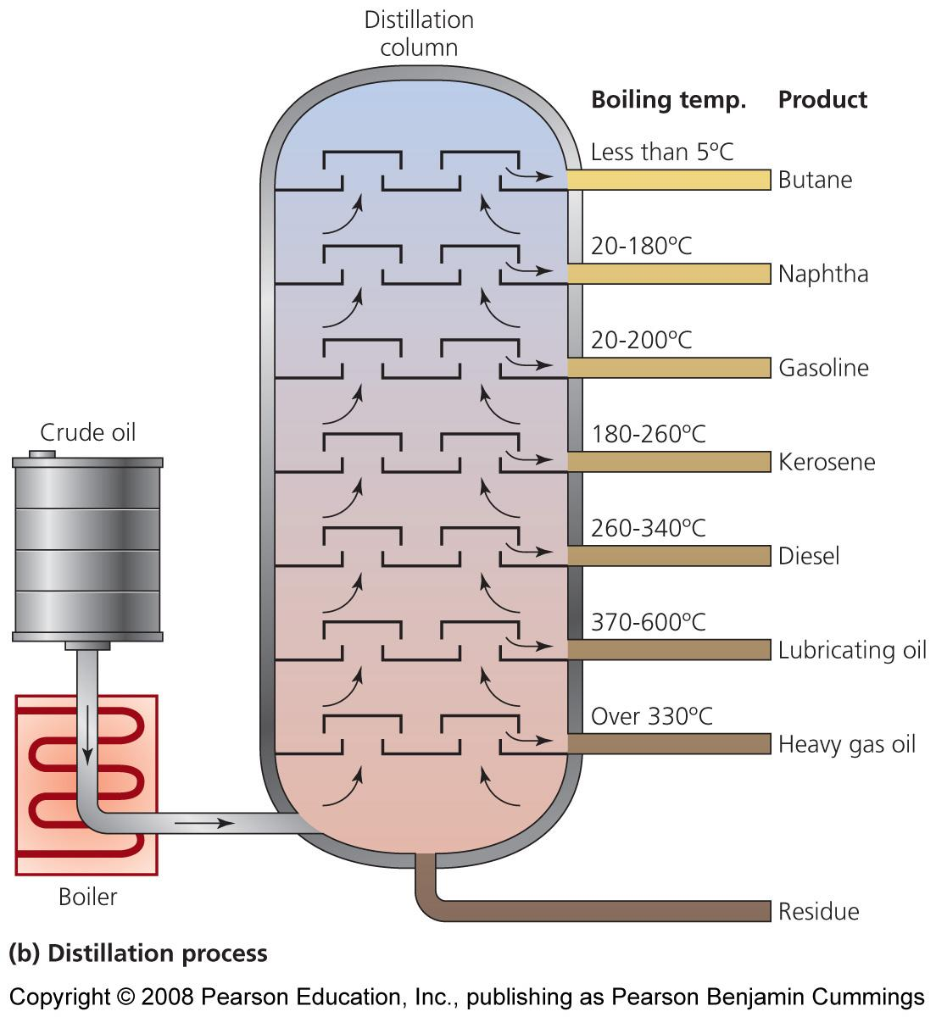
What’s really in the oil?

Slide 13
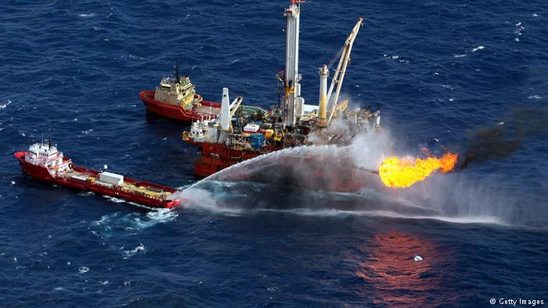
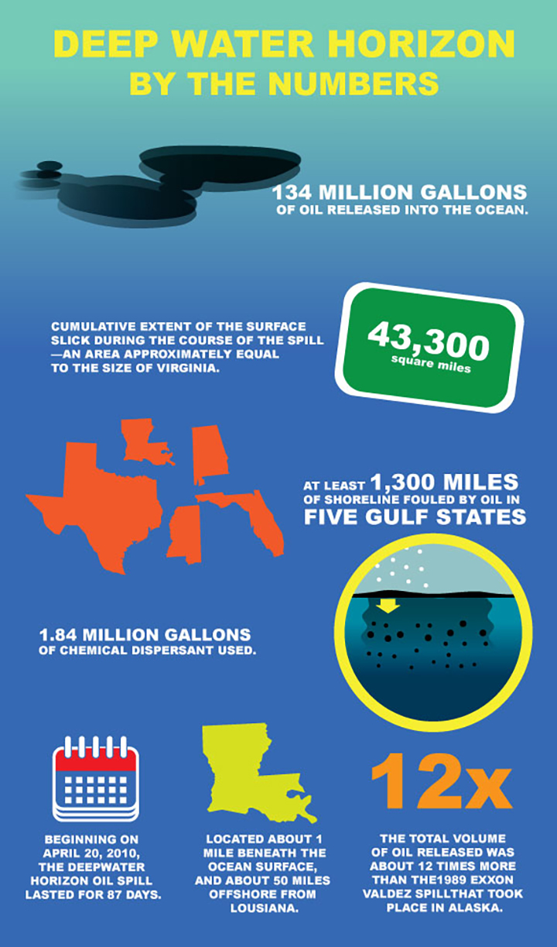
Offshore drilling produces much of our oil
Drilling takes place on land and in the seafloor on the continental shelves
25% of our natural gas comes from offshore drilling
Hurricanes can devastate drilling platforms, and prices rise accordingly
Very dangerous working conditions
Fires, explosions
Spills

Slide 14
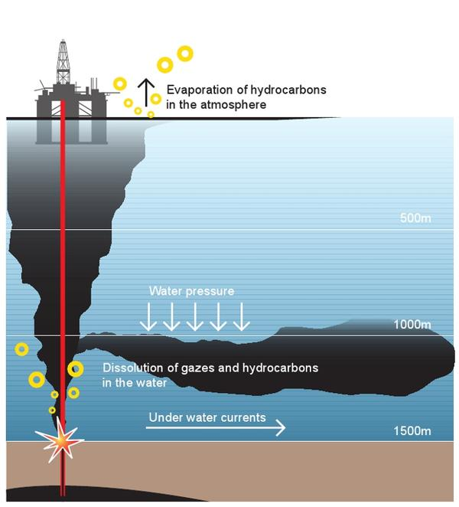
Not all oil can be extracted
Some oil would be so hard to extract, it is not worth the cost
As prices rise, economically recoverable amounts approach technically recoverable amounts
Proven recoverable reserve = the amount of oil (or any other fossil fuel) that is technically and economically feasible to remove under current conditions

Slide 15
Remaining oil reserves
Some have calculated that we have used up about 1.1 trillion barrels of oil
At current levels of production (30 billion barrels/year), we could have as little as 40 years of oil left
We will face a crisis not when we run out of oil, but when the rate of production begins to decline

Slide 16
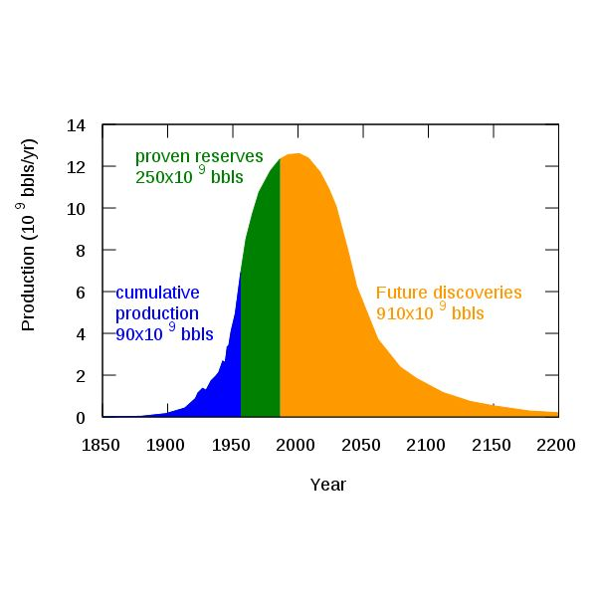
We WILL face an oil shortage
We will face a shortage when production declines and demand increases
Hubbard’s peak = Geologist M. King Hubbard predicted that oil production would peak around 1970
His prediction was accurate, and U.S. production continues to fall
We may have passed peak global production in 2005

Slide 17
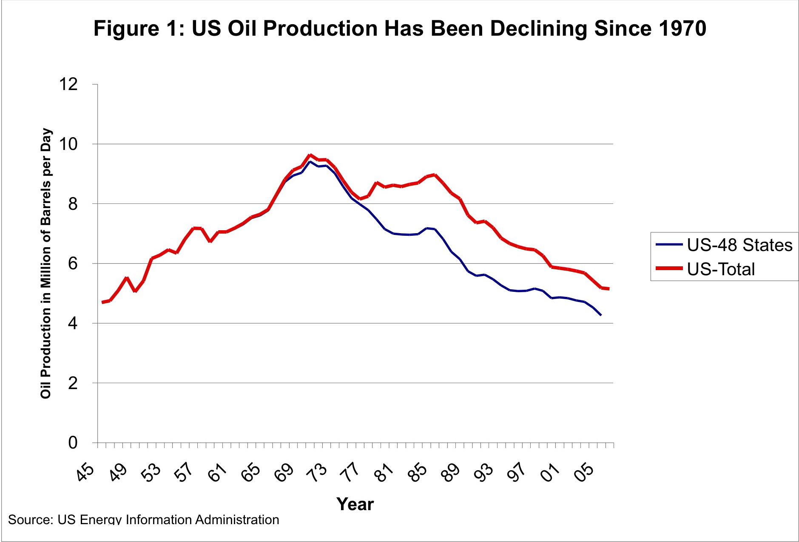
U.S. oil production has already peaked

Slide 18
Global oil production is peaking

Slide 19
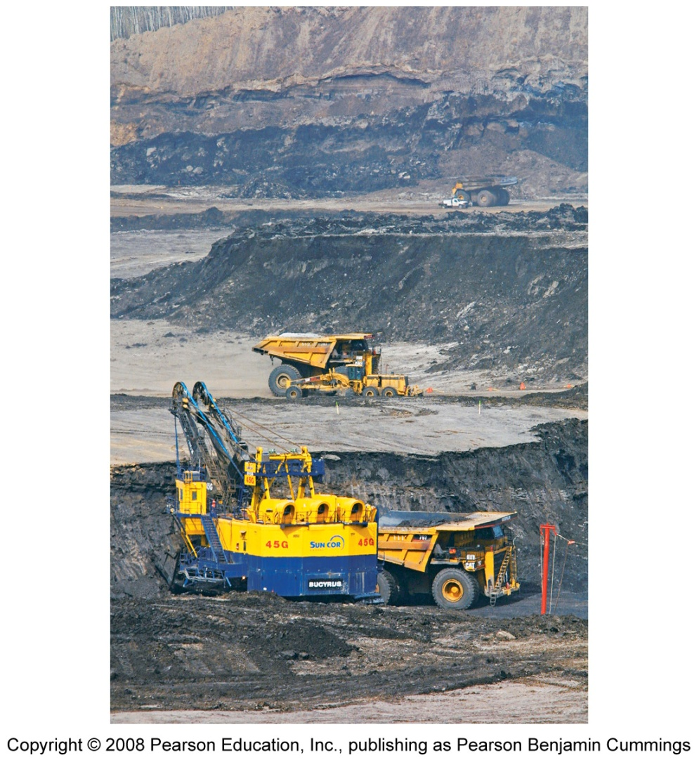
Other oil sources
Oil sands (tar sands)
sand deposits with 1 - 20% Oil
Removed by strip mining
Requires special extraction and refining processes to become useful
Primarily found in Venezuela and Canada

Slide 20
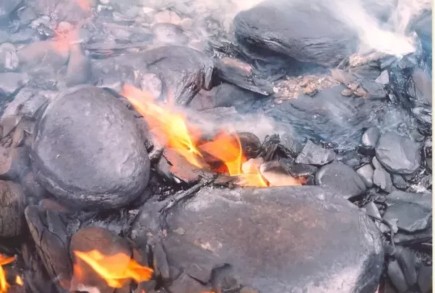
Oil shale
sedimentary rock filled with Oil that can be processed to produce liquid petroleum
More than 40% is found in the U.S., mostly on federally owned land in the west
Currently the largest growing source of oil in the united states.

Slide 21
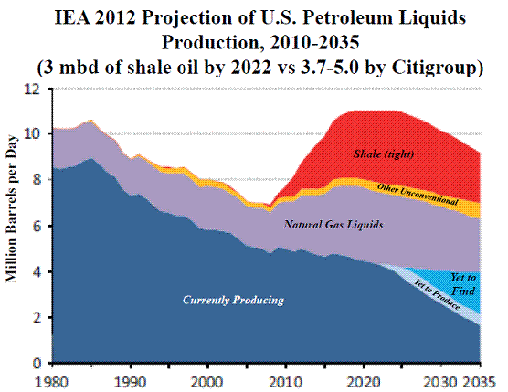

Slide 22
Peaking oil production consequences
Coming decline in oil supply will have enormous economic, social, and political consequences
Our lives will be profoundly affected
“The long emergency”: from lacking cheap oil to transport goods, our economies collapse and become localized
More optimistic observers argue that as supplies dwindle, conservation and alternative energy supplies will kick in
We will be saved from major disruptions

Slide 23
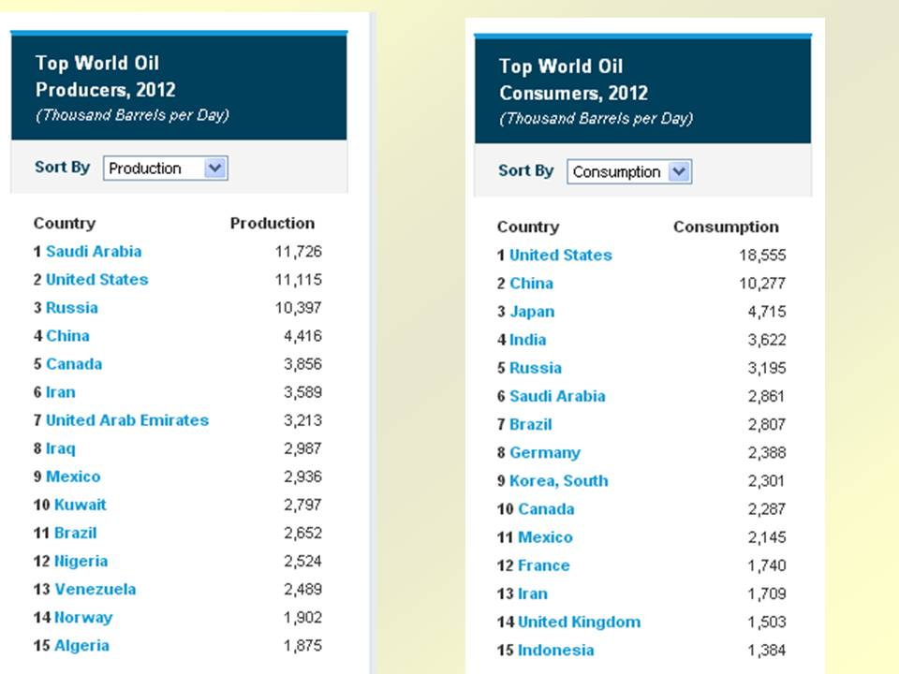
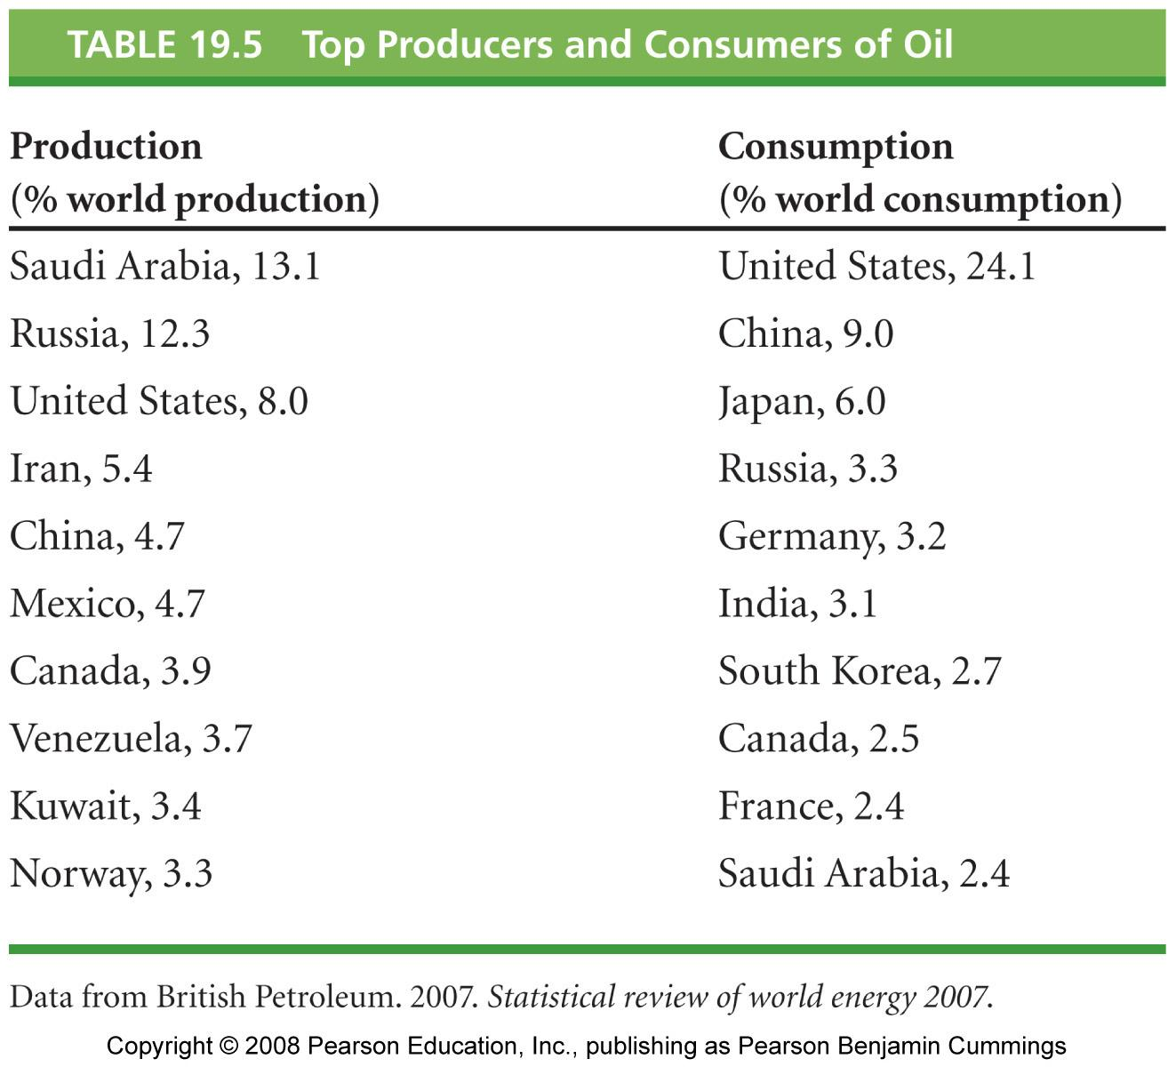

Slide 24
