Slide 1
Earth’s Interior
Inner Core
Solid Metal
Heated by decay of radioactive elements
Outer Core
Composed of iron & some nickel
Generates Earth’s Magnetic Field

Slide 2
Earth’s Interior
Mantle
Rocky
Soft, semi-rigid, and able to slowly flow
Lithosphere (crust)
Solid rocky outer layer of the Earth
Broken into slow-moving pieces called plates.

Slide 3
Cause of Plate Motion
Areas the mantle are heated by the core. The hot material rises and pushes against the lithosphere and drags the plates.

Slide 4
Plate Boundaries are where the plates come in contact with one another.
There are three types of Plate Boundaries:
Divergent – Plates move apart
Convergent – Plates come together
Transform Fault – Slide along each other
Notes:
*

Slide 5
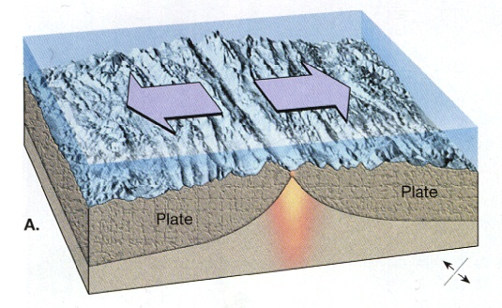
Divergent Boundaries happen when plates move apart and create new crust material.
Produces new crust material by widening oceans and creating new sea floor.
Rift Valleys are found along seafloor divergent boundaries
Notes:
*

Slide 6
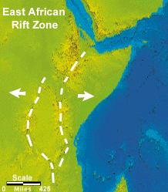
Continental Rifts are when divergent boundaries occur inside a continent.
These are the beginning of the breakup of a continent.
One example is the East African Rift Valley.
Notes:
*

Slide 7
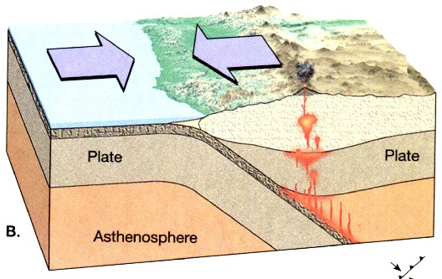
Convergent Boundaries are when two plates move towards one another and one slides beneath the other and is destroyed.
The place where one plate moves beneath the other is called the subduction zone.
Notes:
*

Slide 8
Convergent Boundaries Feature
Ocean trench along subduction zone
Mountain ranges along the continent
Volcanoes often form as the subducted plate melts and the magma rises through the crust.
Notes:
*

Slide 9
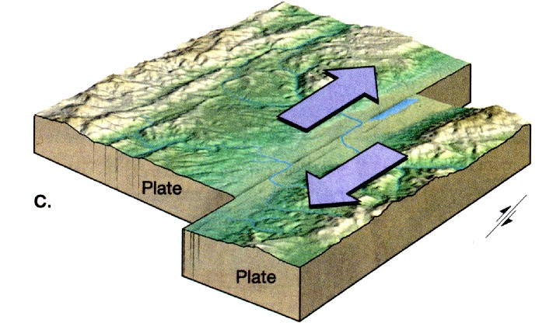
Transform Plate Boundaries are when plates grind past each other without destroying the crust.
These tend to cause earthquakes as the plates grind past one another.
Notes:
*

