Slide 1
Day 2: Primary Pollutants
Air Pollution

Slide 2
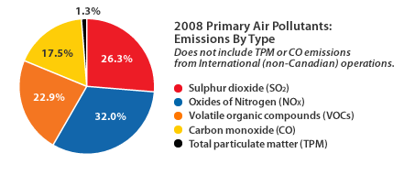
Primary Pollutants
Pollutants put directly into the air
Causes of Primary Pollutants – factories, cars, wind and soil, volcanoes, forest fires, pollen, decaying plants, salt particles from the sea, and refrigerants.

Slide 3
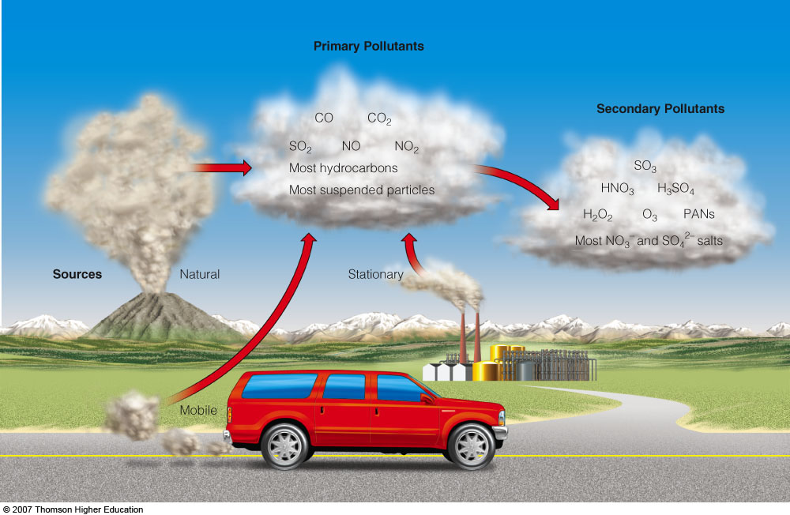
AIR POLLUTION
Some primary air pollutants may react with one another or with other chemicals in the air to form secondary air pollutants.
Notes:
*

Slide 4
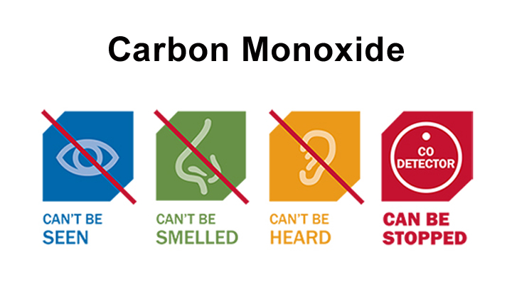
Major Primary Pollutants:CO₂
Carbon oxides:
Carbon monoxide (CO) is a highly toxic gas that forms during the incomplete combustion of carbon-containing materials.
Causes: Incomplete combustion of gasoline & natural gas
93% of carbon dioxide (CO₂) in the troposphere occurs as a result of the carbon cycle.
Causes: Burning of fossil fuels such as coal
7% of CO₂ in the troposphere occurs as a result of human activities
It is not regulated as a pollutant under the U.S. Clean Air Act.
Notes:
*

Slide 6
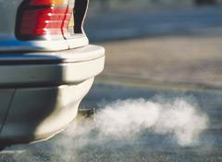
Major Primary Pollutants: NO_{x}
Nitrogen oxides
Nitrogen oxide (NO_{x}) forms when nitrogen and oxygen gas in air react at the high-combustion temperatures in automobile engines and coal-burning plants. (cause)
NO_{x} can also form from lightning and certain soil bacteria.
Notes:
*

Slide 7
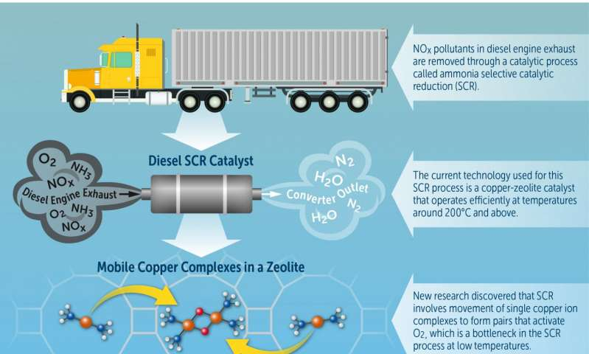

Slide 8
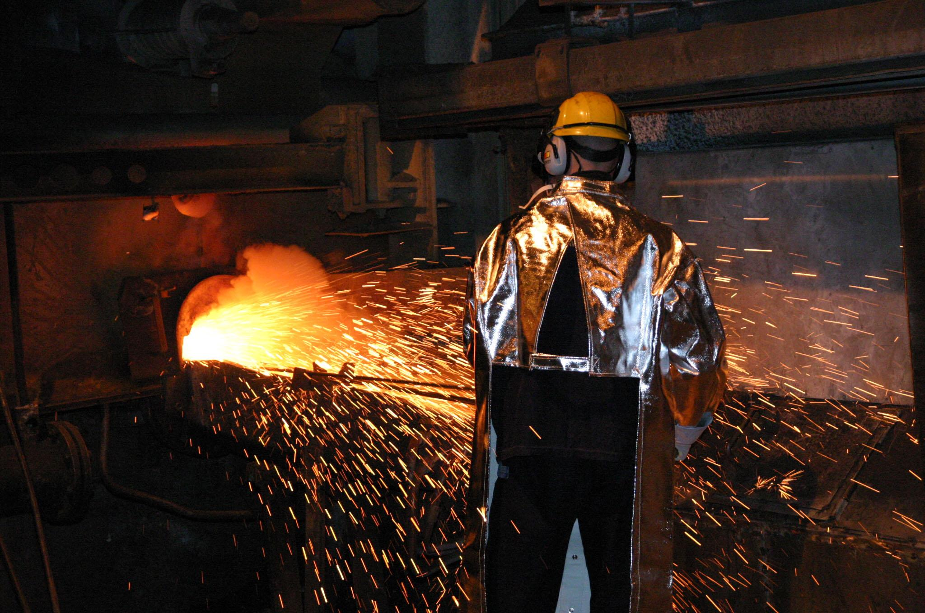
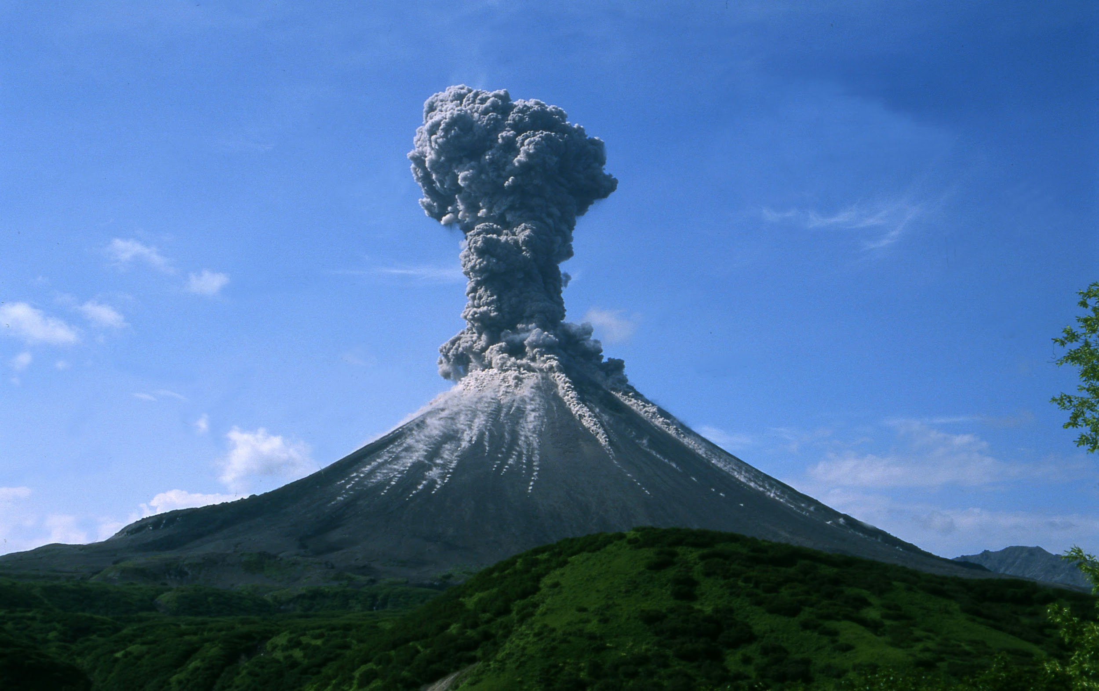
Major Primary Pollutants: SO₂
Sulfur dioxide (SO₂):
About one-third of SO₂ in the troposphere occurs naturally through the sulfur cycle.
Two-thirds come from human sources, mostly combustion (S+ O₂ → SO₂) of sulfur-containing coal and from oil refining and smelting of sulfide ores.
Notes:
*

Slide 9
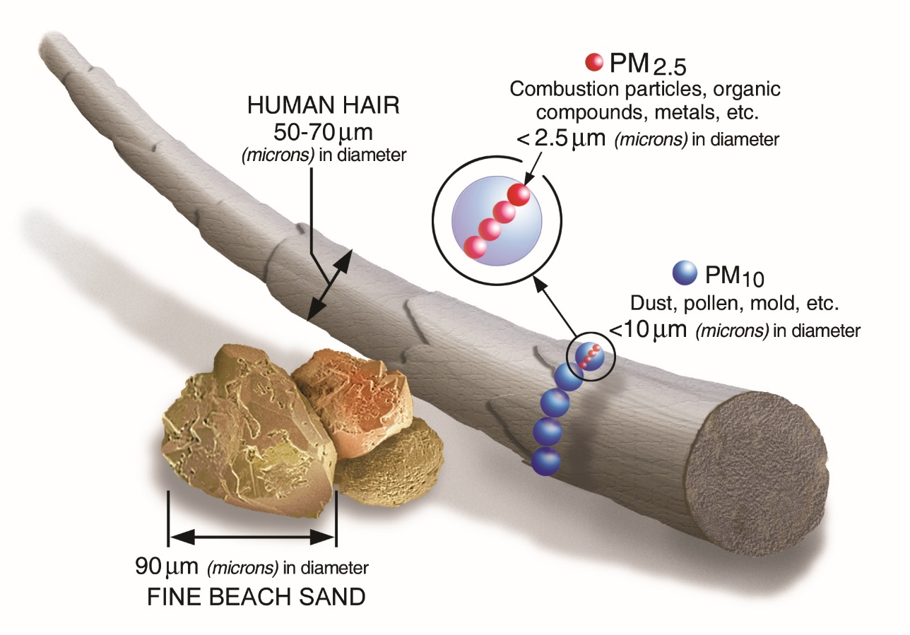
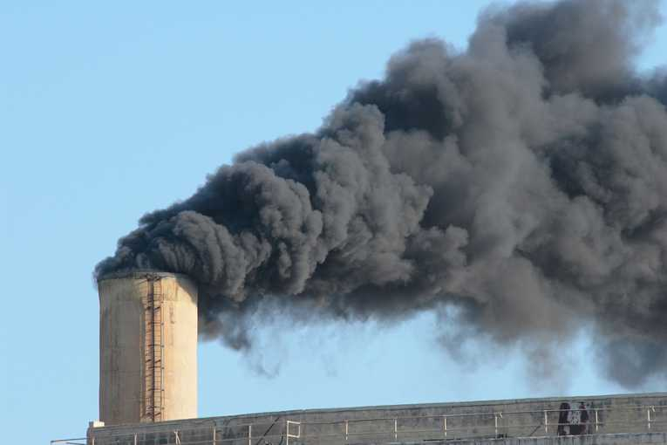
Major Primary Pollutants: SPM
Suspended particulate matter (SPM):
Consists of a variety of solid particles and liquid droplets small and light enough to remain suspended in the air.
The most harmful forms of SPM are fine particles (PM-10, with an average diameter < 10 micrometers) and ultrafine particles (PM-2.5).
According to the EPA, SPM is responsible for about 60,000 premature deaths a year in the U.S.
Notes:
*

Slide 10
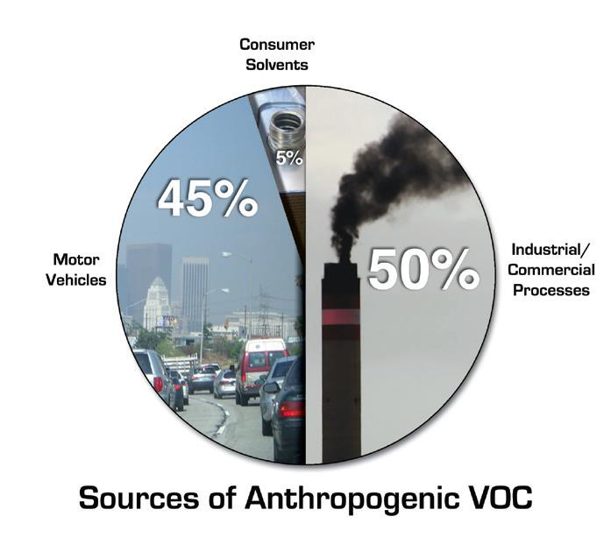
Major Primary Pollutants: VOCs
Volatile organic compounds (VOCs):
Most are hydorcarbons emitted by the leaves of many plants and methane.
About two thirds of global methane emissions comes from human sources such as burning of wood & gas and personal care products such as perfume, hair spray, paints, cleaning agents
Other VOCs include industrial solvents such as trichlorethylene (TCE), benzene, and vinyl chloride.
Long-term exposure to benzene can cause cancer, blood disorders, and immune system damage.
Notes:
*

Slide 11
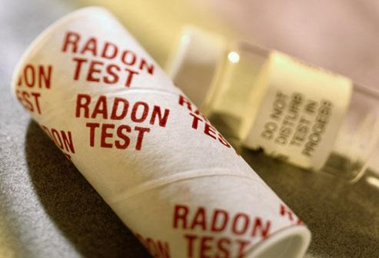
Major Primary Pollutants: Rn
Radon (Rn):
Is a naturally occurring radioactive gas found in some types of soil and rock.
It can seep into homes (basements) and buildings sitting above such deposits.
Notes:
*

Slide 12
Copy this in your notes!

