Slide 1
Sewage Treatment

Slide 2
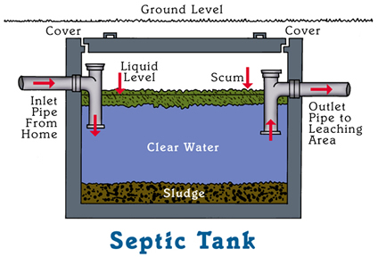
SEPTIC TANKS
Septic tanks are used in areas where there are no combined sewers.
Septic tanks (cesspools) must be emptied each year. Old tanks can crack and leak coliform bacteria into surrounding soil, groundwater, and surface waters.

Slide 3
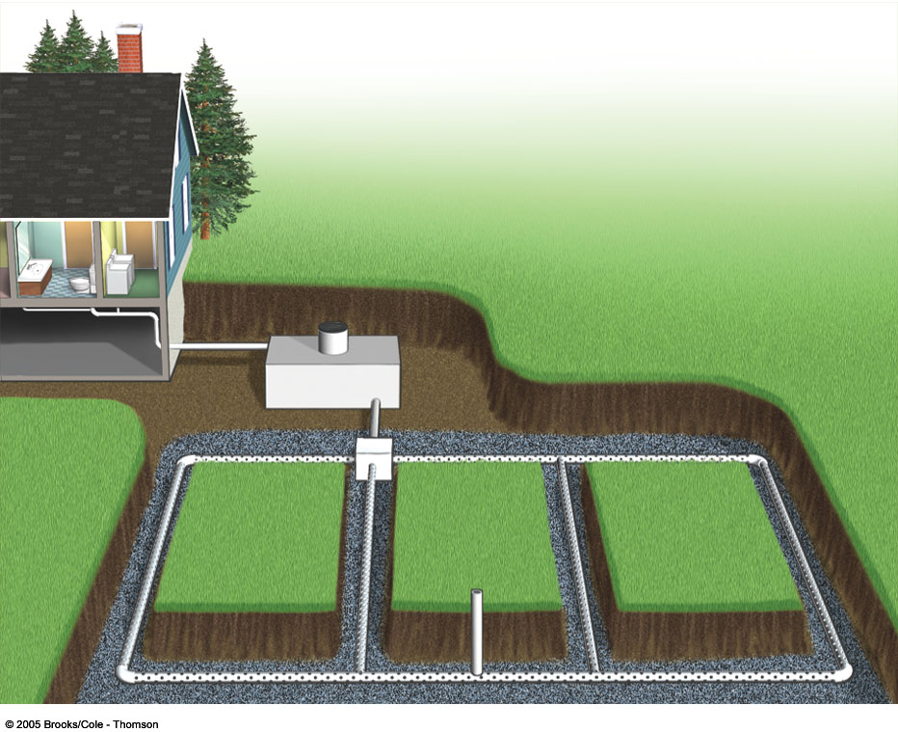
Figure 9-28 Page 196
Septic tank with manhole (for cleanout)
Non-perforated pipe
Household
wastewater
Distribution box (optional)
Gravel or
crushed
stone
Drain
field
Vent pipe
Perforated pipe

Slide 4
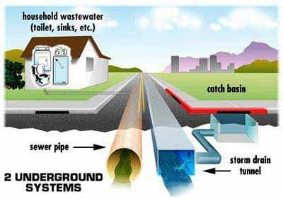
Sewer Systems
Sewage systems collect water from homes to one central location to be treated.
Sewage is kept separate from collected rainwater.
Rainwater goes straight to rivers and lakes.
NOT TREATED

Slide 5
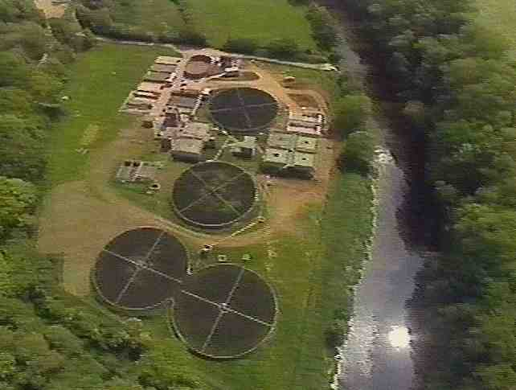
SEWAGE TREATMENT
Sewage treatment means cleaning waste water before returning it to the watershed.
Sewage treatment separates solids from liquids by physical processes and purifies the liquid by biological and chemical processes

Slide 6
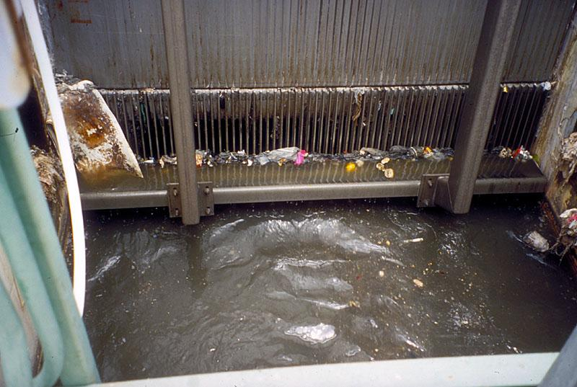
PRIMARY TREATMENT
First large solids are screened out of the water.
Bags, toys, hygiene products, etc.
Fats, oil, and grease (fog) is skimmed off the top as well.

Slide 7
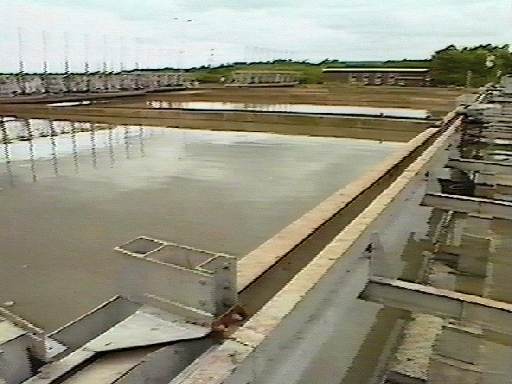
PRIMARY TREATMENT
Liquid is then sent to settling tanks for sand, grit, and small particles to settle out.

Slide 8
SLUDGE TREATMENT
Sludge is an excellent soil conditioner and is used as a fertilizer on farmland.

Slide 9
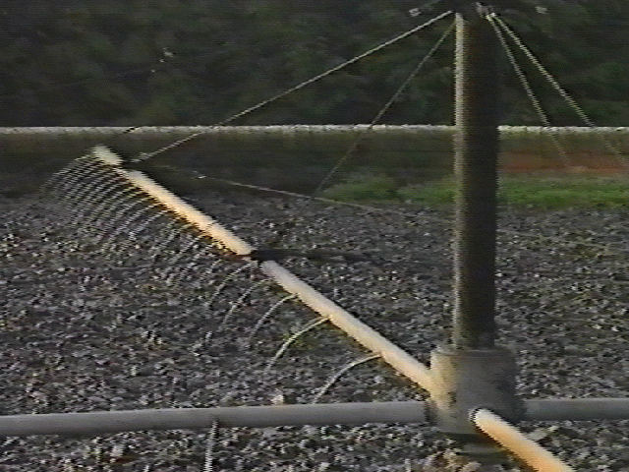
SECONDARY TREATMENT
Microorganisms are used to break down dissolved organic material in the water.

Slide 10
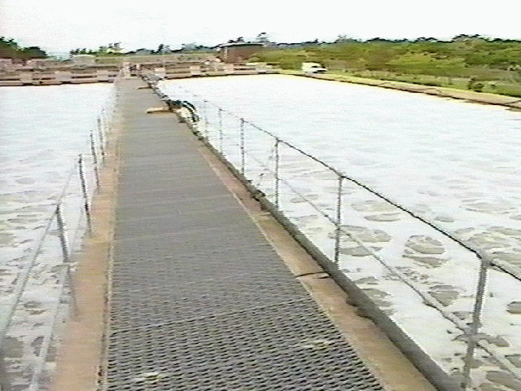
SECONDARY TREATMENT
This process can be sped up by pumping air into the water to provide oxygen.
These treatment units are called aeration tanks. .

Slide 11
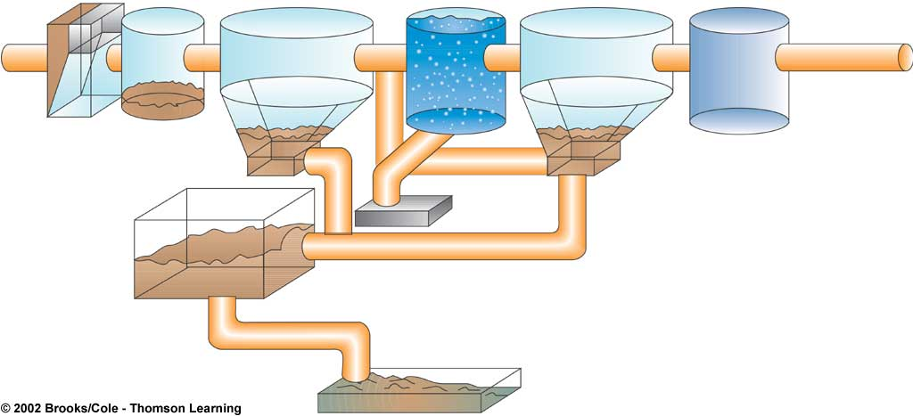
Primary
Secondary
Grit
chamber
Chlorine
disinfection tank
Bar screen
Settling tank
Aeration tank
Settling tank
To river, lake,
or ocean
Raw sewage
from sewers
Sludge
Air pump
(kills bacteria)
Sludge digester
Sludge drying bed
Disposed of in landfill or applied to cropland,
pasture, or rangeland

Slide 12
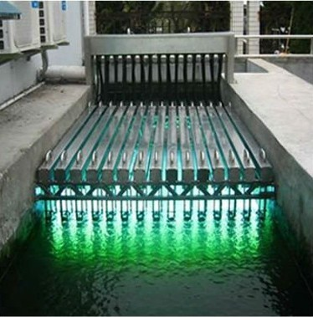
TERTIARY TREATMENT
Water is disinfected before leaving the treatment plant to kill any pathogens.
Chlorine
UV Light
Ozone

Slide 13
POLLUTION FROM SEWAGE
Carries disease-causing agents (cholera bacteria, hepatitis, E. coli.
Causes nutrient-loading (organically-rich) into surface waters.
Causes an increase in BOD (biological oxygen demand), which causes a decrease in dissolved oxygen

Slide 14
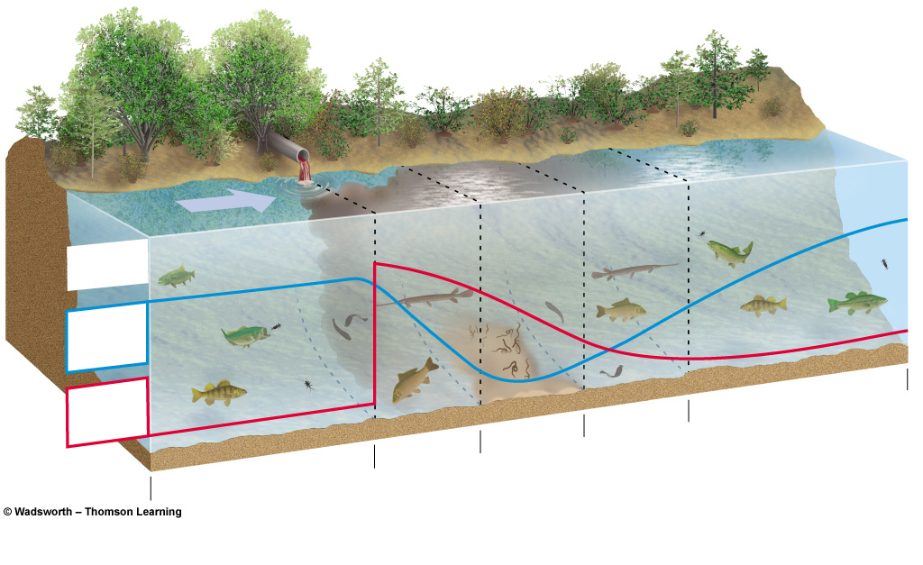
IMPACTS FROM ORGANIC WASTE
8 ppm
Types of
organisms
Clean
Zone
Recovery
Zone
8 ppm (mg/L)
Septic
Zone
Dissolved
oxygen
(ppm)
Decomposition
Zone
Clean Zone
Biological
oxygen
demand
Normal clean water organisms
(Trout, perch, bass,
mayfly, stonefly)
Fish absent,
fungi, sludge
worms,
bacteria
(anaerobic)
Trash fish
(carp, gar,
leeches)
Trash fish
(carp, gar,
leeches)
Normal clean water organisms
(Trout, perch, bass,
mayfly, stonefly)

Slide 15
Mock Essay
Describe the major differences between Primary and Secondary sewage
treatment.
b) What are some of the ways that organic wastes are broken down during
secondary treatment?
c) During the final stages of water treatment, describe one infectious agent and
a method used to remove or kill it.
d) Describe one type of solid material removed from waste water and what
is done with it following treatment.
e) Describe the two effects of untreated (or poorly treated) sewage discharge on
local waterways.

Slide 16
WATER POLLUTION CONTROL LAWS
1988 – Ocean Dumping Ban Act – barred ocean dumping of sewage sludge at the 200 mile marker. All cities were in compliance by 1988 EXCEPT for NYC, who were permitted to dump until June, 1992.
1972 – Water Pollution Control Act – EPA established regulations for the discharge of pollutants in the USA. It gave the EPA authority to implement pollution control programs and set ambient water quality standards for all contaminants entering surface waters. It also funded the construction of sewage treatment plants.

Slide 17
WATER POLLUTION CONTROL LAWS
The Federal Water Pollution Control Act was amended in 1977 and came to be known as the Clean Water Act. The ACT does NOT address water quantity or groundwater, ONLY water quality. Initially addressed point source, since the 1980’s has come to address nonpoint source issues as well.

Slide 18
Homework
Create a virtual tour of a wastewater treatment plant. (prezi or powerpoint)
Include…
1) Each step of treatment
2) How each step cleans the water
3) Pictures of each step

