Slide 1
Secondary Pollutants
Air Pollution

Slide 2
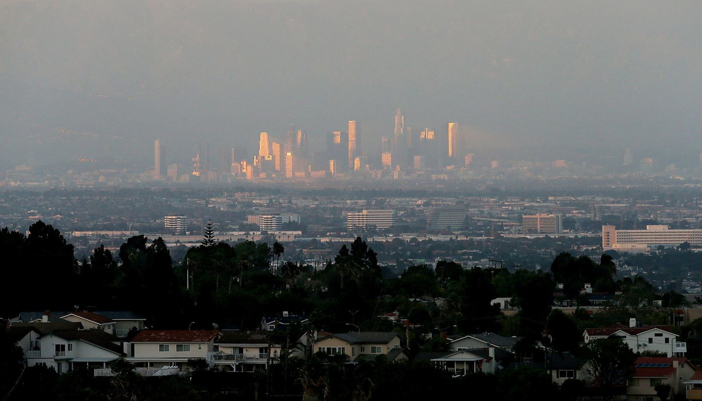
Industrial Smog
Industrial smog is a mixture of sulfur dioxide, droplets of sulfuric acid, and a variety of suspended solid particles emitted mostly by burning coal.
Southern California
Notes:
*

Slide 3
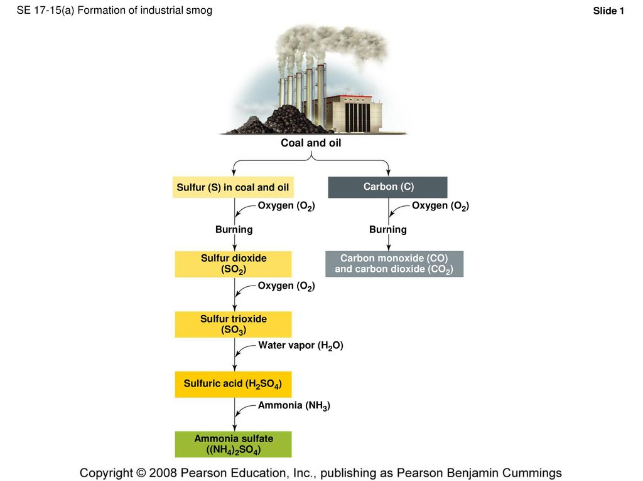

Slide 4
Sunlight plus Cars Equals Photochemical Smog
Photochemical smog is a mixture of air pollutants formed by the reaction of nitrogen oxides and volatile organic compounds under the influence of sunlight and heat.
Notes:
*

Slide 5
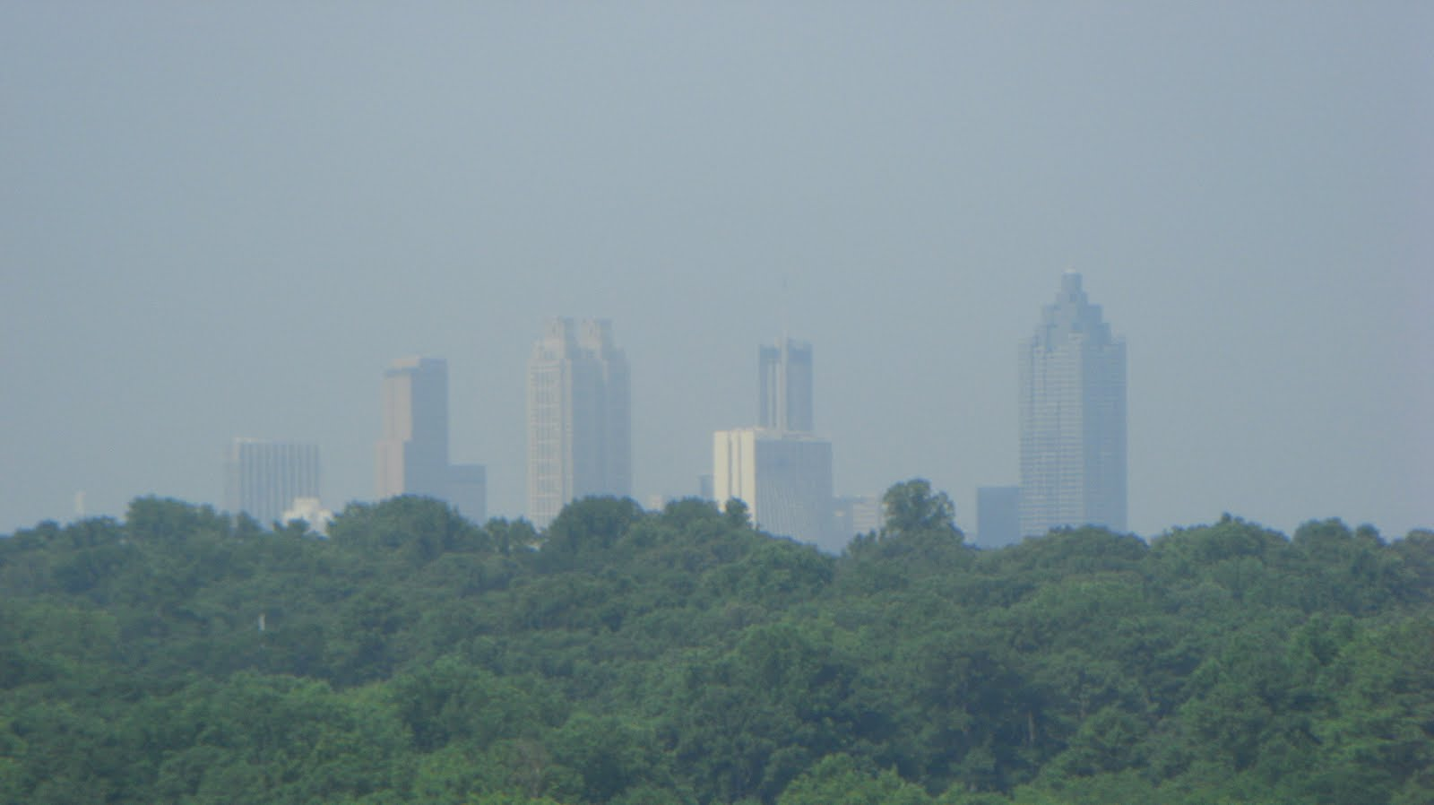
Sunlight plus Cars Equals Photochemical Smog
Atlanta, GA: taken from high point near campus of Emory
Notes:
*

Slide 6
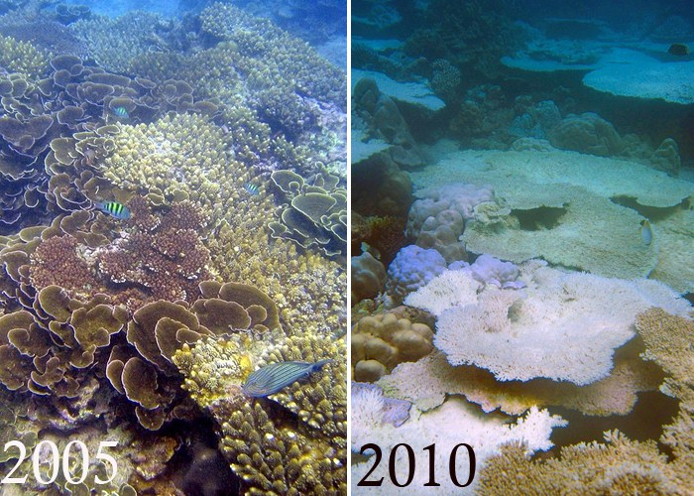
ACID DEPOSITION
Sulfur dioxides, nitrogen oxides, and particulates can react in the atmosphere to produce acidic chemicals that can travel long distances before returning to the earth’s surface.
Tall smokestacks reduce local air pollution but can increase regional air pollution.
Notes:
*

Slide 7
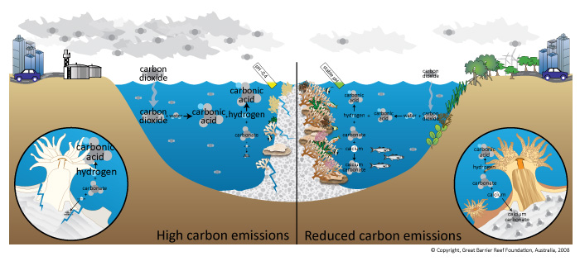

Slide 8
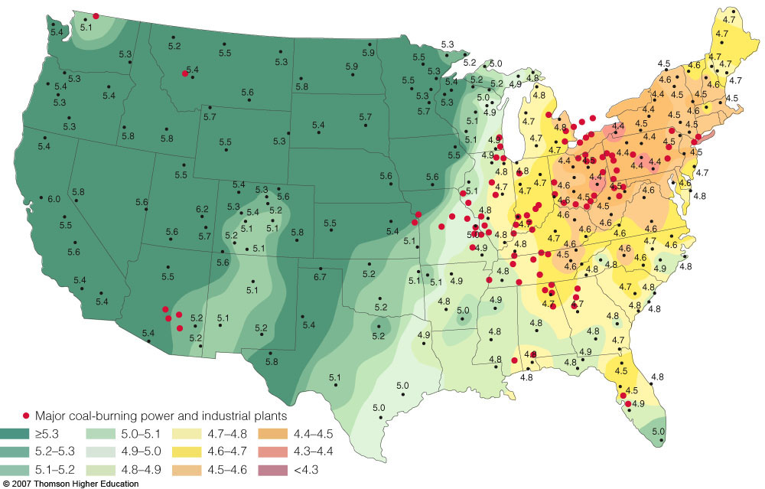
pH measurements in relation to major coal-burning and industrial plants.
Figure 19-7
Notes:
*

Slide 9
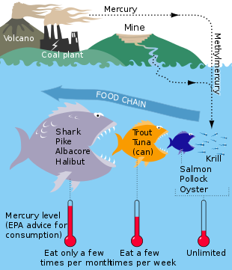
ACID DEPOSITION
Acid deposition contributes to chronic respiratory disease and can leach toxic metals (such as lead and mercury) from soils and rocks into acidic lakes used as sources for drinking water.
Notes:
*

Slide 10
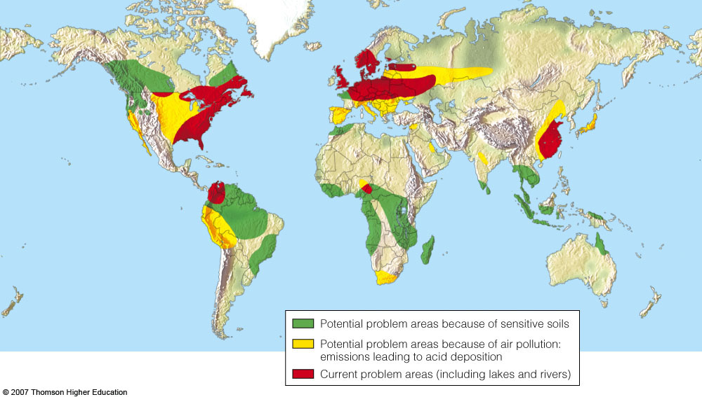
Figure 19-8
Notes:
*

Slide 11
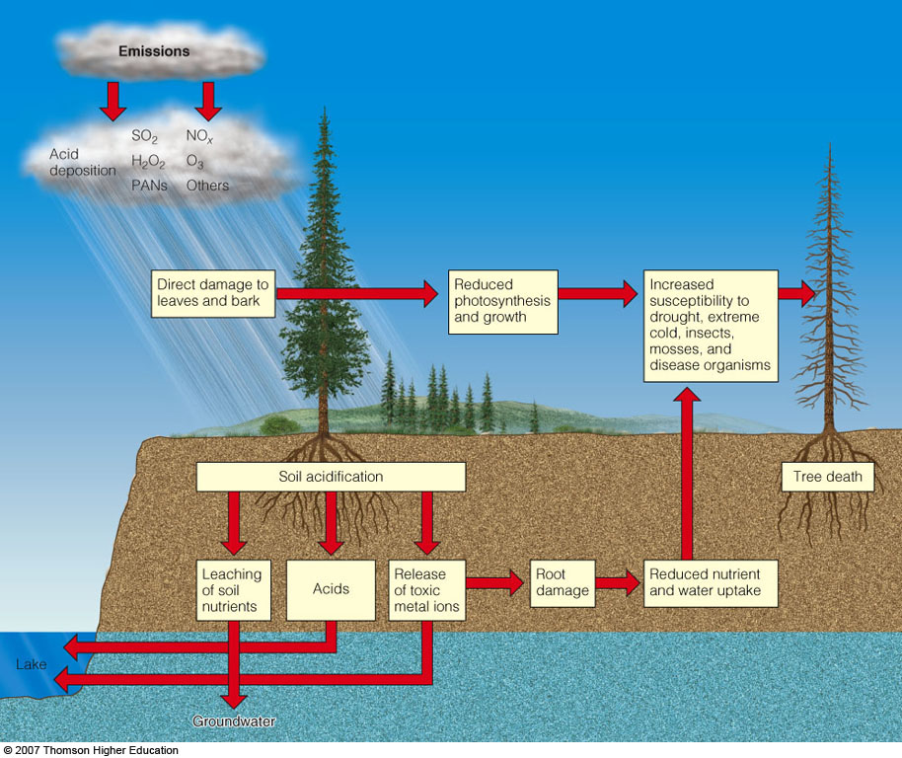
Air pollution is one of several interacting stresses that can damage, weaken, or kill trees and pollute surface and groundwater.
Figure 19-9
Notes:
*

Slide 12
Air Quality is better in US; EPA estimates since 1970
Particulate Matter (PM)- down 78%
Carbon Dioxide (CO₂)- down 23%
Nitrogen Dioxide (NO_{x})- up 14%
Lead (Pb)- down 98%
Sulfur Dioxide (SO2)- down 32%
Air quality is worse in developing countries:
Mexico City & Beijing: air exceeds WHO standards 350 days/year

Slide 13
Factors Influencing Levels of Outdoor Air Pollution
Outdoor air pollution can be reduced by:
settling out, precipitation, sea spray, winds, and chemical reactions.
Outdoor air pollution can be increased by:
urban buildings (slow wind dispersal of pollutants), mountains (promote temperature inversions), and high temperatures (promote photochemical reactions).
Notes:
*

Slide 14
Temperature Inversions
Cold, cloudy weather in a valley surrounded by mountains can trap air pollutants (left).
Areas with sunny climate, light winds, mountains on three sides and an ocean on the other (right) are susceptible to inversions.
Notes:
*

Slide 15
INDOOR AIR POLLUTION
Indoor air pollution usually is a greater threat to human health than outdoor air pollution.
According to the EPA, the four most dangerous indoor air pollutants in developed countries are:
Tobacco smoke.
Formaldehyde.
Radioactive radon-222 gas.
Very small fine and ultrafine particles.
Notes:
*

Slide 16
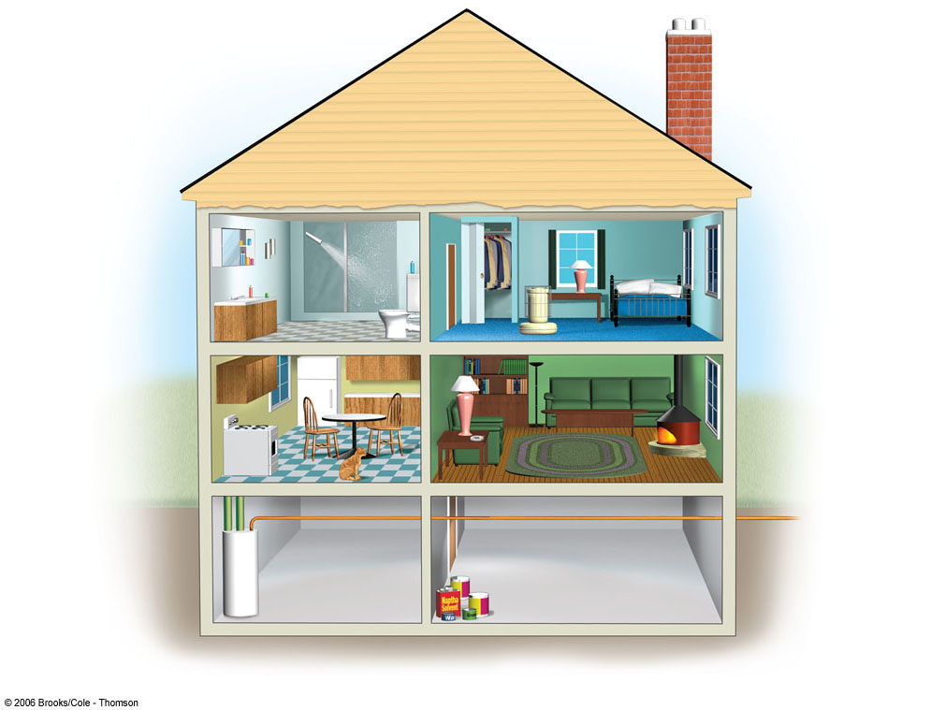
Chloroform
Para-dichlorobenzene
Tetrachloroethylene
Formaldehyde
1, 1, 1-
Trichloroethane
Styrene
Nitrogen Oxides
Benzo-α-pyrene
Particulates
Tobacco Smoke
Radon-222
Asbestos
Carbon Monoxide
Methylene Chloride
Fig. 19-11, p. 453
Notes:
*

Slide 17
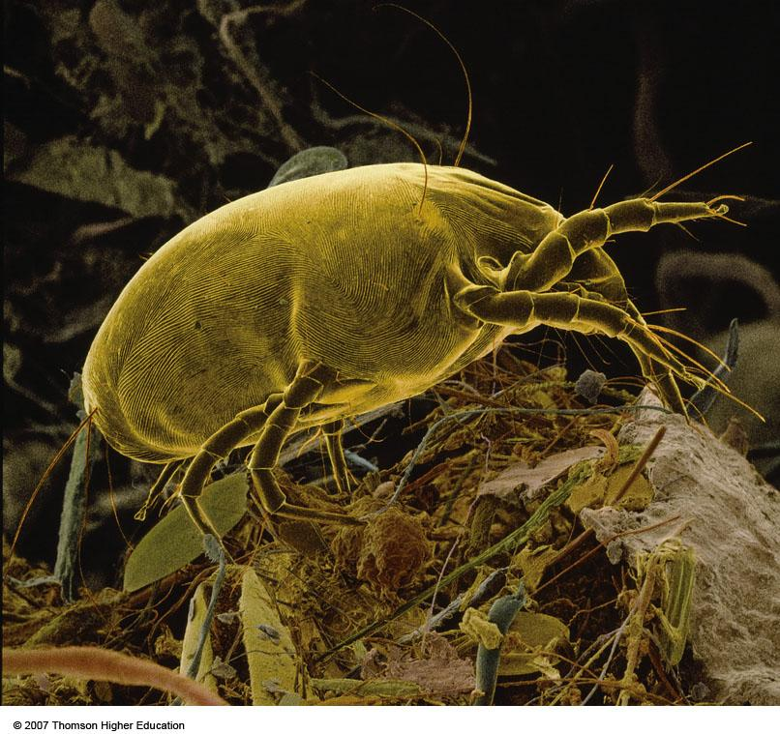
INDOOR AIR POLLUTION
Household dust mites that feed on human skin and dust, live in materials such as bedding and furniture fabrics.
Can cause asthma attacks and allergic reactions in some people.
Figure 19-12
Notes:
*

Slide 18
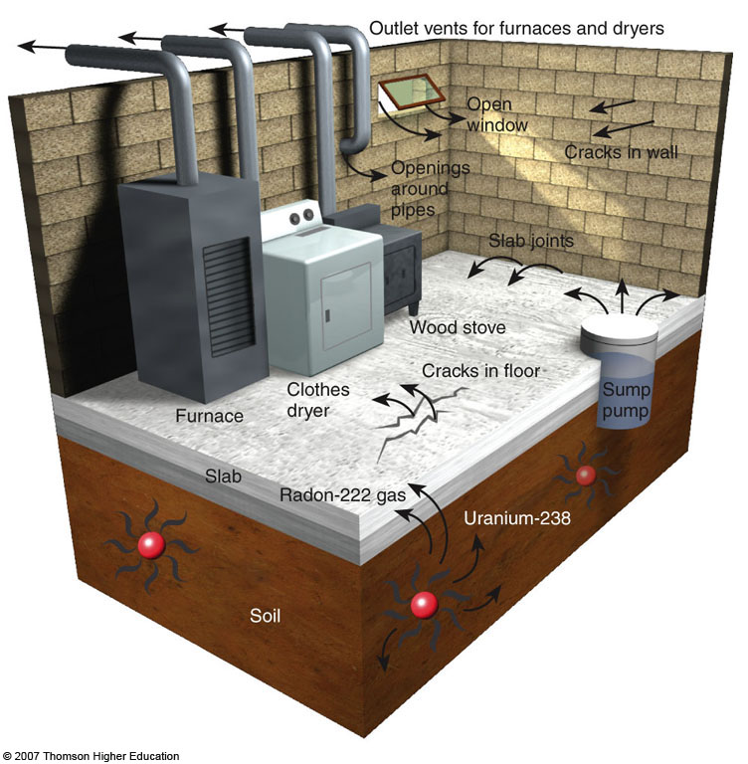
Case Study: Radioactive Radon
Radon-222, a radioactive gas found in some soils and rocks, can seep into some houses and increase the risk of lung cancer.
Notes:
*

Slide 19
