Slide 1
In 2004 the there was 35ppm of nitrates in a river. In 2010 the water was tested again and found to contain 105ppm of nitrates.
Describe one human activity that might account for the change in the amount of nitrates.
For the activity you identified in part “a” describe one way to reduce that impact.
Calculate…
The amount the nitrates increased.
The percent increase of the nitrates.

Slide 2
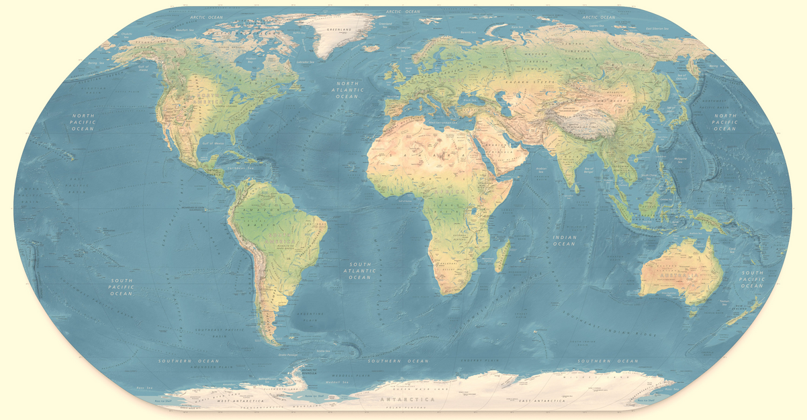

Slide 3
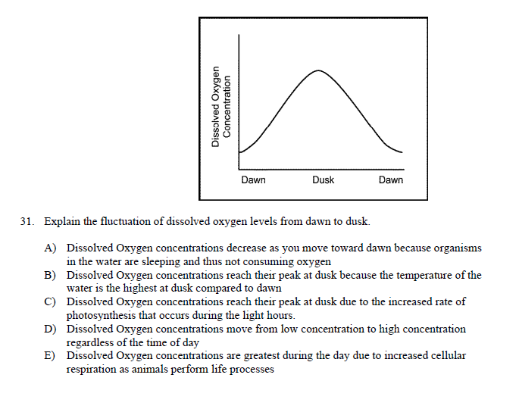
ChemCatalyst: Sept 29

Slide 4
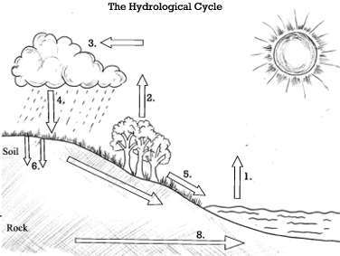
The Hydrologic Cycle

Slide 5
Out of the Air…
Condensation
Precipitation

Slide 6
On the ground…
Runoff
Infiltration

Slide 7
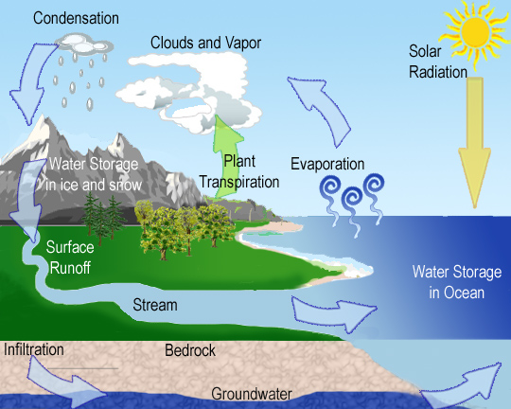

Slide 9
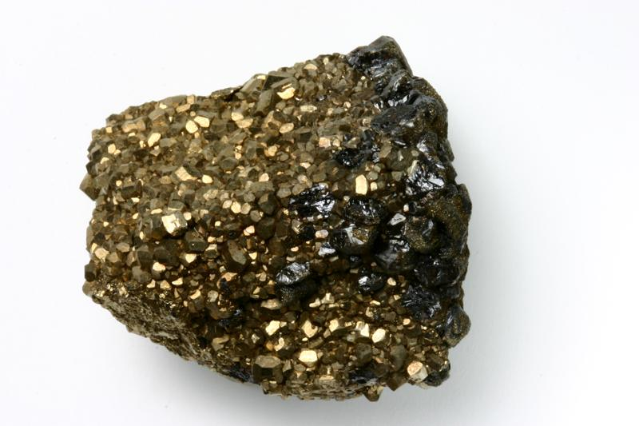
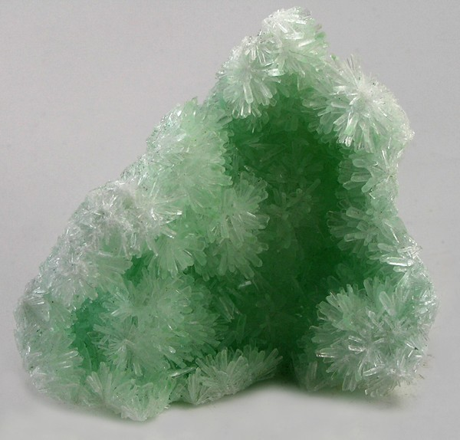
Sulfur Cycle
The sulfur cycle is primarily gaseous (SO₂)
Most sulfur found in underground rocks FeS₂ (iron pyrite) and CaSO₄ (gypsum)

Slide 10
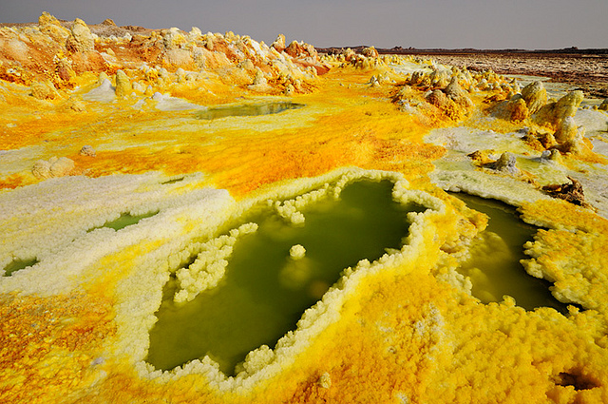
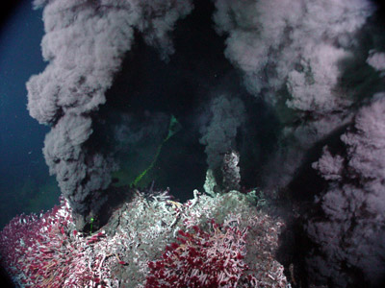
Natural release of sulfur into the atmosphere comes from
weathering,
gases from sea floor vents
volcanic eruptions

Slide 11
Human Impacts
Most S enters the atmosphere through human activity
Burning high sulfur fossil fuels, coal and oil,
Smelting metal ores containing sulfur
Utilizing sulfuric acid in industrial processes and manufacture
Refining of petroleum

Slide 12
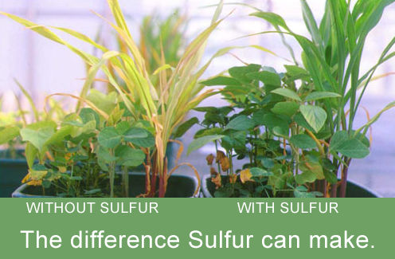
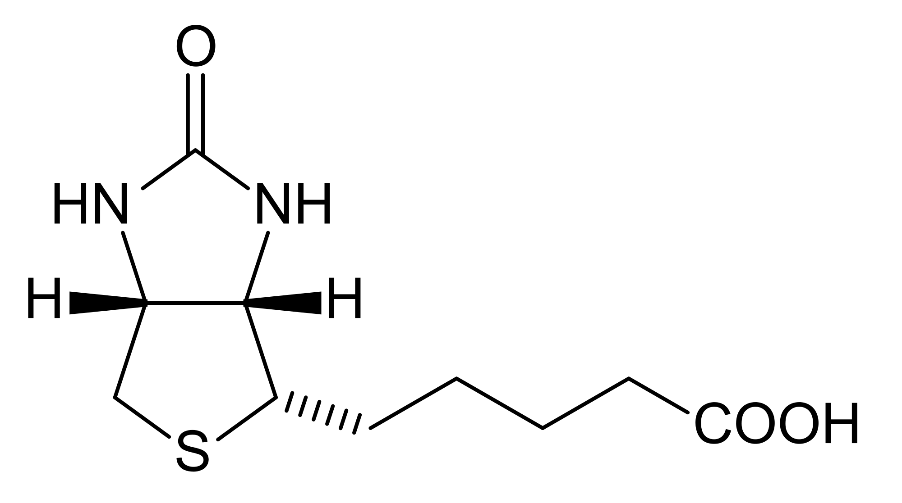
Plants assimilate sulfur in the form from the soil for specialized uses
Biotin, thiamin,(vitamins)
insulin and some amino acids

Slide 13
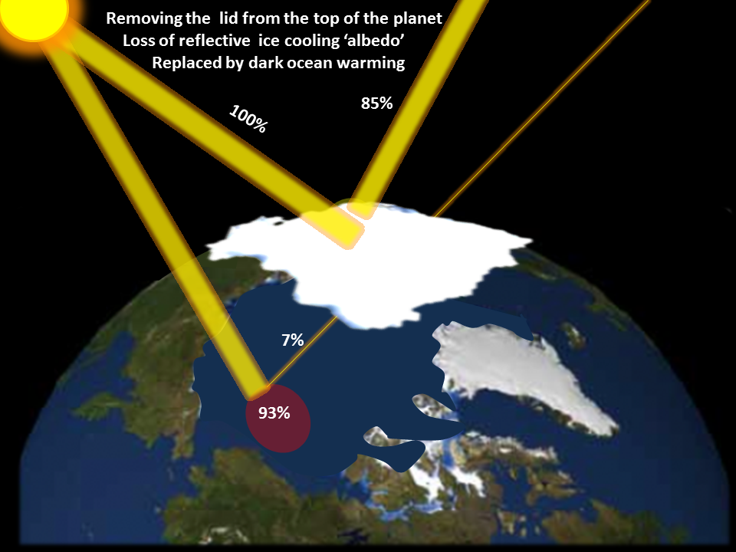
Sulfur containing clouds are “brighter” and increase Earth’s albedo – provides a cooling effect which may offset a minor portion of earth’s heating caused by CO₂ and other greenhouse gases.

Slide 14
The Phosphorus Cycle

Slide 15
Phosphorus is found in sedimentary rock, not in the atmosphere. Never never never.
Essential in the production of DNA, fats in cell membranes of plants and animals, bones, teeth and shells.
Not dependent on bacterial action to cycle

Slide 16
Released from rock through weathering and acid rain. A slow process
Dissolved in soil & water, and taken up by plant roots
Found in guano (waste of fish eating birds)

Slide 17
Human impact
Mining large quantities for production of inorganic fertilizer
Clear cutting tropical areas for agriculture
Decreases available phosphorus
Little found in the soil
When the vegetation is gone, P is washed away

Slide 18
Runoff of animal wastes from feedlots
Stream runoff carries P to lakes and ponds
Increase growth of cyanobacteria
Green algae and aquatic plants
Increase causes sunlight to be blocked
Aerobic decomposers decrease O₂ content in water
Excess P ends up killing aquatic animals and plants

Slide 19
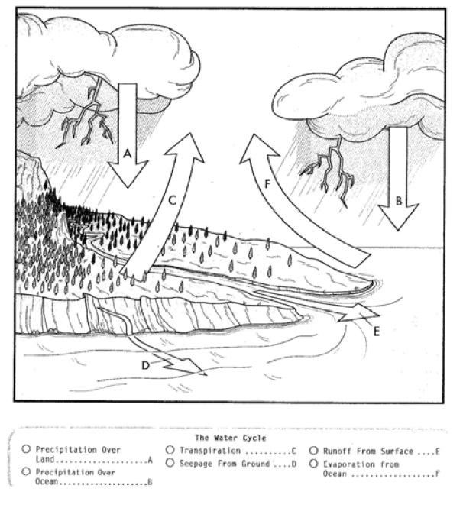

Slide 20
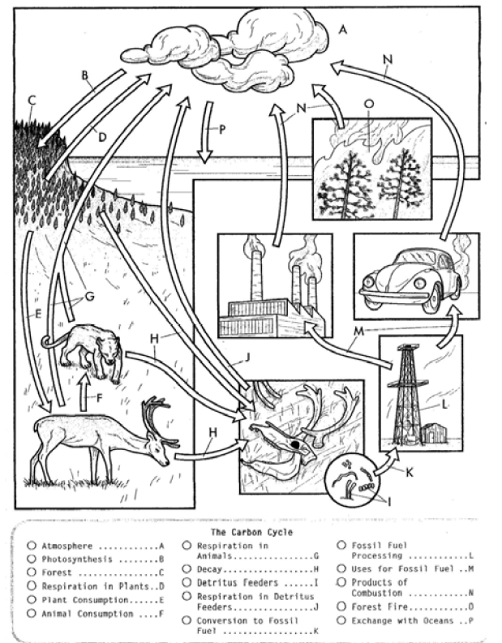

Slide 21
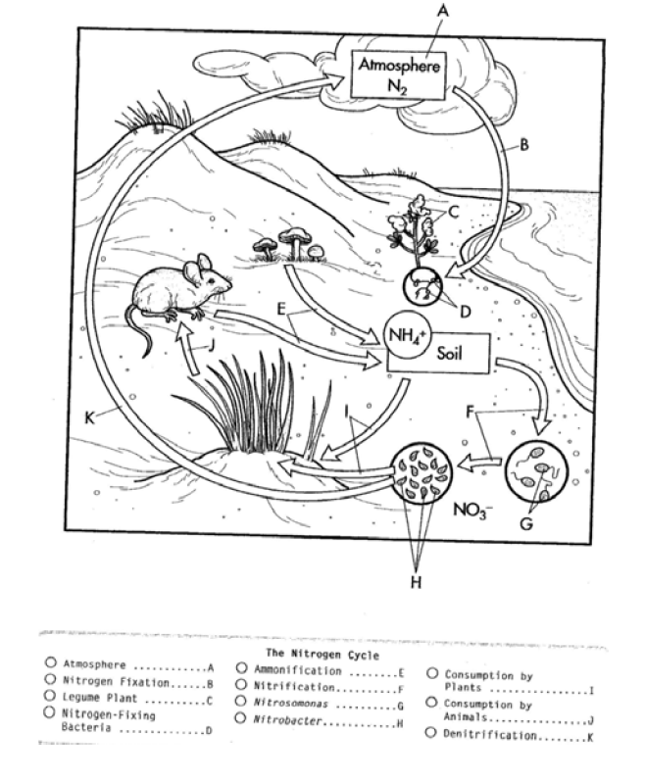

Slide 22
