Slide 1
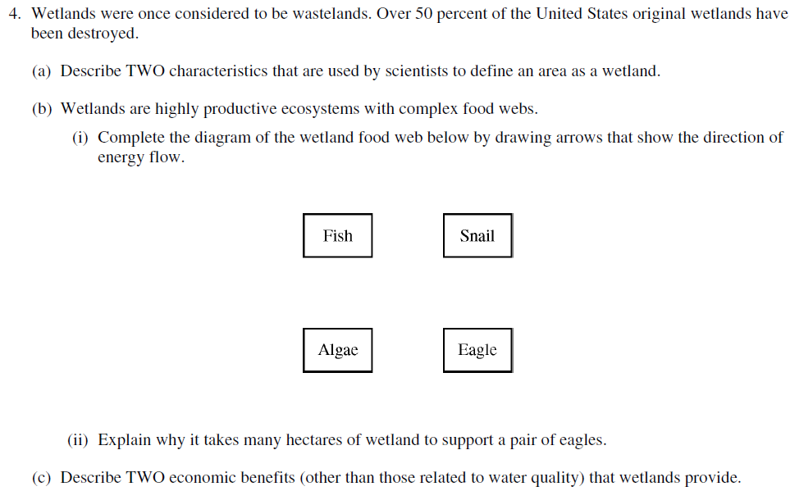
2
0
1
2

Slide 2
ENERGY FLOW IN ECOSYSTEMS
All organisms require energy, - for growth, maintenance, reproduction, locomotion, etc.
Hence, for all organisms there must be: A source of energy
A loss of usable energy

Slide 3
Types of energy
heat energy
mechanical energy (+gravitational energy, etc.)
chemical energy = energy stored in bonds between atoms
Nuclear Energy = Energy stored in the nucleus of atoms

Slide 4
Autotrophs
Photoautotrophs store energy from the sun in organic compounds
(= green plants, algae, some bacteria)
CO₂ + H₂O → C₆H₁₂O₂ + O₂
light
simple
inorganic
compounds
complex
organic
compounds
photoautotrophs

Slide 5
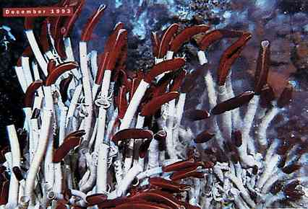
Chemosynthesis near hydrothermal vents

Slide 6
Heterotrophs
Heterotrophs (=other-nourishing) Require energy previously stored in complex molecules.
C₆H₁₂O₂ + O₂→ CO₂ + H₂O
heat
complex
organic
compounds
simple
inorganic
compounds
heterotrophs

Slide 7
The Laws of Thermodynamics
FIRST LAW of THERMODYNAMICS:
Energy can be converted from one form to another, but cannot be created or destroyed.

Slide 8
SECOND LAW of THERMODYNAMICS
Transformations of energy always result in some loss or dissipation of energy
or
In energy exchanges in a closed system, the potential energy of the final state will be less than that of the initial state
or
Entropy tends to increase (entropy = amount of unavailable energy in a system)
or
Systems will tend to go from ordered states to disordered states (to maintain order, energy must be added to the system, to compensate for the loss of energy)

Slide 9
Energy flow
This pattern of energy flow among different organisms is the TROPHIC STRUCTURE of an ecosystem.
Simplistically:
heat
Producers
Consumers
Decomposers
heat

Slide 10
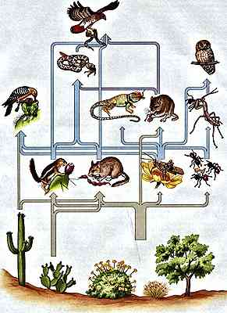

Slide 11
Energy transfers among trophic levels
How much energy is passed from one trophic level to the next?
How efficient are such transfers?
How much mass is in each level?
How many organisms are in each level?

Slide 12
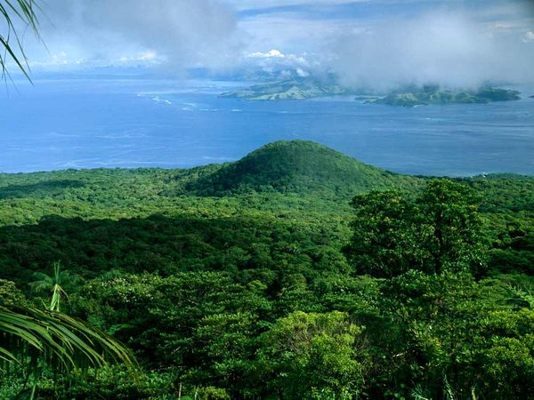
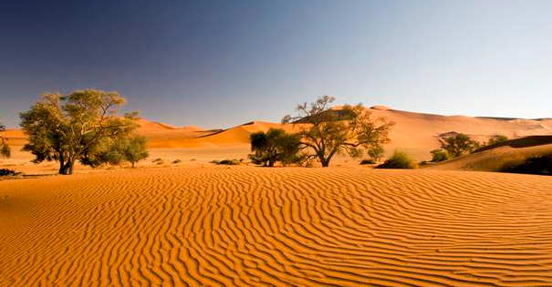
Biomass--the dry mass of organic material in the organism(s).
Primary productivity is the rate of energy capture by producers.
Measured by the amount of new biomass of producers in an area

Slide 13
Gross primary production (GPP) = total amount of energy captured
Net primary production (NPP) = GPP - respiration
Net primary production is thus the amount of energy stored by the producers and available to consumers and decomposers.

Slide 14
Ecological pyramids
The standing crop, productivity, number of organisms, etc. of an ecosystem can be conveniently depicted using “pyramids”, where the size of each compartment represents the amount of the item in each trophic level of a food chain.
Secondary Consumers
Primary Consumers
Producers

Slide 15
Pyramid of numbers
A pyramid of numbers indicates the number of individuals in each trophic level.
Since the size of individuals may vary widely and may not indicate the productivity of that individual, pyramids of numbers say little or nothing about the amount of energy moving through the ecosystem.
# of Secondary Consumers
# of Primary Consumers
# of Producers

Slide 16
Pyramid of biomass
A pyramid of biomass indicates how much biomass is present in each trophic level at any one time.
As for pyramids of numbers, a pyramid of biomass may not well reflect the flow of energy through the system, due to different sizes and growth rates of organisms.
biomass of secondary consumers
biomass of primary consumers
biomass of producers
(at one point in time)

Slide 17
Pyramid of energy
A pyramid of energy depicts the energy flow, or productivity, of each trophic level.
Due to the Laws of Thermodynamics, each higher level must be smaller than lower levels, due to loss of some energy as heat (via respiration) within each level.
Secondary Consumers
Primary Consumers
Producers

Slide 18
10% Rule
Only 10% of the energy in one trophic level is passed on to the next trophic level.
The other 90% is used by organisms and lost as HEAT
Secondary Consumers
Primary Consumers
Producers

Slide 19
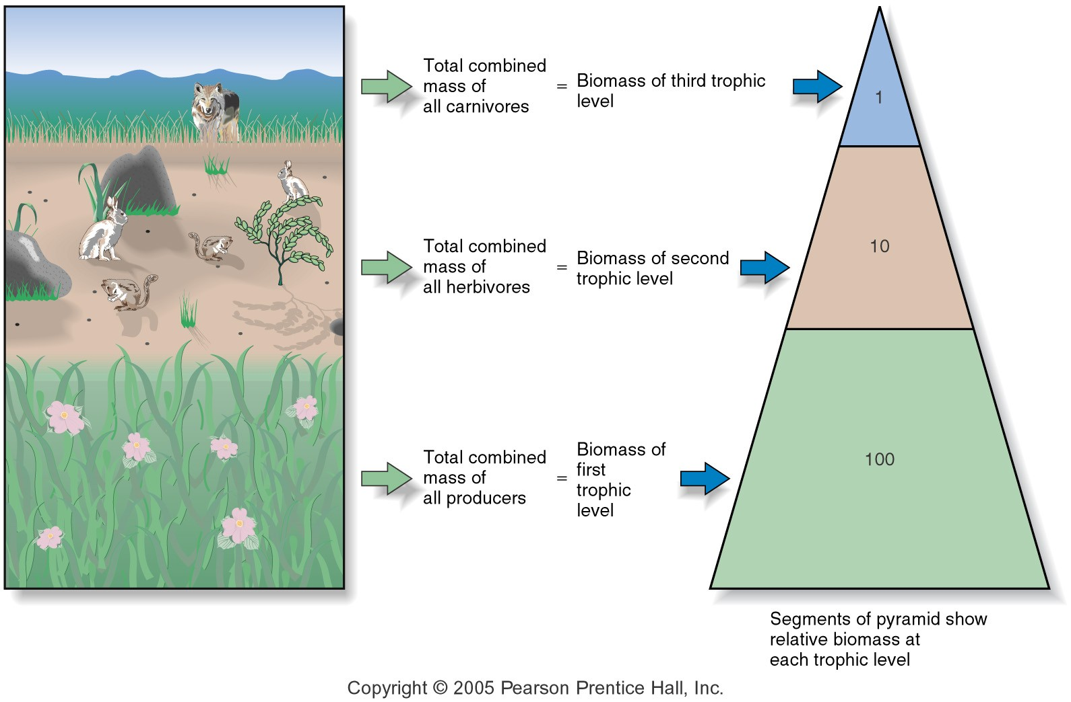
Limits of Trophic Levels
Biomass
Total combined weight of all the organisms at each trophic level.
Each level moving up loses 90% mass
Biomass pyramid

