Slide 1
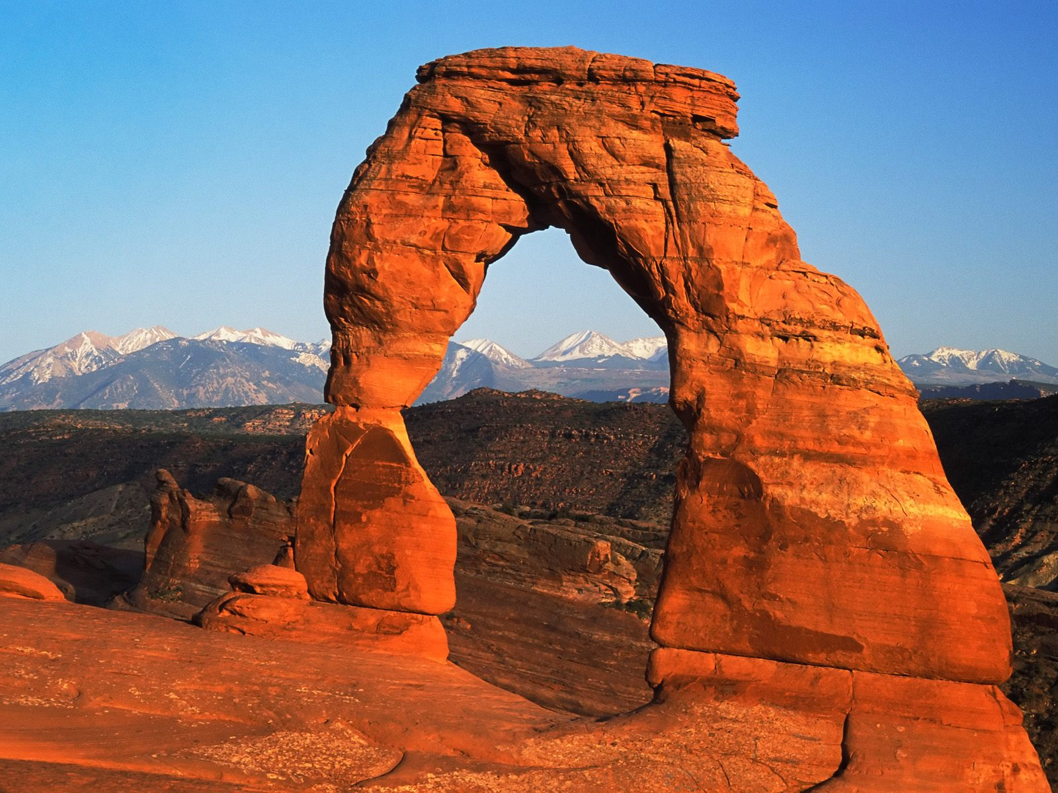
Soil &
Weathering
Notes:
Animated picture and caption sweep in
(Basic)
To reproduce the shape effects on this slide, do the following:
On the Home tab, in the Slides group, click Layout, and then click Blank.
On the Home tab, in the Drawing group, click Shapes, and then under Lines click Line (first option from the left).
On the slide, press and hold SHIFT, and then drag to draw a straight, vertical line.
Select the line. Under Drawing Tools, on the Format tab, in the Size group, in the Shape Height box, enter 7.5”.
Also on the Format tab, in the Shape Styles group, click the Format Shape dialog box launcher. In the Format Shape dialog box, click Line Color in the left pane. In the Line Color pane, select Solid line, click the button next to Color, and then under Theme Colors click Black, Text 1 (first row, second option from the left).
Also in the Format Shape dialog box, click Line Style in the left pane. In the Line Style pane, in the Weight box, enter 2 pt.
Also in the Format Shape dialog box, click Glow and Soft Edges in the left pane. In the Glow and Soft Edges pane, do the following:
Under Glow, click the button next to Presets, and then under Glow Variations click Blue, 5 pt glow, Accent color 1 (first row, first option from the left).
Click the button next to Color, and then under Theme Colors click White, Background 1 (first row, first option from the left).
On the Home tab, in the Drawing group, click Arrange, point to Align, and then do the following:
Click Align to Slide.
Click Align Center.
Click Align Middle.
On the slide, select the line. On the Home tab, in the Clipboard group, click the arrow next to Copy, and then click Duplicate.
Drag the duplicate line slightly off the right edge of the slide.
With the duplicate line still selected, on the Home tab, in the Drawing group, click Arrange, point to Align, and then do the following:
Click Align to Slide.
Click Align Middle.
On the Insert tab, in the Images group, click Picture. In the Insert Picture dialog box, select a picture, and then click Insert.
On the slide, select the picture. Under Picture Tools, on the Format tab, in the Size group, click the Size and Position dialog box launcher. In the Format Picture dialog box, resize or crop the image so that the height is set to 7.5” and the width is set to 5”. To crop the picture, click Crop in the left pane, and in the right pane, under Crop position, enter values into the Height, Width, Left, and Top boxes. To resize the picture, click Size in the left pane, and in the right pane, under Size and rotate, enter values into the Height and Width boxes.
On the Home tab, in the Drawing group, click Arrange, point to Align, and then do the following:
Click Align to Slide.
Click Align Right.
Click Align Middle.
To reproduce the text effects on this slide, do the following:
On the Insert tab, in the Text group, click Text Box. On the slide, drag to draw a text box.
Enter text in the text box, and then select the text. On the Home tab, in the Font group, do the following:
In the Font list, select Arial.
In the Font Size list, select 28.
Click Bold.
Click the button next to Font Color, and then under Theme Colors click White, Background 1 (first row, first option from the left).
On the Home tab, in the Paragraph group, click Align Text Right to align the text right in the text box.
Drag the text box onto the left half of the slide.
To reproduce the background effects on this slide, do the following:
On the Design tab, in the Background group, click Background Styles and then click Format Background. In the Format Background dialog box, click Fill in the left pane, select Gradient fill in the Fill pane, and then do the following:
In the Type list, select Linear.
In the Angle box, enter 90.
Under Gradient stops, click Add gradient stops or Remove gradient stops until two stops appear in the slider.
Also under Gradient stops, customize the gradient stops as follows:
Select the first stop in the slider, and then do the following:
In the Position box, enter 40%.
Click the button next to Color, and then under Theme Colors click Black, Text 1 (first row, second option from the left).
In the Transparency box, enter 0%.
Select the next stop in the slider, and then do the following:
In the Position box, enter 100%.
Click the button next to Color, and then under Theme Colors click Black, Text 1, Lighter 50% (second row, second option from the left).
In the Transparency box, enter 0%.
To reproduce the animation effects on this slide, do the following:
Select the line off the right edge of the slide. On the Animations tab, in the Advanced Animation group, click Add Animation, and then under Entrance click Fly In.
Also on the Animations tab, in the Animation group, click Effect Options, and then click From Left.
On the Animations tab, in the Timing group, in the Duration box, enter 0.5.
On the Animations tab, in the Timing group, in the Start list, select After Previous.
Select the line at the center of the slide. On the Animations tab, in the Advanced Animation group, click Add Animation, and then under Entrance click Fly In.
Also on the Animations tab, in the Animation group, click Effect Options, and then click From Right.
On the Animations tab, in the Timing group, in the Duration box, enter 1.
On the Animations tab, in the Timing group, in the Start list, select After Previous.
Select the picture. On the Animations tab, in the Advanced Animation group, click Add Animation, and then under Entrance click Wipe.
Also on the Animations tab, in the Animation group, click Effect Options, and then click From Right.
On the Animations tab, in the Timing group, in the Duration box, enter 1.
On the Animations tab, in the Timing group, in the Start list, select With Previous.
Select the text box. On the Animations tab, in the Advanced Animation group, click Add Animation, and then under Entrance click Fly In.
Also on the Animations tab, in the Animation group, click Effect Options, and then click From Right.
On the Animations tab, in the Timing group, in the Duration box, enter 1.
On the Animations tab, in the Timing group, in the Start list, select With Previous.

Slide 2
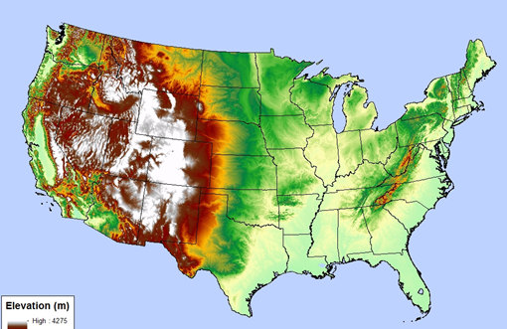
Inference Point
How does the age of a mountain range relate to its size?
What processes cause this to happen?
What can you say about the speed of these processes?
Rockies
80 milllion years old
Appalachians
480 million years old

Slide 3
Soil: the foundation for agriculture
Land devoted to agriculture covers 38% of Earth’s land surface
Agriculture = practice of raising crops and livestock for human use and consumption
Cropland = land used to raise plants for human use
Rangeland or pasture = land used for grazing livestock
Soil = a complex plant-supporting system consisting of disintegrated rock, organic matter, water, gases, nutrients, and microorganism
It is a renewable resource

Slide 4
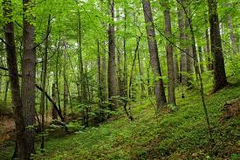
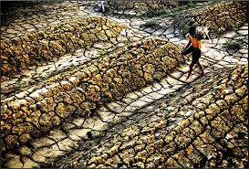
Population & consumption degrades soil
Feeding the world’s rising human population requires changing our diet or increasing agricultural production
Land suitable for farming is running out
We must find ways to improve the efficiency of food production
Mismanaged agriculture turns grasslands into deserts; removes forests; diminishes biodiversity; and pollutes soil, air, and water
Fertile soil is blown and washed away

Slide 5
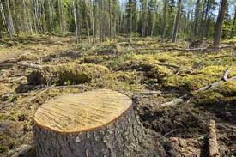
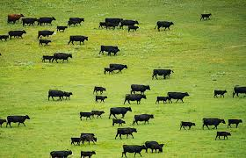
Soil degradation has many causes
Soil degradation results from
Deforestation
Agriculture (Irrigation)
Overgrazing
Over the past 50 years, soil degradation has reduced global grain production by 13%

Slide 6
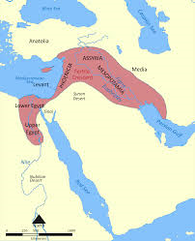
Agriculture arose 10,000 years ago
Agriculture was invented independently by different cultures
The earliest plant and animal domestication is from the “Fertile Crescent” of the Middle East
Wheat, barley, rye, peas, lentils, onions, goats, sheep

Slide 7
Traditional agriculture
Traditional agriculture = biologically powered agriculture, using human and animal muscle power
Subsistence agriculture = families produce only enough food for themselves
Intensive agriculture = produces excess food to sell
Uses animals, irrigation and fertilizer, but not fossil fuels

Slide 8
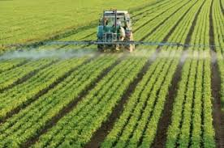
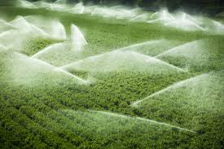
Industrialized agriculture is a recent phenomenon
Industrialized agriculture = using large-scale mechanization and fossil fuels to boost yields
Also uses pesticides, irrigation and fertilizers

Slide 9
Soil as a system
It’s NOT DIRT
Soil consists of mineral matter, organic matter, air, and water
Dead and living microorganisms, and decaying material
Bacteria, algae, earthworms, insects, mammals, amphibians, and reptiles
Since soil is composed of living and non-living matter, it is considered an ecosystem

Slide 10
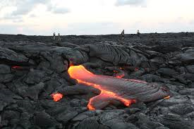
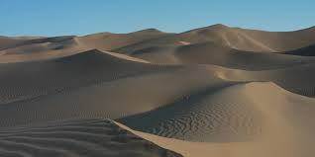
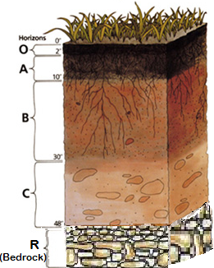
Soil formation is slow and complex
Parent material = the base geologic material of soil
Lava, volcanic ash, rock, dunes
Bedrock = the continuous mass of solid rock comprising the Earth’s crust
Weathering = the physical, chemical, or biological processes that break down rocks to form soil
Physical (mechanical) = wind and rain, no chemical changes in the parent material
Chemical = substances chemically interact with parent material
Biological = organisms break down parent material

Slide 11
3 Types of Weathering produces soil

Slide 12
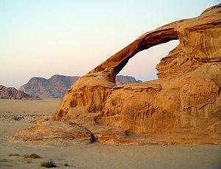
Weathering
Any process that breaks rocks into smaller and smaller pieces.
Pieces of broken down rock and soil are called sediments.
Notes:
*

Slide 13
Physical Weathering: Frost Wedging
Physical weathering is any process that breaks a rock apart without a chemical reaction.
Frost wedging is when water freezes in a crack in a rock, expands, and widens the crack.

Slide 14
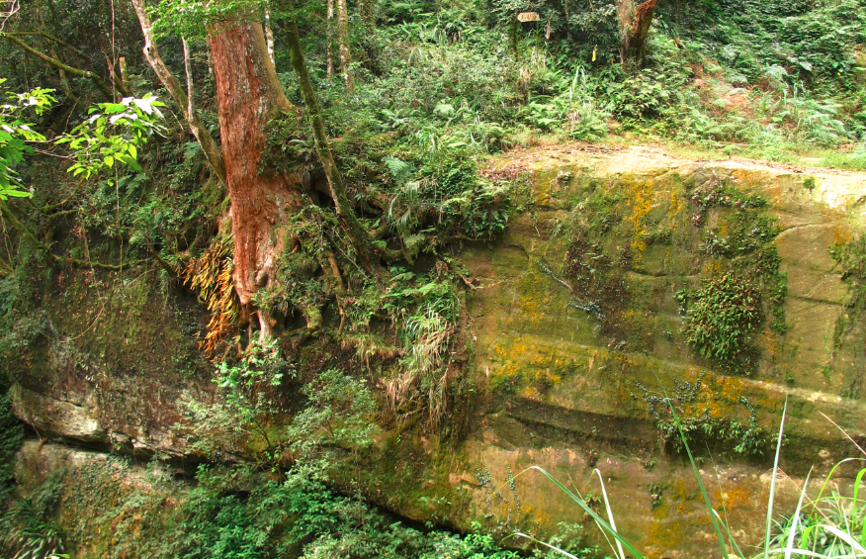
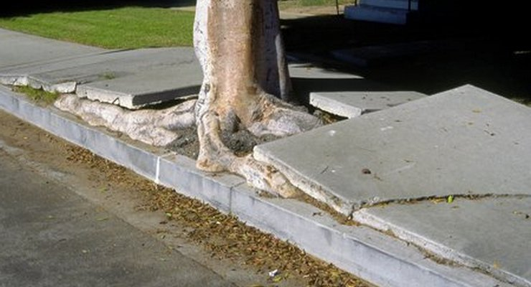
Physical Weathering: Biological Activity

Slide 15
Physical Weathering: Abrasion
Notes:
*

Slide 16
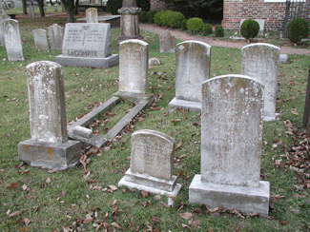
Chemical Weathering: Acid Precipitation

Slide 17
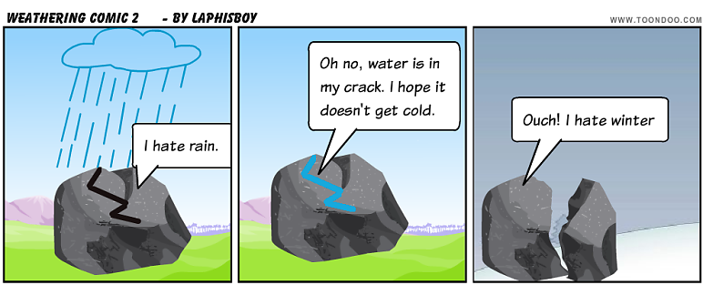
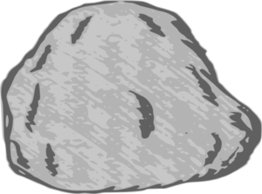
Mercury
(Hg)
Lead
(Pb)
Cadmium
(Cd)
Arsenic
(As)

Slide 18
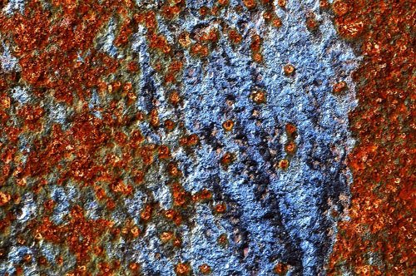
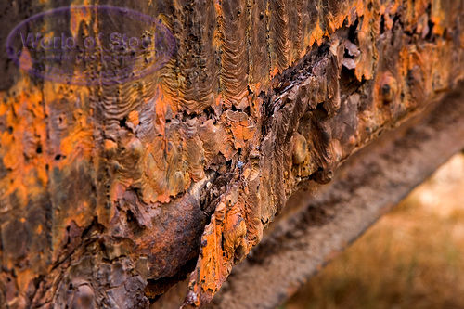
Chemical Weathering:
Rusting & Oxidation

Slide 19
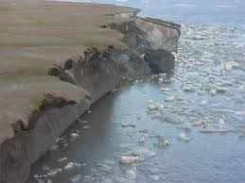
Other processes affect soil formation
Erosion = the dislodging and movement of soil by wind or water
Occurs when vegetation is absent
Biological activity includes deposition, decomposition, and accumulation of organic matter
Humus = a dark, spongy, crumbly mass of material formed by partial decomposition

Slide 20
A soil profile consists of horizons
Horizon = each layer of soil
Soil profile = the cross-section of soil as a whole
Up to six major horizons may occur in a soil profile
Topsoil = inorganic and organic material most nutritive for plants
Leaching = dissolved particles move down through horizons

Slide 21
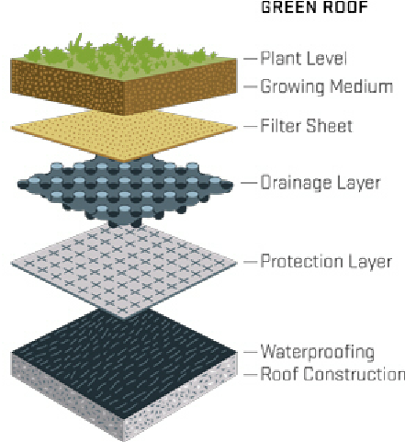
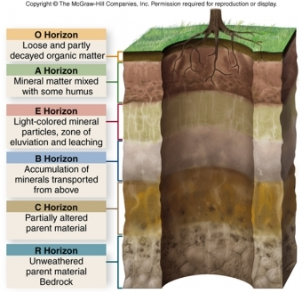
Soil Horizon Profile

Slide 22
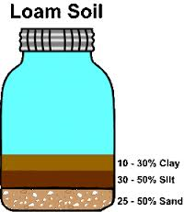
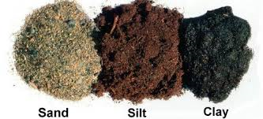
Soils are characterized in many ways
Soils are classified based on color, texture, structure, and pH
Soil color = indicates its composition and fertility
Black or dark brown = rich in organic matter
Pale gray or white = indicates leaching
Soil texture = determined by the size of particles
From smallest to largest = clay, silt, sand
Loam = soil with an even mixture of the three
Influences how easy it is to cultivate and let air and water travel through the soil

Slide 23
Soil texture classification
Silty soils with medium-size pores, or loamy soils with mixtures of pore sizes are best for plant growth and crop agriculture

Slide 24
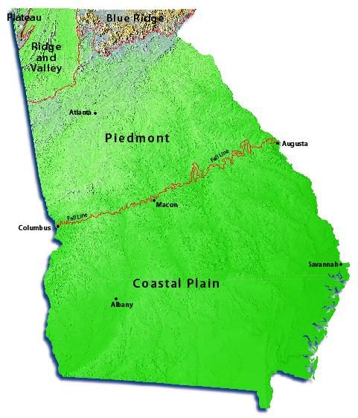
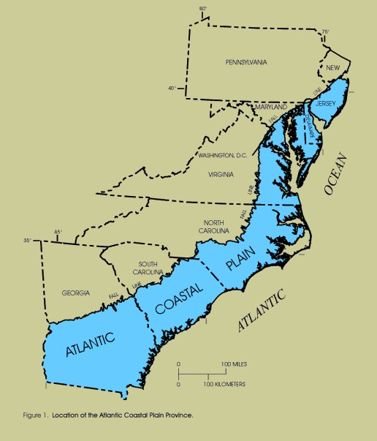

Slide 25
Magma
Exit

