Slide 1
Directions for today:
Copy each slide on the Cornell Notes (yellow paper) that I gave you yesterday. Please do NOT take the notes out of the classroom! Tonight, answer your cues for the notes.
Reminders:
1. Soil Lab Analysis Report is due Wednesday
2. 4 types of coal is due Wednesday

Slide 2
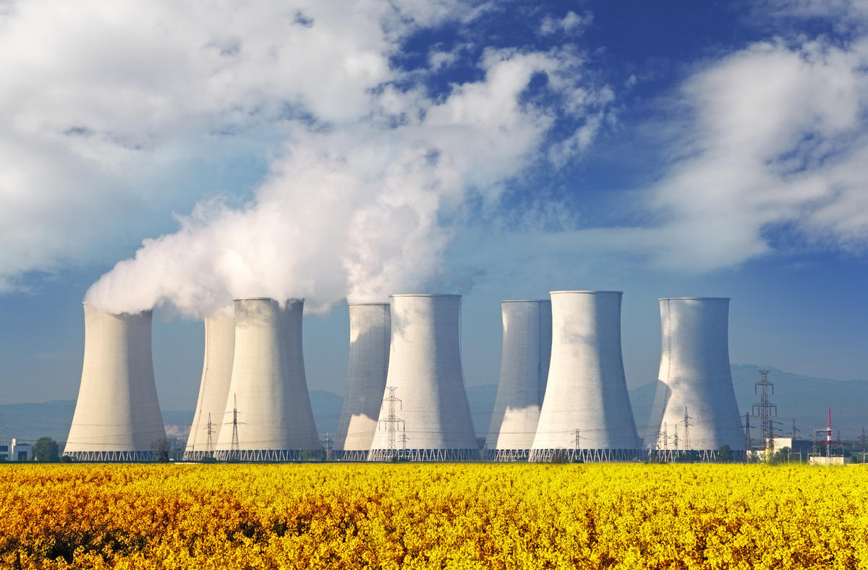
Nuclear Power
Public safety concerns and the costs of addressing them have constrained the development and spread of nuclear power in the United States, Sweden, and many other nations
The U.S. generates the most electricity from nuclear power
20% of U.S. electricity comes from nuclear sources
France receives 78% of its electricity from nuclear power

Slide 3
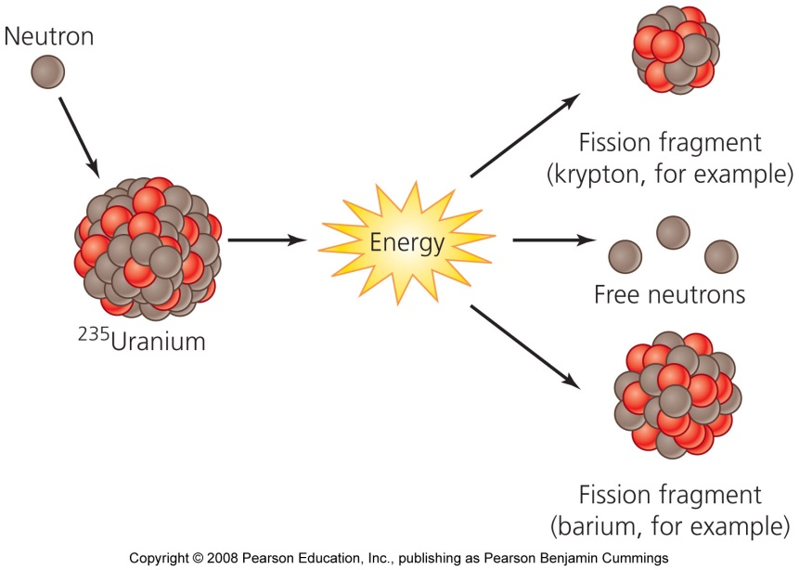
Fission releases nuclear energy
Nuclear energy = the energy that holds together protons and neutrons within the nucleus of an atom
The reaction that drives the release of nuclear energy in power plants is nuclear fission = the splitting apart of atomic nuclei

Slide 4
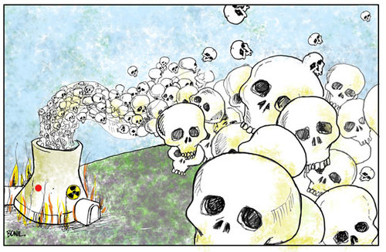
Delivers energy cleanly
Nuclear power helps us avoid emitting 600 million metric tons of carbon each year
Equivalent to 8% of global greenhouse gas emissions
Nuclear power plants are safer for workers than coal-fired plants
Drawbacks of nuclear power:
Nuclear waste is radioactive
If an accident occurs at a power plant, the consequences can potentially be catastrophic
Today, the world has 436 operating nuclear plants in 30 nations

Slide 5
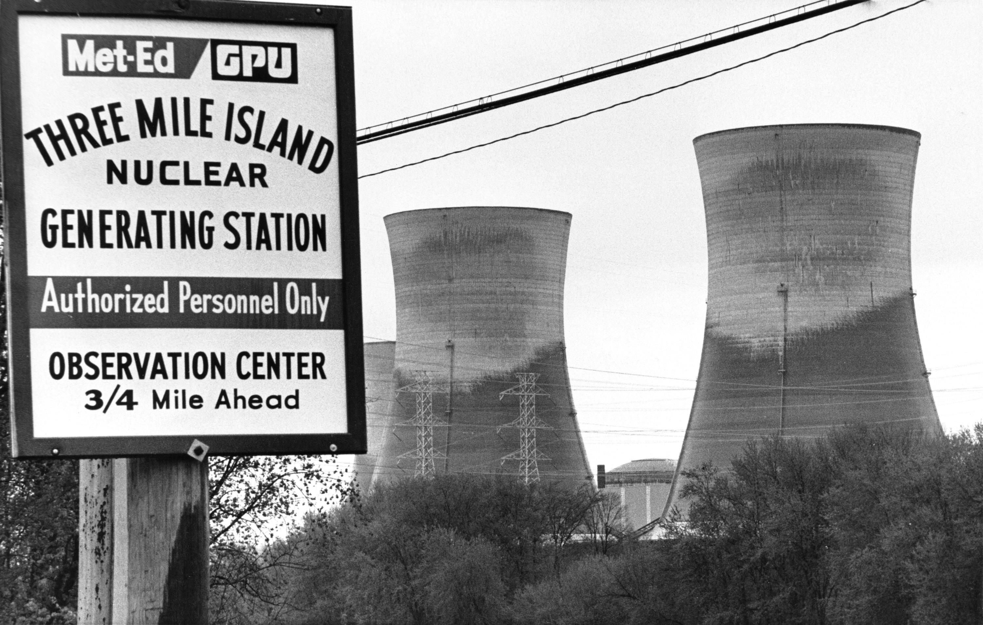
Nuclear power poses small risks
Nuclear power poses the possibility of catastrophic accidents
Spawning public anxiety over nuclear power
Three Mile Island was the most serious accident in the U.S.

Slide 6
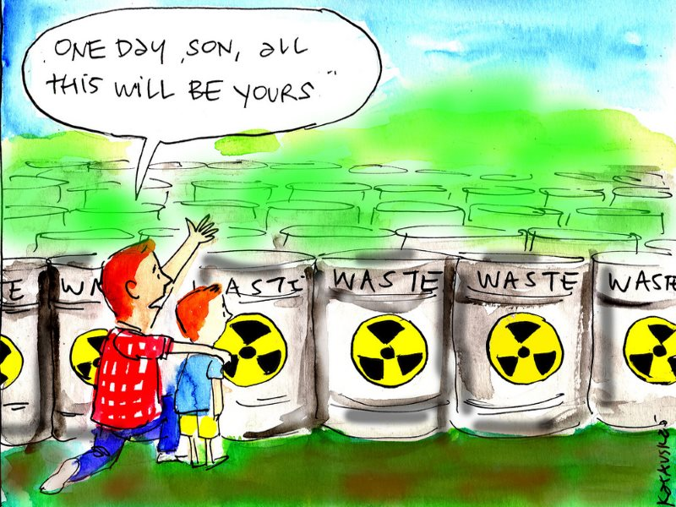
Waste disposal remains a problem
The long half-lives of uranium, plutonium, and other radioisotopes will cause them to continue emitting radiation for thousands of years
Radioactive waste must be placed in unusually stable and secure locations where radioactivity will not harm future generations
Nuclear waste from power generation is being held in temporary storage at nuclear power plants across the U.S. and the world

Slide 7
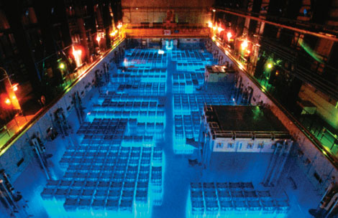
Spent fuel rods must be stored
Spent fuel rods are sunk in pools of cooling water to minimize radiation leakage
By 2010, 75% of U.S. plants will have no room left for this type of storage
They are now expanding their storage capacity by storing waste in thick casks of steel, lead, and concrete

Slide 8
U.S. power plants store tons of waste
U.S. power plants store 56,000 metric tons of high-level radioactive waste, as well as much more low-level radioactive waste
Waste is held at 125 sites in over 39 states
Most of these sites are vulnerable to terrorist attacks
Over 161 million U.S. citizens live within 75 miles of temporarily stored waste

Slide 9
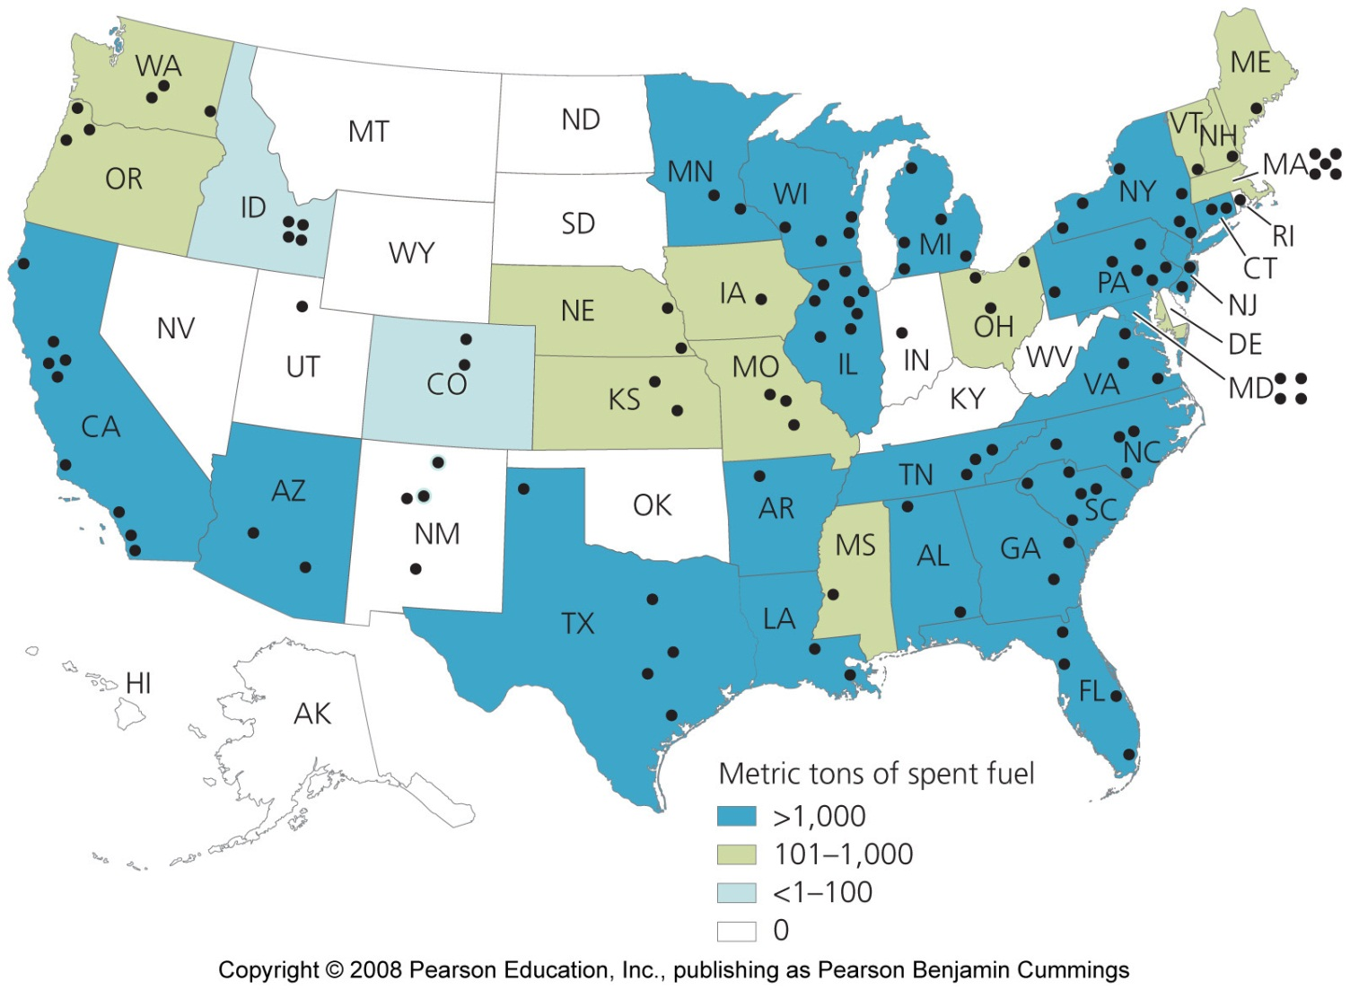
Storage of high-level radioactive waste

Slide 10
Waste storage at Yucca Mountain, Nevada
Nuclear waste managers want to send all waste to a central repository that can be heavily guarded
Yucca Mountain, Nevada, was recommended by the president and approved by Congress
It’s waiting approval from the Nuclear Regulatory Commission to become the site that receives waste from nuclear reactors and military installations

Slide 11
Scientists and policymakers chose Yucca Mountain
It is 14 miles to the nearest year-round residences
It has stable geology, with minimal risk of earthquakes that could damage the tunnels and release radioactivity
Its dry climate should minimize water infiltration, reducing chances of groundwater contamination
The water table is deep underground, making groundwater contamination less likely
The pool of groundwater does not connect with groundwater elsewhere, so any contamination would be contained
The location on federal land can be protected from sabotage

Slide 12
Dilemmas have slowed nuclear power’s growth
It is enormously expensive to build, maintain, operate, and ensure the safety of nuclear facilities
Shutting down (decommissioning) plants can be more expensive than construction
Nuclear power plants in Western Europe will be retired by 2030
Asian nations are increasing nuclear capacity; 15 to 26 plants are under construction

Slide 13
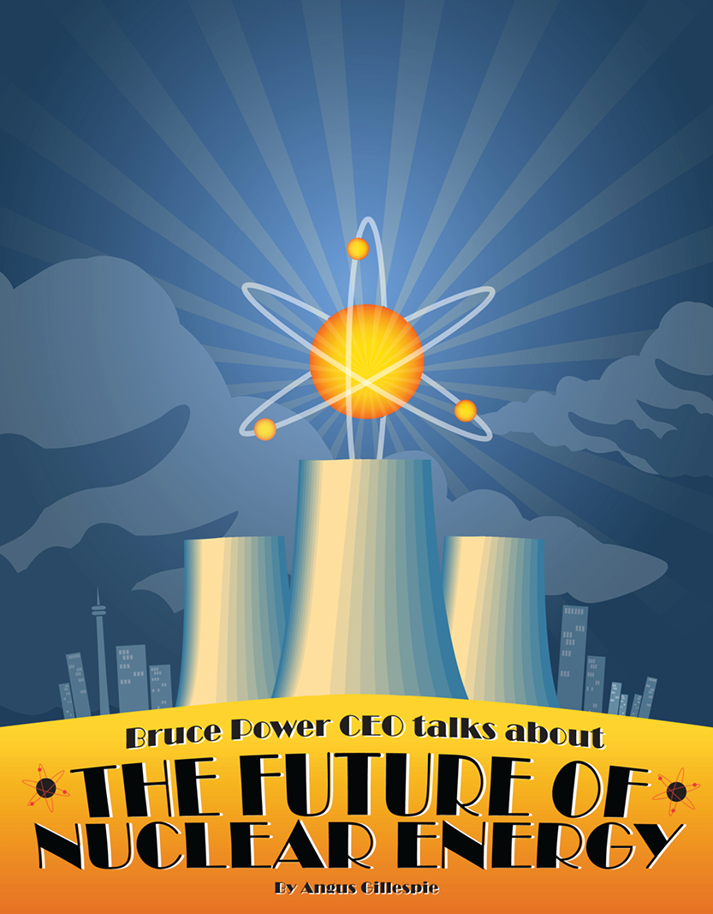
The future of U.S. nuclear energy
The U.S. nuclear industry has stopped building plants
Expanding nuclear capacity would decrease reliance on fossil fuels
Engineers are planning ways to make nuclear power plants safer and less expensive

Slide 14
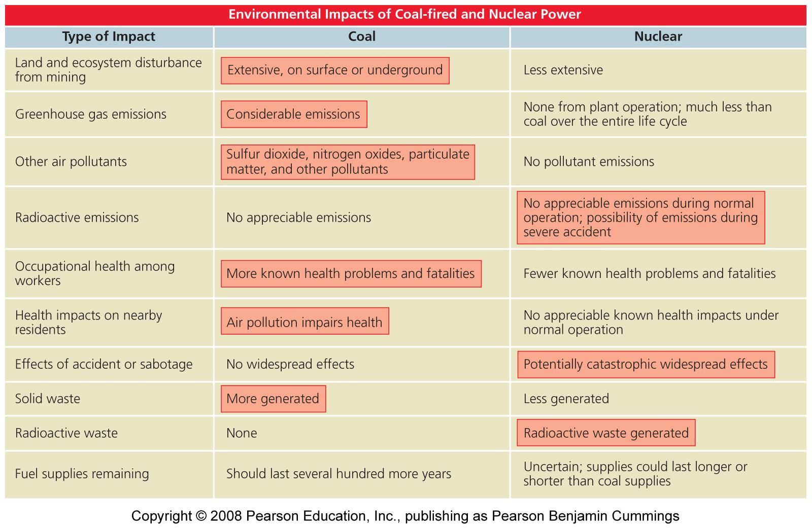
Coal versus nuclear power

Slide 15
Yucca Mountain, Nevada

