Slide 1
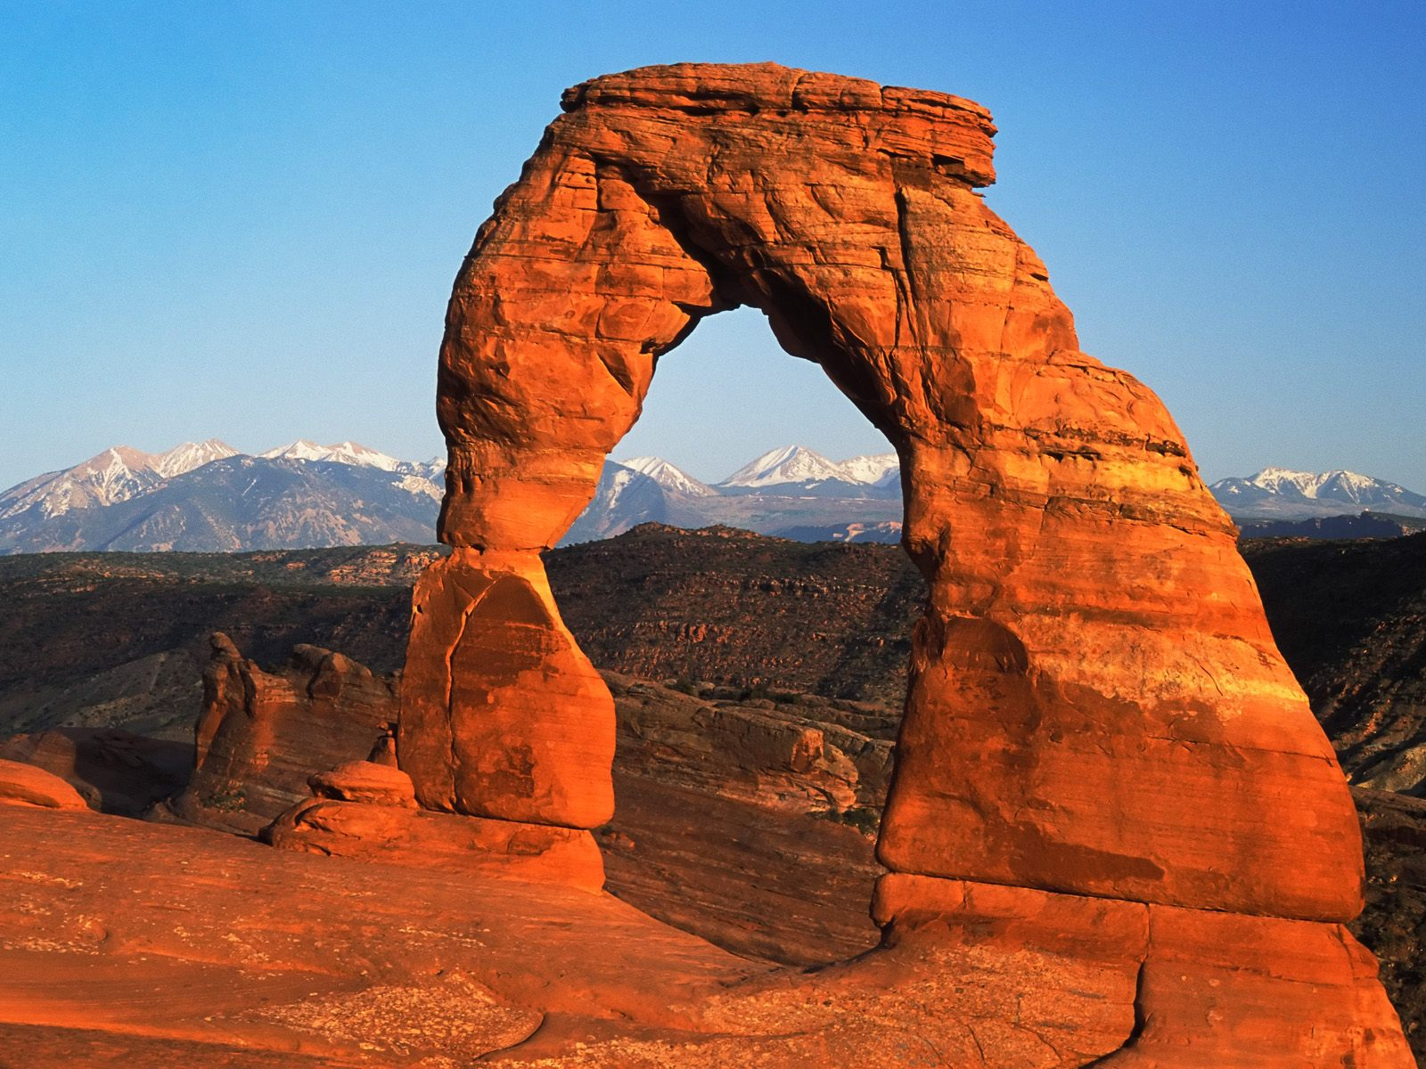
Day 5
Soil Formation
& Erosion
Notes:
Animated picture and caption sweep in
(Basic)
To reproduce the shape effects on this slide, do the following:
On the Home tab, in the Slides group, click Layout, and then click Blank.
On the Home tab, in the Drawing group, click Shapes, and then under Lines click Line (first option from the left).
On the slide, press and hold SHIFT, and then drag to draw a straight, vertical line.
Select the line. Under Drawing Tools, on the Format tab, in the Size group, in the Shape Height box, enter 7.5”.
Also on the Format tab, in the Shape Styles group, click the Format Shape dialog box launcher. In the Format Shape dialog box, click Line Color in the left pane. In the Line Color pane, select Solid line, click the button next to Color, and then under Theme Colors click Black, Text 1 (first row, second option from the left).
Also in the Format Shape dialog box, click Line Style in the left pane. In the Line Style pane, in the Weight box, enter 2 pt.
Also in the Format Shape dialog box, click Glow and Soft Edges in the left pane. In the Glow and Soft Edges pane, do the following:
Under Glow, click the button next to Presets, and then under Glow Variations click Blue, 5 pt glow, Accent color 1 (first row, first option from the left).
Click the button next to Color, and then under Theme Colors click White, Background 1 (first row, first option from the left).
On the Home tab, in the Drawing group, click Arrange, point to Align, and then do the following:
Click Align to Slide.
Click Align Center.
Click Align Middle.
On the slide, select the line. On the Home tab, in the Clipboard group, click the arrow next to Copy, and then click Duplicate.
Drag the duplicate line slightly off the right edge of the slide.
With the duplicate line still selected, on the Home tab, in the Drawing group, click Arrange, point to Align, and then do the following:
Click Align to Slide.
Click Align Middle.
On the Insert tab, in the Images group, click Picture. In the Insert Picture dialog box, select a picture, and then click Insert.
On the slide, select the picture. Under Picture Tools, on the Format tab, in the Size group, click the Size and Position dialog box launcher. In the Format Picture dialog box, resize or crop the image so that the height is set to 7.5” and the width is set to 5”. To crop the picture, click Crop in the left pane, and in the right pane, under Crop position, enter values into the Height, Width, Left, and Top boxes. To resize the picture, click Size in the left pane, and in the right pane, under Size and rotate, enter values into the Height and Width boxes.
On the Home tab, in the Drawing group, click Arrange, point to Align, and then do the following:
Click Align to Slide.
Click Align Right.
Click Align Middle.
To reproduce the text effects on this slide, do the following:
On the Insert tab, in the Text group, click Text Box. On the slide, drag to draw a text box.
Enter text in the text box, and then select the text. On the Home tab, in the Font group, do the following:
In the Font list, select Arial.
In the Font Size list, select 28.
Click Bold.
Click the button next to Font Color, and then under Theme Colors click White, Background 1 (first row, first option from the left).
On the Home tab, in the Paragraph group, click Align Text Right to align the text right in the text box.
Drag the text box onto the left half of the slide.
To reproduce the background effects on this slide, do the following:
On the Design tab, in the Background group, click Background Styles and then click Format Background. In the Format Background dialog box, click Fill in the left pane, select Gradient fill in the Fill pane, and then do the following:
In the Type list, select Linear.
In the Angle box, enter 90.
Under Gradient stops, click Add gradient stops or Remove gradient stops until two stops appear in the slider.
Also under Gradient stops, customize the gradient stops as follows:
Select the first stop in the slider, and then do the following:
In the Position box, enter 40%.
Click the button next to Color, and then under Theme Colors click Black, Text 1 (first row, second option from the left).
In the Transparency box, enter 0%.
Select the next stop in the slider, and then do the following:
In the Position box, enter 100%.
Click the button next to Color, and then under Theme Colors click Black, Text 1, Lighter 50% (second row, second option from the left).
In the Transparency box, enter 0%.
To reproduce the animation effects on this slide, do the following:
Select the line off the right edge of the slide. On the Animations tab, in the Advanced Animation group, click Add Animation, and then under Entrance click Fly In.
Also on the Animations tab, in the Animation group, click Effect Options, and then click From Left.
On the Animations tab, in the Timing group, in the Duration box, enter 0.5.
On the Animations tab, in the Timing group, in the Start list, select After Previous.
Select the line at the center of the slide. On the Animations tab, in the Advanced Animation group, click Add Animation, and then under Entrance click Fly In.
Also on the Animations tab, in the Animation group, click Effect Options, and then click From Right.
On the Animations tab, in the Timing group, in the Duration box, enter 1.
On the Animations tab, in the Timing group, in the Start list, select After Previous.
Select the picture. On the Animations tab, in the Advanced Animation group, click Add Animation, and then under Entrance click Wipe.
Also on the Animations tab, in the Animation group, click Effect Options, and then click From Right.
On the Animations tab, in the Timing group, in the Duration box, enter 1.
On the Animations tab, in the Timing group, in the Start list, select With Previous.
Select the text box. On the Animations tab, in the Advanced Animation group, click Add Animation, and then under Entrance click Fly In.
Also on the Animations tab, in the Animation group, click Effect Options, and then click From Right.
On the Animations tab, in the Timing group, in the Duration box, enter 1.
On the Animations tab, in the Timing group, in the Start list, select With Previous.

Slide 2
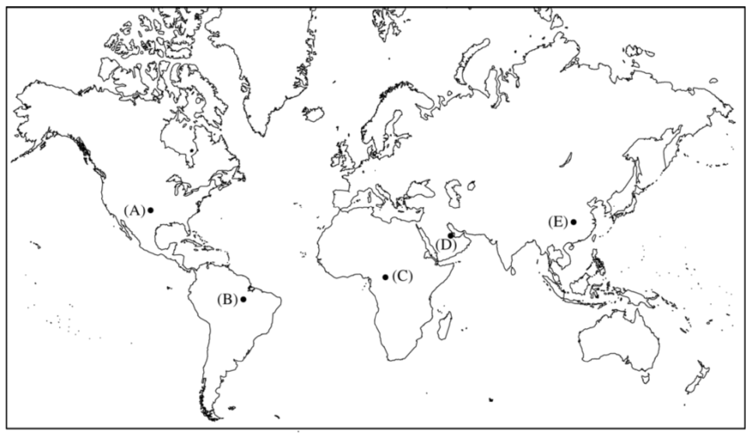
Location likely likely affected by weathering by frost wedging

Slide 3
Location likely likely affected by weathering by sand abrasion

Slide 4
Location likely likely affected by weathering by river abrasion

Slide 5
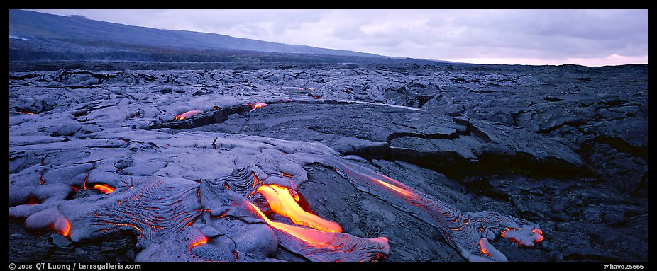
Primary Succession

Slide 6
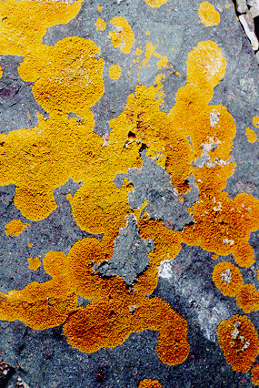
Primary Succession & Soil Formation
Mosses invade an area and cling to exposed rocks.
Provides a surface for soil to begin to collect.
These first species are called pioneer species.

Slide 7
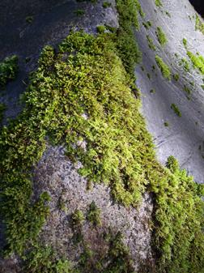
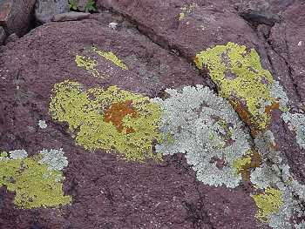
Because they can live just about anywhere, these species are called generalists.

Slide 8
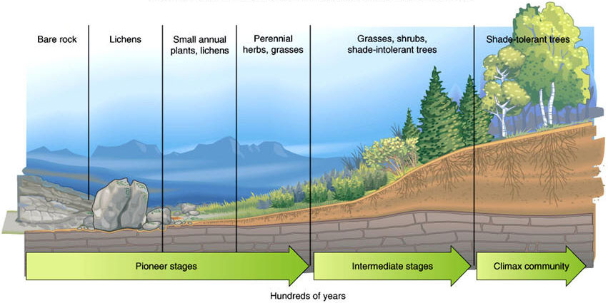
Primary Succession

Slide 9
Primary Succession
Over hundreds of years sediment from weathered rocks builds up a thick layer of soil.

Slide 10
Primary Succession
The final ecosystem is called a climax community.
The climax community is made up of highly adapted species called specialists

Slide 11
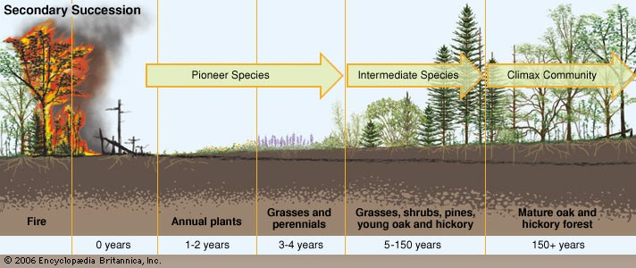
Secondary Succession
Secondary succession is the series of community changes which take place on a previously colonized, but disturbed or damaged habitat.
The final ecosystem is called a climax community.

Slide 13
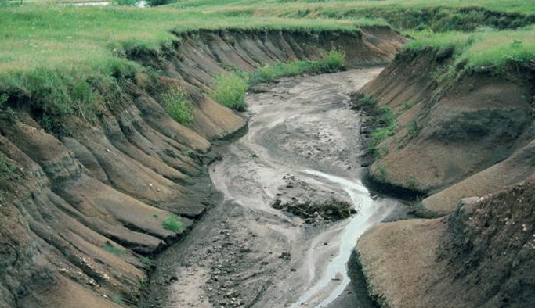
Erosion is the process of carrying sediments and soil away from where they formed.
Agents of erosion
Wind
Water
Ice
Notes:
*

Slide 14
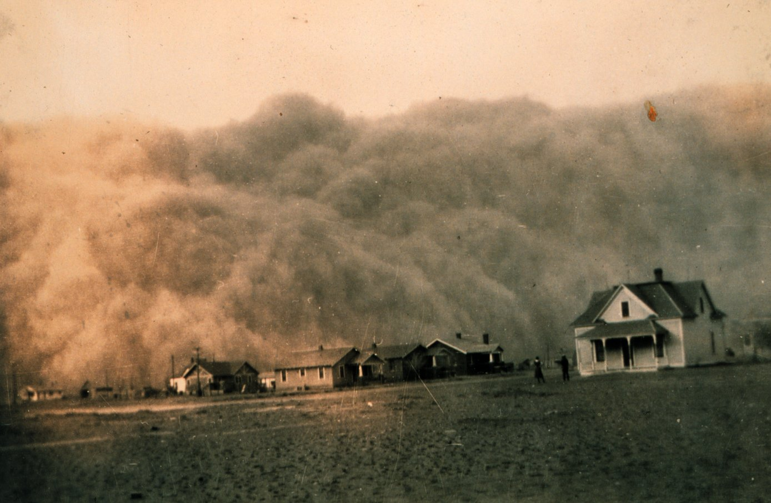
Erosion by wind
Wind picks up and carries loose soil particles.
Mostly in dry climates
Notes:
*

Slide 15
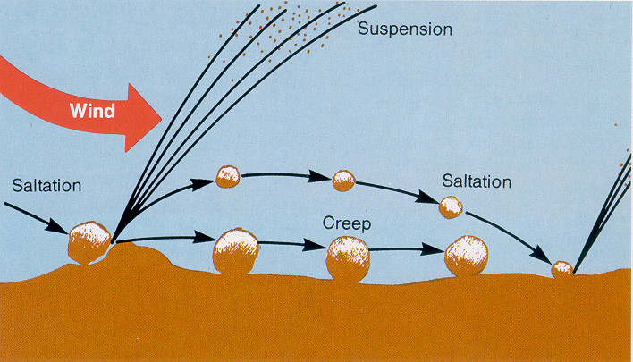
Erosion by wind
Notes:
*

Slide 16
Erosion by water
water can carve deep gullies as it carries soil away.
Notes:
*

Slide 17
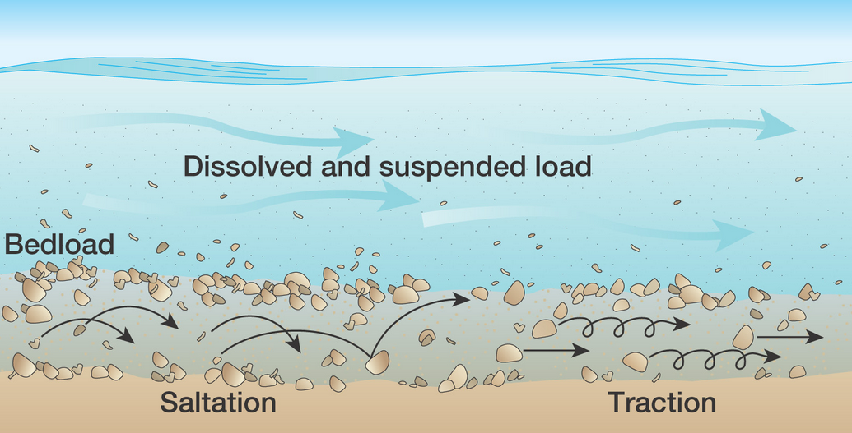
Erosion by water
Notes:
*

Slide 18
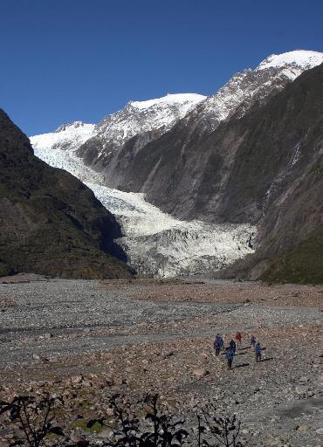
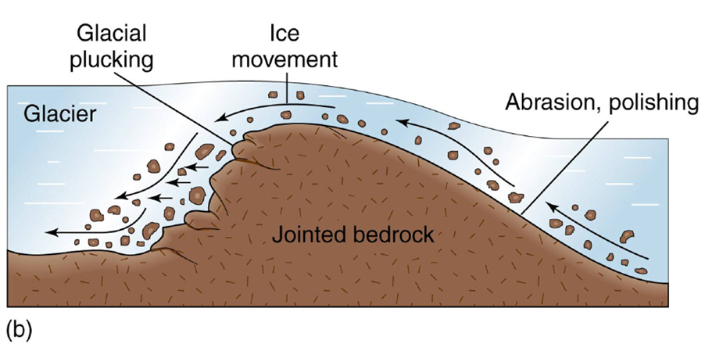
Erosion by Ice
Glaciers can slowly move sediments long distances and carve out deep valleys in mountains.
Notes:
*

Slide 19
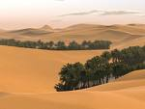
Speed of Erosion
a. Erosion is controlled primarily by trees, grasses and other plants that hold the soil in place.
b. Human activities remove these plants and speed up erosion.
Notes:
*

Slide 20
Extra Info
Zones of a pond or lake Difference between s and P waves Types of volcanoes (cinder cone, composite, shield, spatter cone)

Slide 21
Homework
Find and photograph two examples of erosion outside.

Slide 22
Magma
Exit

Slide 23
Magma
Exit

Slide 24
Magma
Exit

Slide 25
Magma
Exit

