Slide 1
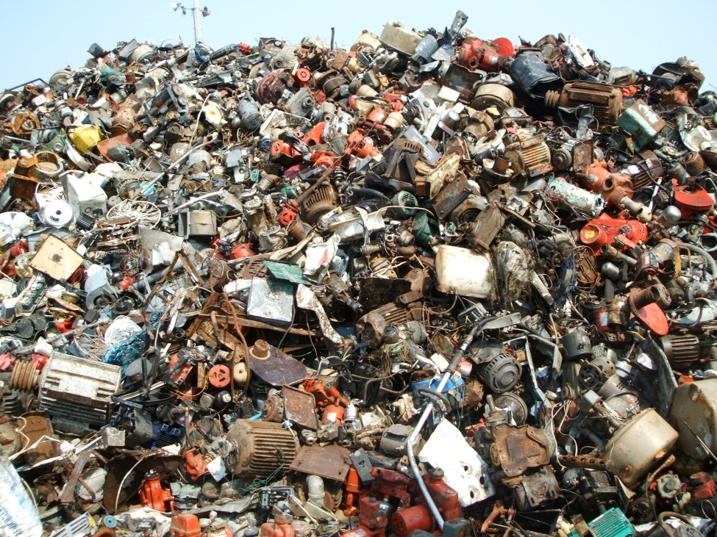
Wasting Resources
United States
4.6% of the world's population
33% of the world's solid waste
75% of its hazardous waste

Slide 2
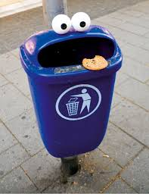
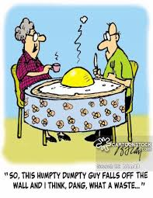
Day 5 Notes Waste & Landfill

Slide 3
Solid Waste
Day 5 Notes Waste & Landfill
98.5% is from Industry
1. Mining
2. Oil and gas production
3. Agriculture
4. Sewage treatment
1.5% is municipal solid waste (MSW)

Slide 4
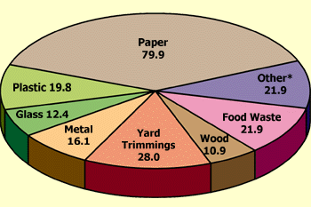
Municipal Solid Waste
MSW—more commonly known as trash or garbage—consists of everyday items
Grass clippings
Furniture
Bottles
Food scraps
Newspapers
Appliances
http://www.epa.gov/epaoswer/non-hw/muncpl/facts.htm

Slide 5
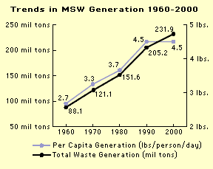

Slide 6
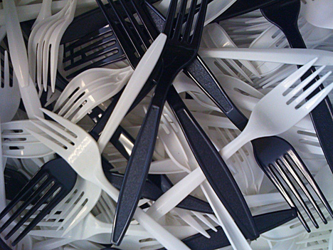
Source Reduction
Source reduction (waste prevention) means consuming and throwing away less
Purchasing durable, long-lasting goods
Seeking products and packaging that are as free of toxins as possible
http://www.epa.gov/epaoswer/non-hw/muncpl/facts.htm

Slide 7
Reuse
Reusing items by repairing them, donating them to charity and community groups, or selling them
Use a product more than once, either for the same purpose or for a different purpose
Reusing, when possible, is preferable to recycling because the item does not need to be reprocessed before it can be used again

Slide 8
Ways to Reuse
Using durable coffee mugs
Using cloth napkins or towels
Refilling bottles
Donating old magazines or surplus equipment
Reusing boxes
Turning empty jars into containers for leftover food
Purchasing refillable pens and pencils
Participating in a paint collection and reuse program

Slide 9
Recycling
Recycling, including composting, diverted 64 million tons of material away from landfills and incinerators in 1999, up from 34 million tons in 1990
Typical materials that are recycled include batteries, recycled at a rate of 96.9%, paper and paperboard at 41.9%, and yard trimmings at 45.3%
These materials and others may be recycled through curbside programs, drop-off centers, buy-back programs, and deposit systems
http://www.epa.gov/epaoswer/non-hw/muncpl/facts.htm

Slide 10
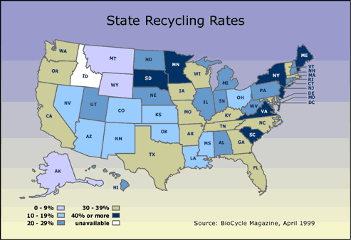
http://www.epa.gov/epaoswer/non-hw/muncpl/mswdata.htm

Slide 11
Benefits
Recycling
Prevents the emission of many greenhouse gases and water pollutants
Saves energy, supplies valuable raw materials to industry
Creates jobs
Stimulates the development of greener technologies
Conserves resources for our children’s future
Reduces the need for new landfills and combustors

Slide 12
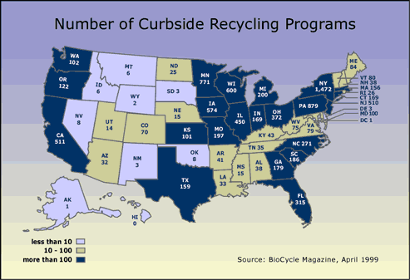
http://www.epa.gov/epaoswer/non-hw/muncpl/mswdata.htm

Slide 13
Composting
Composting is the controlled biological decomposition of organic matter, such as food and yard wastes, into humus, a soil-like material
Composting is nature's way of recycling organic wastes into new soil used in vegetable and flower gardens, landscaping, and many other applications
http://www.epa.gov/epaoswer/non-hw/muncpl/facts.htm

Slide 14
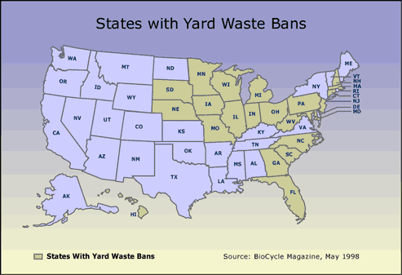
http://www.epa.gov/epaoswer/non-hw/muncpl/mswdata.htm

Slide 15
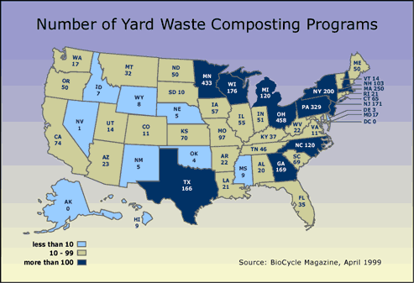
http://www.epa.gov/epaoswer/non-hw/muncpl/mswdata.htm

Slide 16
Benefits
Composting
Keeps organic wastes out of landfills
Provides nutrients to the soil
Increases beneficial soil organisms (e.g., worms and centipedes)
Suppresses certain plant diseases
Reduces the need for fertilizers and pesticides
http://www.epa.gov/epaoswer/non-hw/muncpl/facts.htm

Slide 17
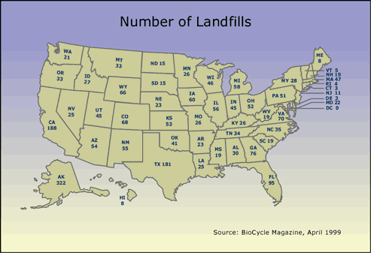

Slide 18
Federal Landfill Standards
Location restrictions ensure that landfills are built in suitable geological areas away from faults, wetlands, floodplains, or other restricted areas
Liners are plastic sheets reinforced with two feet of clay on the bottom and sides of landfills

Slide 19
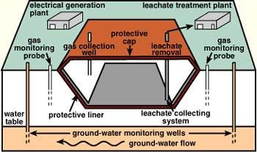
Landfill Design

Slide 20
Federal Landfill Standards
Operating practices such as compacting and covering waste frequently with several inches of soil help reduce odor; control litter, insects, and rodents; and protect public health
Groundwater monitoring requires testing groundwater wells to determine whether waste materials have escaped from the landfill

Slide 21
Federal Landfill Standards
Closure and post-closure care include covering landfills and long-term care of closed landfills
Corrective action controls and cleans up landfill releases and achieves groundwater protection standards

Slide 22
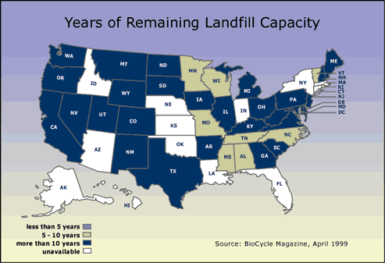

Slide 23
What are 10 disposable items in your home that you could replace with a reusable version?

