Slide 1
Title Notes: Soil Degradation
Copy all the notes in your notebook.
Please do NOT take the notes out of the classroom.
Hmk: Look over both sets of notes. Formative quiz tomorrow. I will put the notes on the website so if you don’t finish, complete them for homework.
I’m in the media center for a planning day. Hope y’all had a great weekend.

Slide 2
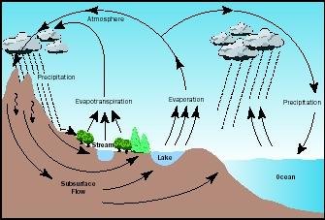
Soil: Absolutely Essential
Soil is a vital part of the natural environment. It influences the distribution of plant species and provides a habitat for a wide range of organisms.
It controls the flow of water and chemicals between the atmosphere and the earth.

Slide 3
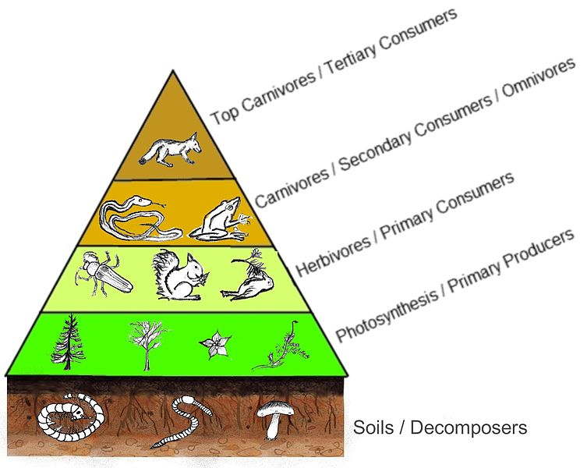
Without it, what would we do?
Soil helps to provide much of the food that humans consume.
Only 25% of the Earth’s surface is made up of soil and only 10% of that soil can be used to grow food.
I.E., without soil, we cannot support primary producers.

Slide 4
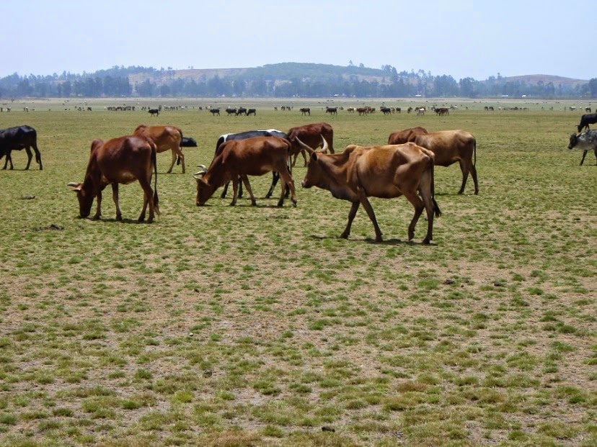
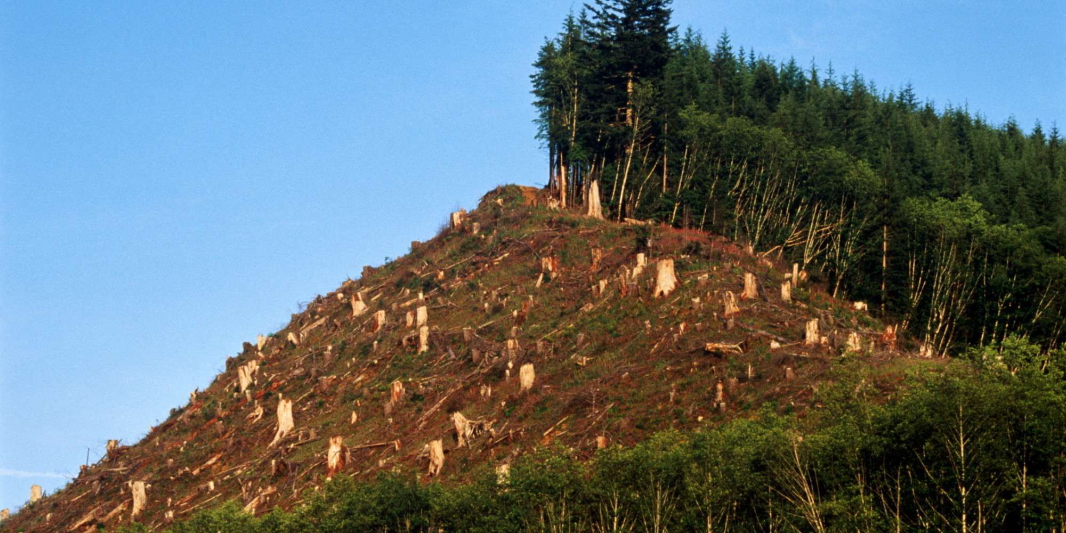
Major Causes of Soil Degradation
Overgrazing 35%
Deforestation 30%
Other Agricultural Activities 27%
Other Causes 8%

Slide 5
Soil Exhaustion
Agricultural systems disrupt natural mineral cycling.
CAUSE:
The soil may become mineral deficient and lose fertility.
Planting the same crop year after year will drain the soil of needed nutrients
PREVENTION
Give soil an “off year” with no planting
Rotate crops planted each year on the same line
Supplement soil with organic material

Slide 6
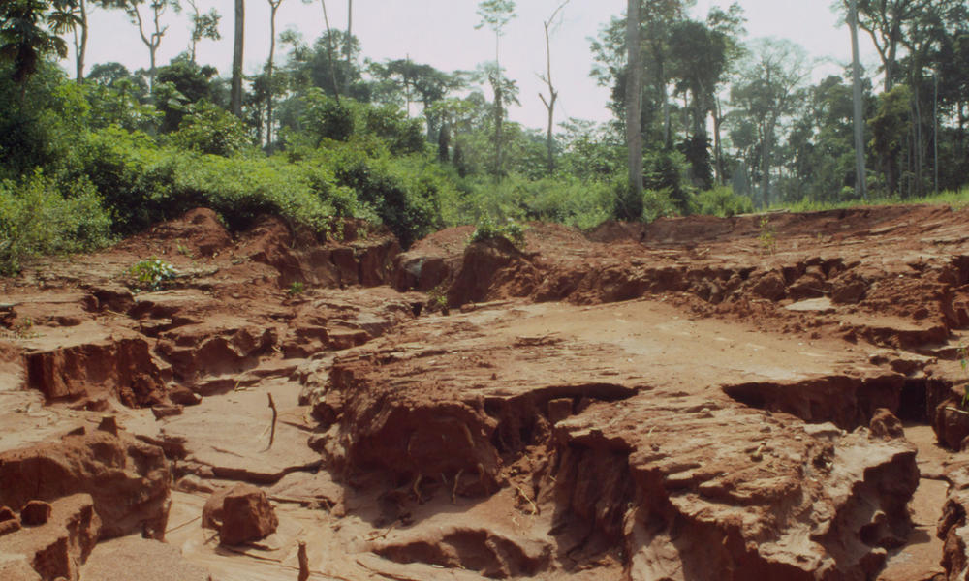
Soil Erosion
The removal of trees that stabilize slopes result in erosion.
Erosion is the removal of the topsoil by physical means.
Deforestation is one of the major causes of soil erosion.

Slide 7
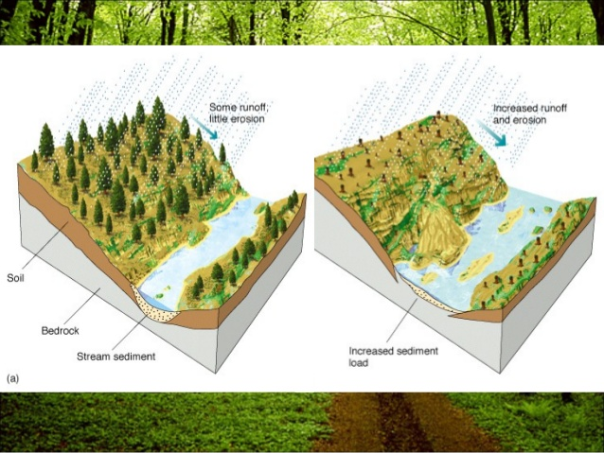
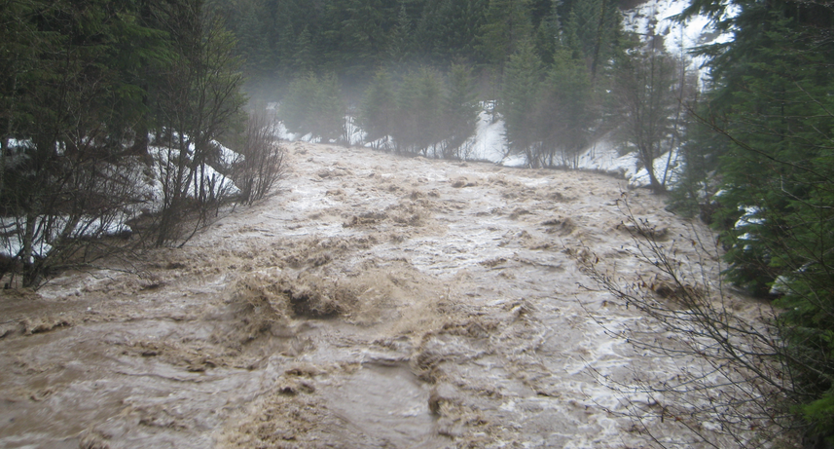
Erosion from flooding
Floodplains and tropical rain forests are areas where there is a lot of erosion.
Climate change leads to more high-rain events and flash flooding.

Slide 8
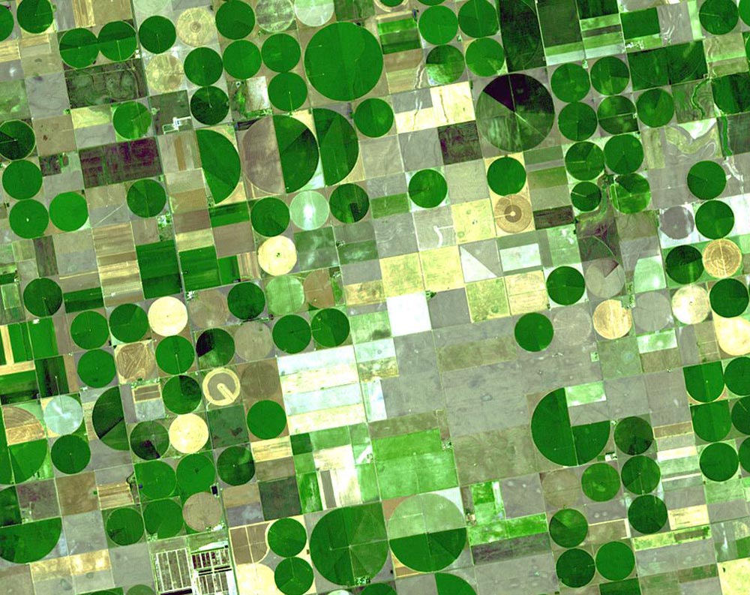
Salinization
Salinization is an increase in salt (ionic compounds) in soil.
groundwater contains tiny amounts of salt.
When this water is used for irrigation, the salt will slowly build up in the soil.
Irrigation of farmland and deforestation has in Western and South Eastern Australia has caused widespread salinization.

Slide 9
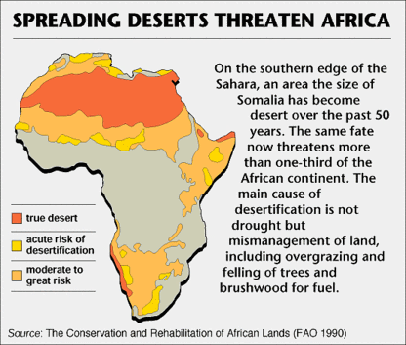
Desertificaion
The conversion of agricultural soils to desert soils.
Overuse of agricultural lands is the cause.
10% of the world’s land has been desertified.
25% is at risk.
In Mali, the Sahara desert has expanded more than 650 km in less than 20 years.

Slide 11
The Laws
The U.S. Soil Conservation Act of 1935 established the Soil Conservation Service.
This agency deals with soil erosion problems and was enacted following the Dust Bowl.
Soil & Water Resources Conservation Act of 1977
This Act provides for a continuing appraisal of U.S. soil, water and related resources, including fish and wildlife habitats, and a soil and water conservation program to assist landowners and land users in furthering soil and water conservation

Slide 12
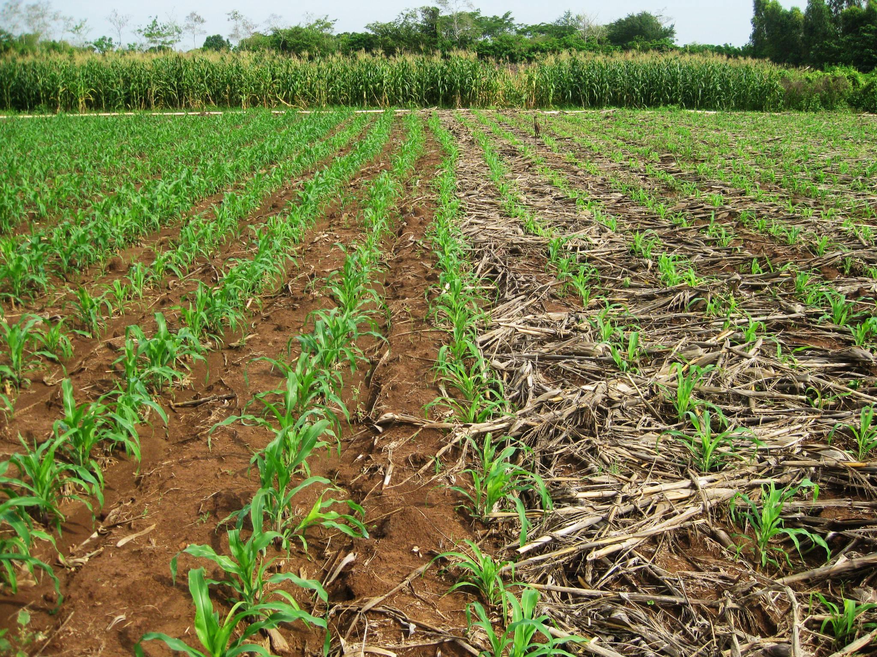
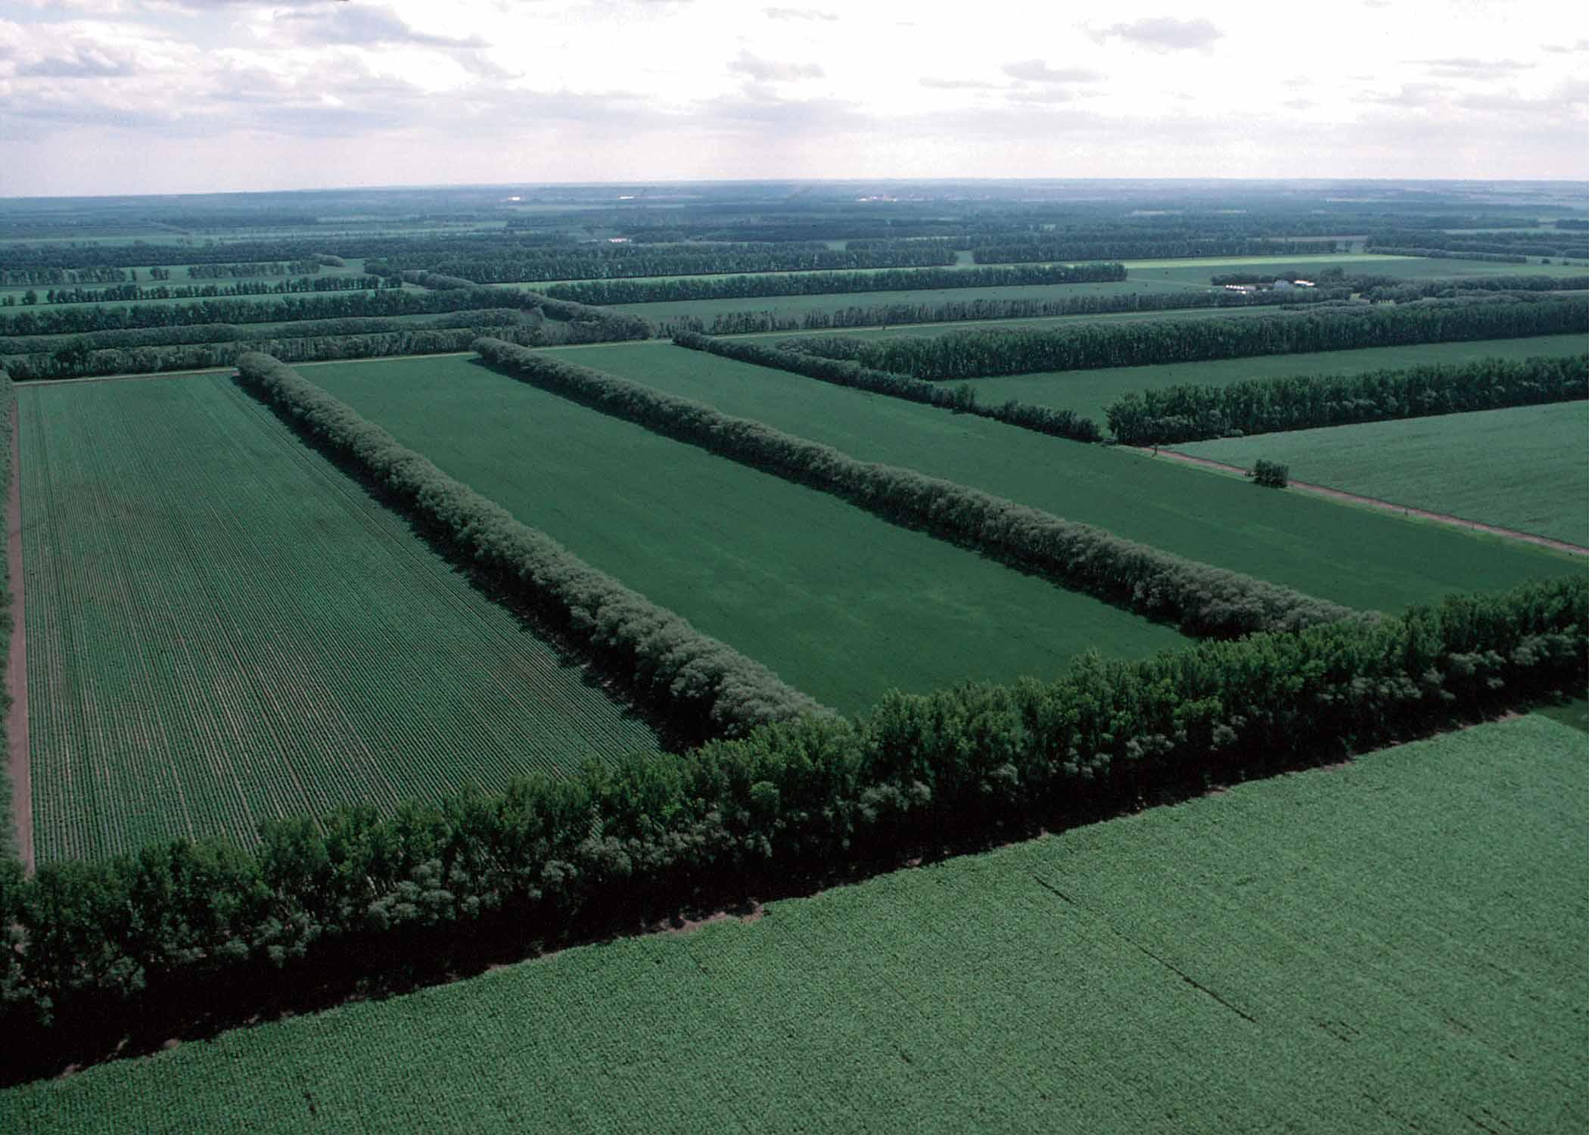
Agricultural Methods
No-till or minimum tillage methods protect the top soil
Shaping of the land decreases runoff
Windbreaks prevent erosion from wind
Crop rotation prevents nutrient depletion

Slide 13
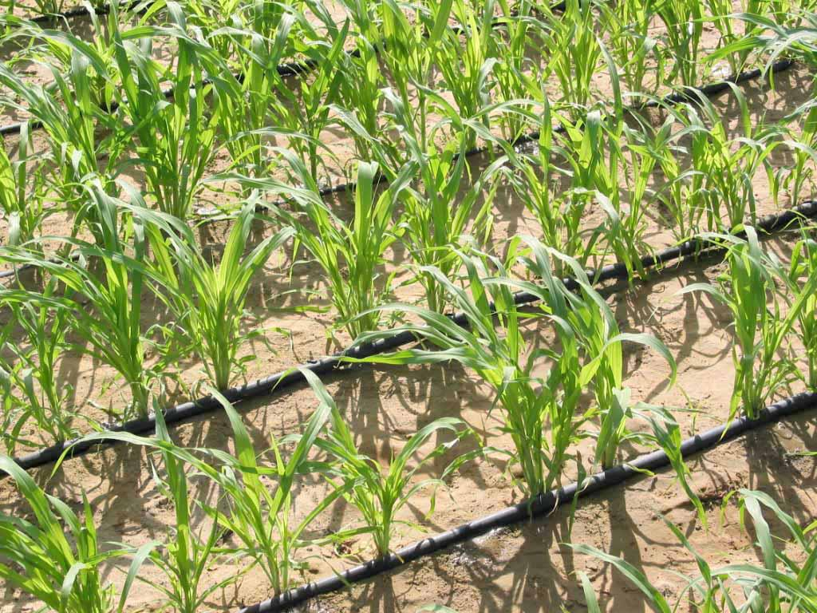
Alternative Irrigation
Drip irrigation methods deliver water directly to the plant which
Reduces water loss through evaporation
Increases crop yield and efficiency
Reduces erosion potential
Protects the top soil

