Slide 1
Soil Tests & Profiles

Slide 2
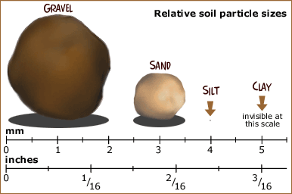
Soil Particles
Most soils have a combination of soil particles sizes
Sand
Silt
Clay

Slide 3
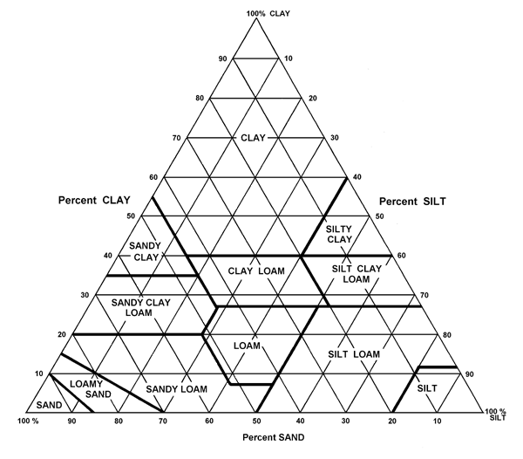
Sand + Silt + Clay = 100%
34 % Sand
Texture =
CLAY LOAM
33 % Silt
33 % Clay
Notes:
*

Slide 4
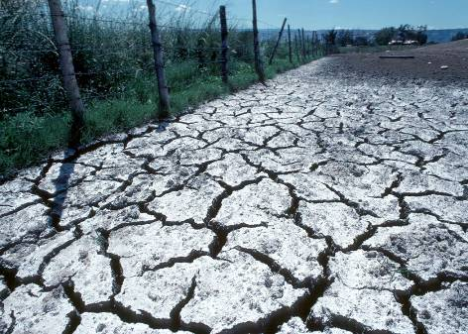
Properties Related to Texture
Porosity
Permeability
Infiltration
Water holding Capacity

Slide 5
General Influence of Soil Particles
Property/Behavior | Sand | Silt | Clay
Water holding | Low | Med-high | high
Aeration | Good | Med | Poor
OM decomposition | Fast | Med | Slow
Water erosion pot. | Low | High | Low
Compact-ability | Low | Med | High
Sealing (ponds) | Poor | Poor | Good
Nutrient supplying | Poor | Med-high | High
Pollutant leaching | High | Med | Low

Slide 6
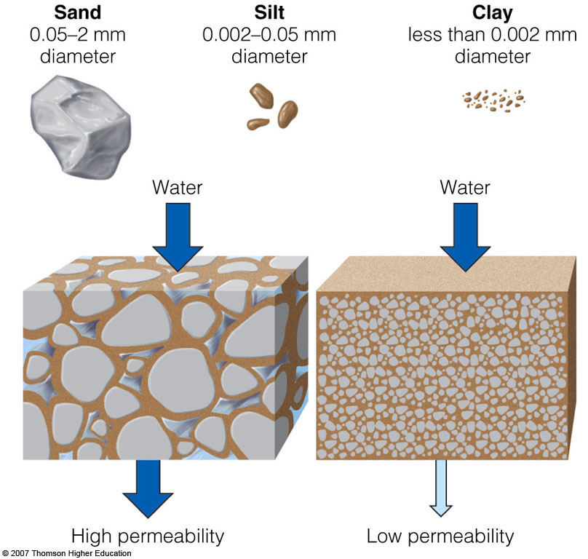
Soil Particles
Soils vary in the size of the particles they contain, the amount of space between these particles, and how rapidly water flows through them.
Notes:
*

Slide 7
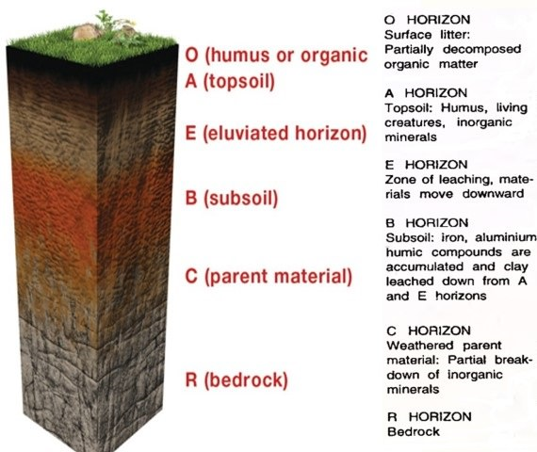
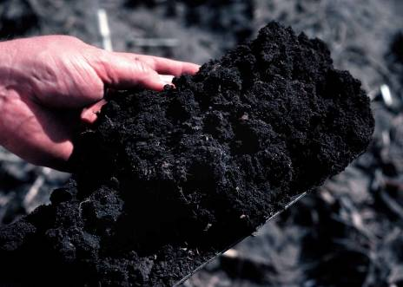
Influences of Soil Properties
Organic Matter is derived from decomposing plant and animal remains
Humus is the dark, moist layer found on the top of a soil profile made up of dead and decaying matter.

Slide 8
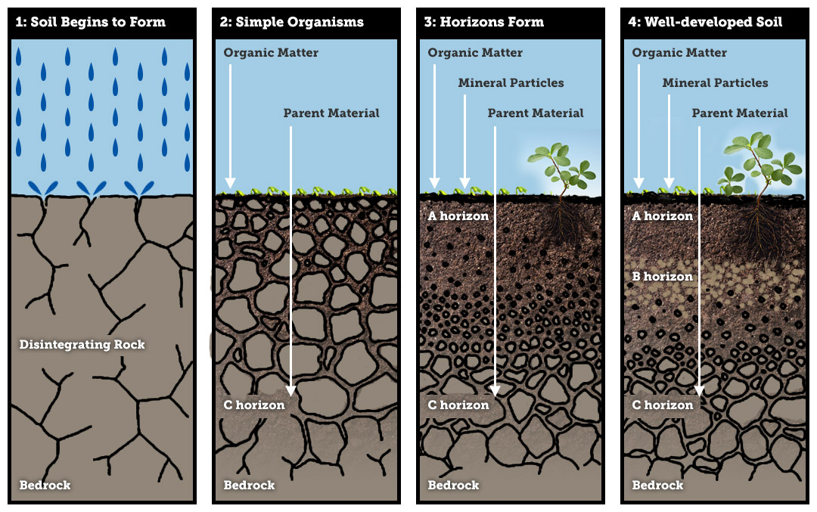
Influences of Soil Properties
Parent Material:
Rock or original source of soil particles
Usually a combination of weathered parent materials and organic matter make a soil

Slide 9
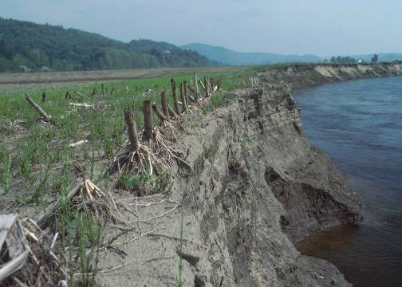
Sources of Parent Material
Weathering or erosive actions:
heating/cooling
freezing/thawing
glaciers
water
wind
chemistry
plants & animals

Slide 10
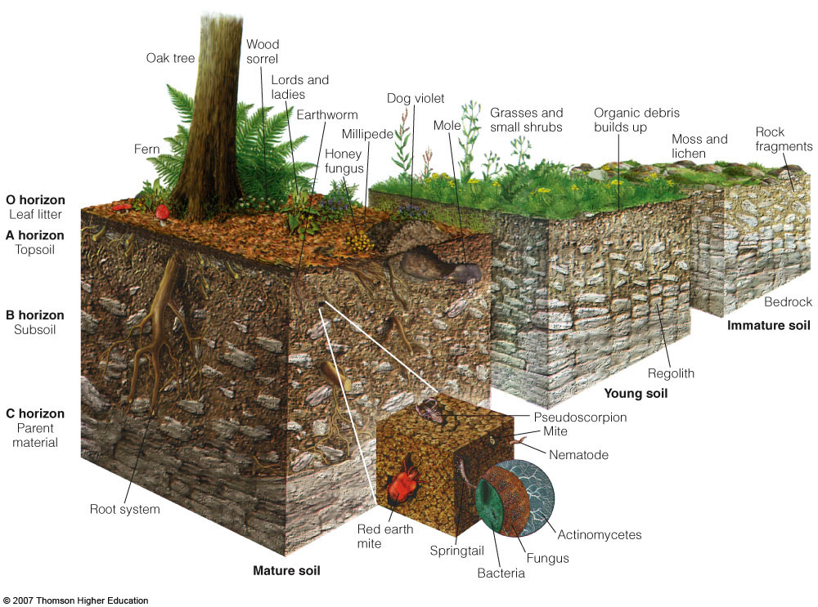
SOIL: Horizons
Notes:
*

Slide 11
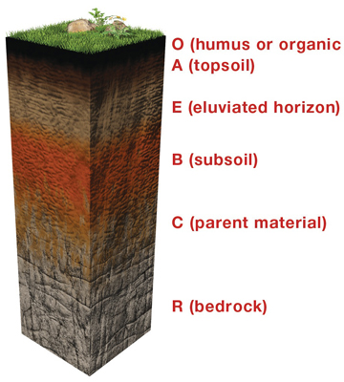
Soil Horizons
O horizon: leaf litter
A horizon: top soil
E horizon: eluviation zone
B horizon: subsoil
C horizon: parent material
Bedrock

Slide 12
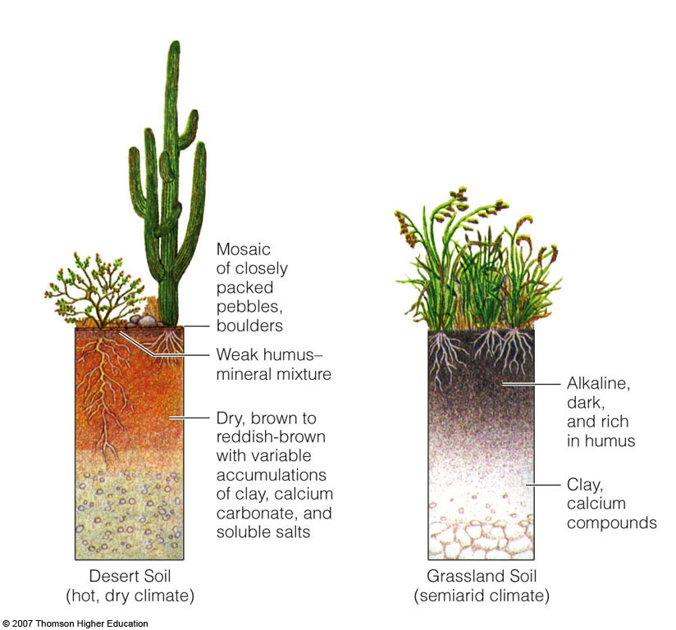
Soil Profiles of the Principal Terrestrial Soil Types
Notes:
*

Slide 13
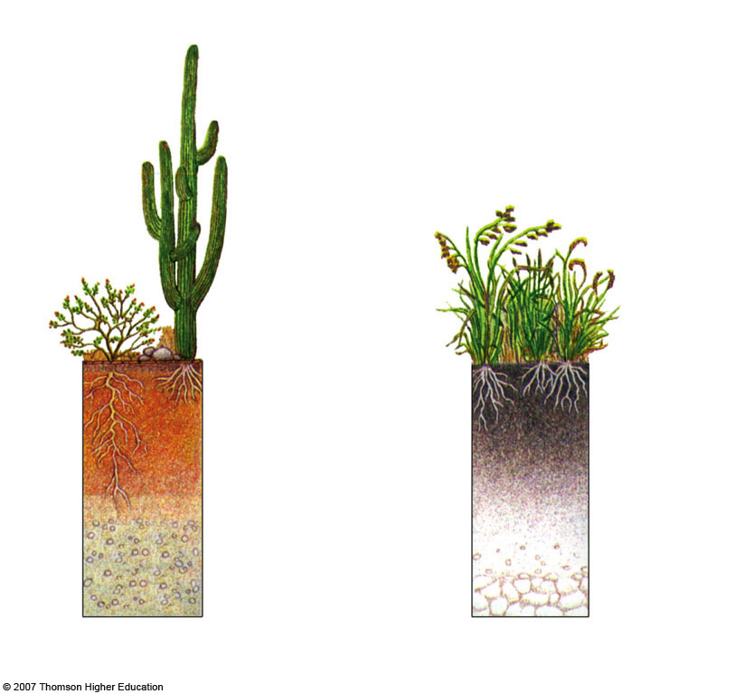
Weak humus- mineral mixture
Alkaline,
dark,
and rich
in humus
Fig. 3-24a, p. 69
Notes:
*

Slide 14
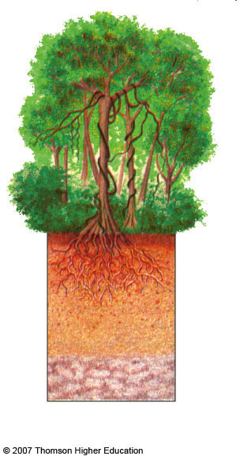
Tropical Rain Forest Soil
(humid, tropical climate)
Acidic
light-colored humus
Fig. 3-24b, p. 69
Notes:
*

Slide 15
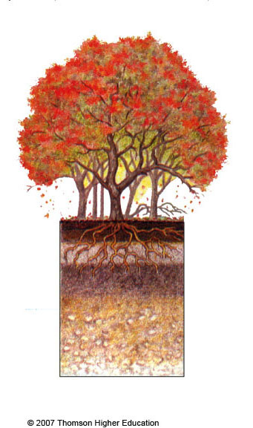
___________________
(humid, mild climate)
Forest litter leaf mold
Thick O-Horizon
Humus-mineral mixture
A-Horizon
Fig. 3-24b, p. 69
Notes:
*

Slide 16
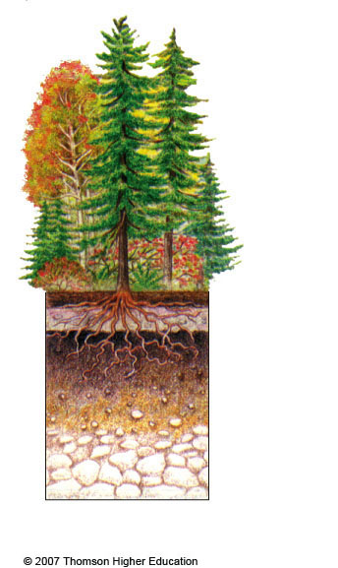
_____________
_______
(humid, cold climate)
Acidic litter and humus
Light-colored topsoil
Fig. 3-24b, p. 69
Notes:
*

