Slide 1
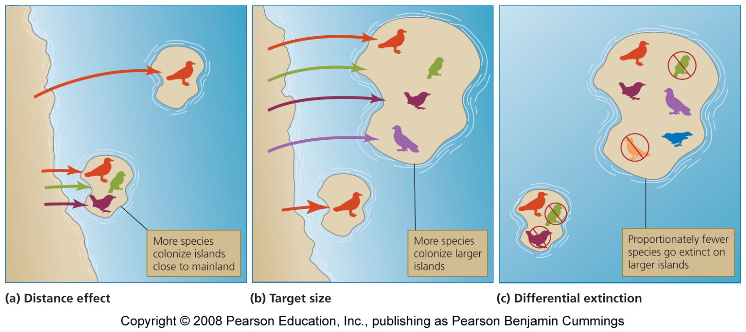
Island biogeography
Equilibrium theory of island biogeography = explains how species come to be distributed among oceanic islands
Fewer species colonize an island far from the mainland
Large islands have higher immigration rates
Large islands have lower extinction rates
Ex: Galapagos Islands

Slide 2
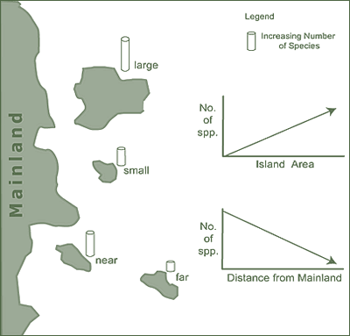
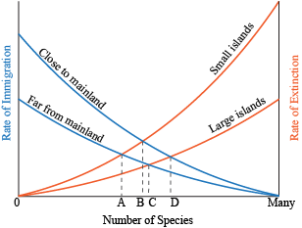
Island Biogeography

Slide 3
Island Biogeography

Slide 4
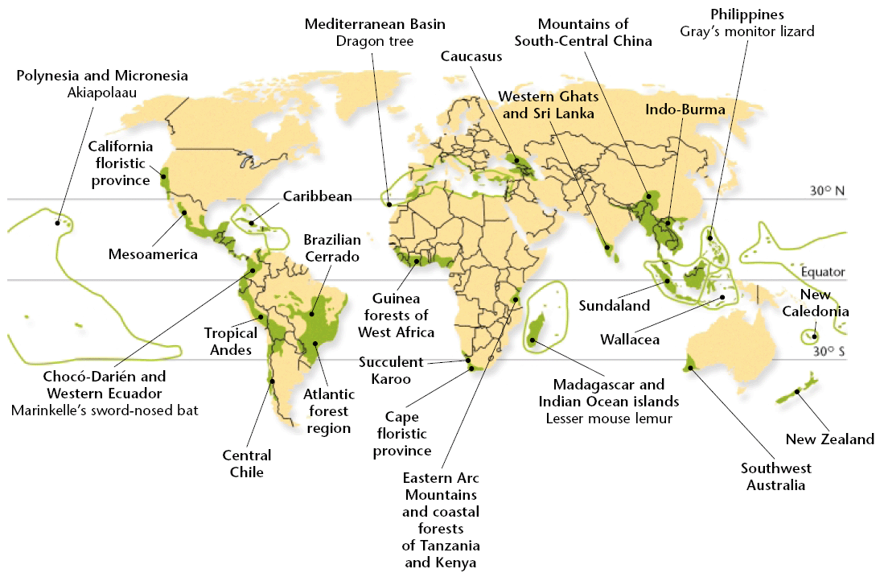
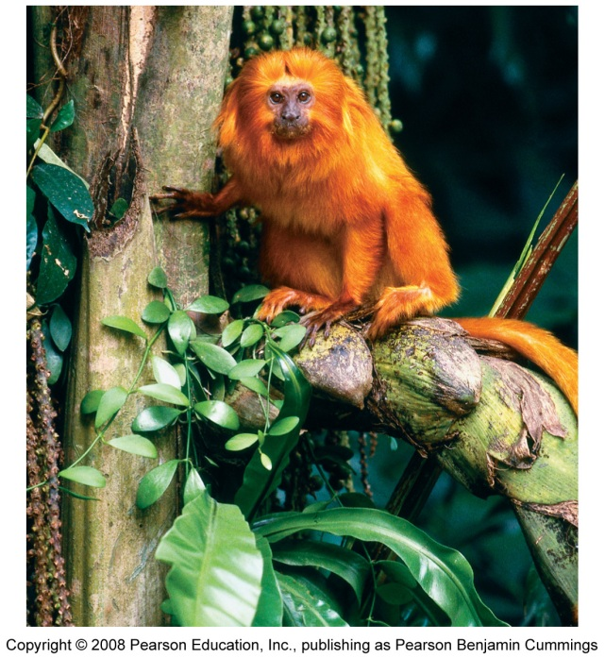
Biodiversity Hotspots
biodiversity hotspots: most threatened areas of high species diversity (tropical rainforests, coastal areas, and islands)
Have high numbers of endemic species & are threatened by humans
Most have lost at least 70 percent of their original natural vegetation

Slide 5
Endangered Species Act (ESA)
The overall goal of the 1973 U.S. Endangered Species Act (ESA) is to identify and protect endangered species in the U.S. and abroad.
The ESA is meant to compliment the international CITES agreement
The U.S. Fish and Wildlife Service determines which species are listed as endangered
The endangered species list contains 600+ animals and 800+ plants

Slide 6
Endangered Species Act (ESA)
One of the world’s most far-reaching and controversial environmental laws:
ESA makes it illegal for Americans to engage in commerce associated with, or hunt / kill / collect, endangered or threatened species.
ESA forbids federal agencies (besides defense department) to carry out or even fund projects that would jeopardize an endangered species.
ESA calls for the development of recovery plans to increase populations
The act also authorizes the government to purchase habitat that is critical to the species.

Slide 7
Endangered Species Act (ESA)
Accomplishments:
More than half of the species listed are stable or improving
99% of all listed species are still living
Challenges:
Very small budget
Species are listed when faced with serious threat of extinction
It can take decades to bring a species’ populations up
Suggested changes to ESA:
Increase the budget
Develop recovery plans more quickly
Establish a core of the endangered organism’s survival habitat

Slide 8
Convention on International Trade in Endangered Species (CITES)
The 1973 Convention on International Trade of Endangered Species (CITES)
Protects wildlife against over-exploitation, and prevents international trade from threatening species with extinction.
Signed by 172 countries
Enforcement is difficult
Probably only 10% of illegal trade in the U.S. is caught
Red List: Lists hundreds of species that cannot be commercially traded as live specimens or wildlife products.

