Slide 1
Carbon Cycle
Natural Geochemical Cycles

Slide 2
Journey of a Carbon Atom

Slide 3
Matter Cycles in Ecosystems
Biogeochemical cycles
1. Carbon
2. Water/hydrologic
Driven primarily by solar energy (evaporation) & gravity (precipitation)
3. Nitrogen (five-step cycle)
4. Sulfur
5. Phosphorous

Slide 4
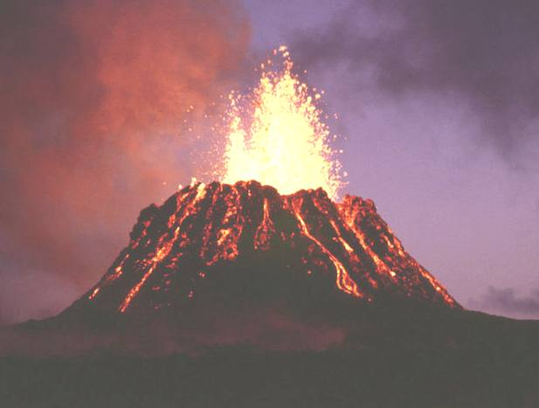
Carbon Dioxide
a. CO₂ = 0.036% of the atmosphere
b. Easily dissolved in H₂O
c. CO₂ enters the atmosphere by burning fossil fuels, aerobic respiration and volcanic activity
d. CO₂ is a heat-trapping gas, and an important part of regulating global temperatures
e. More CO₂ = higher temperatures with the greenhouse effect

Slide 5
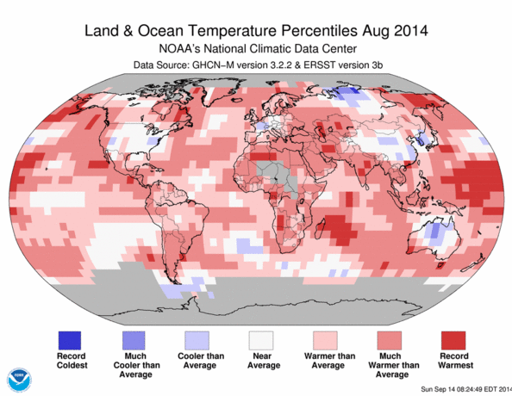
How much warmer...

Slide 6
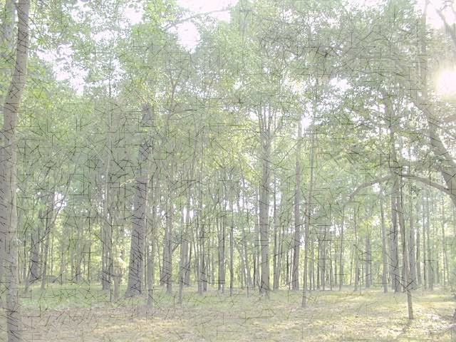
The Carbon Cycle
Cycles closely between plants and animals.
Aerobic respiration:
C₆H₁₂O₆ + 6O₂ → 6 CO₂ + 6H₂O
Photosynthesis:
6CO₂ + 6H₂O + light energy → C₆H₁₂O₆ + 6O₂
Notes:
*

Slide 7
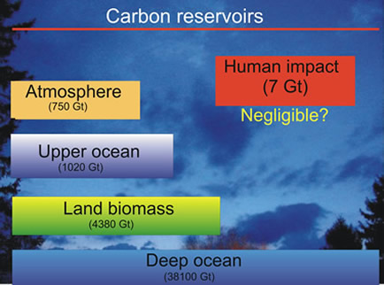
Carbon Dioxide Reservoirs
Carbon dioxide is stored on the planet.
The short term carbon storage units are the atmosphere, soils, & oceans
Atmosphere
(3 years)
Soils (25-30 years)
Oceans
(up to 1500 years )
Notes:
*

Slide 8
Carbon Dioxide Reservoirs
The long term carbon storage units sequester CO₂ for thousands or millions of years
1. Limestone and other sedimentary rocks
2. Limestone on the ocean floor
The source of limestone includes marine organisms that make shells and skeletons out of CaCO₃ (water reacting with CO₂)
3. Fossil Fuels
As plants and animals die and are burried the carbon in their bodies is trapped beneath the ground and converted into coal, oil, and natural gas.
Notes:
*

Slide 9
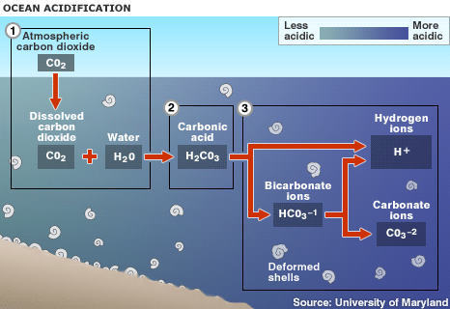
Carbon Dioxide & the Oceans
When oceans take in CO₂…
Some CO₂ stays dissolved in sea water which causes ocean acidification

Slide 10
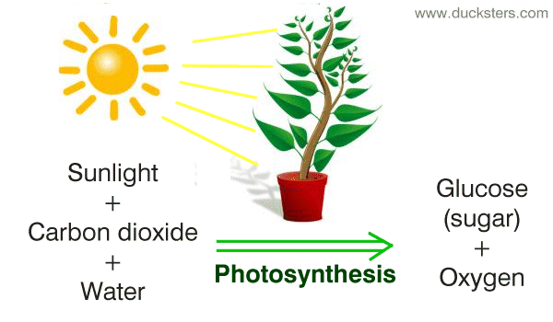
Carbon Dioxide & the Oceans
When oceans take in CO₂…
Some is removed by photosynthesis (plants, algae and phytoplankton)

Slide 11
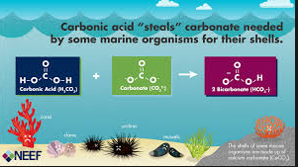
Carbon Dioxide & the Oceans
When oceans take in CO₂…
Some reacts with sea water to form CaCO₃ in shells and corals.

Slide 12
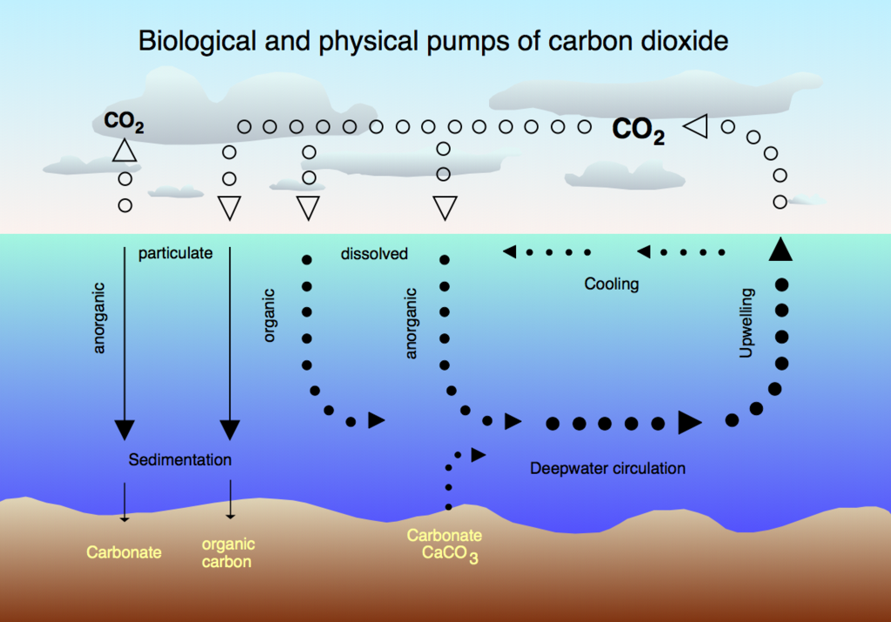

Slide 13
Chemistry Review...
Gases dissolve better in cool liquids…
Gases will leave warm liquids and go into the air…
Think about that warm flat soda...

Slide 14
Carbon Dioxide & the Oceans
Global warming heats the oceans...
Increasing the rate of global warming...
POSITIVE
FEEDBACK
Oceans lose CO₂ to the air...
Extra CO₂ in the air traps heat from the sun...

Slide 15
Carbon Dioxide & the Oceans
Increasing amounts of CO₂ in the oceans, which causes acidification of the oceans
H₂O + CO₂ --> H₂CO₃ (carbonic acid)
Acidification negatively impacts corals, mussels, and other marine organisms by dissolving the shells they live in.

Slide 16
Significant Human Interventions
Two major activities that lead to increasing levels of CO₂ in the atmosphere
1. Vegetation removal/deforestation
2. Fossil fuel and wood burning
Reason for concern:
1. Altered global food production due to shifting climate belts
2. Altered wildlife habitat due to changes in temperature and precipitation (e.g., loss of Arctic sea ice)
3. Altered species interactions (e.g., bird and insect births)
4. Rise in sea levels due to melting ice and thermal expansion of water
Notes:
*

