Slide 1
Water Pollution

Slide 2
Water Pollution Types
Pathogens/Sewage
Organic Wastes
Inorganic Chemicals
Sediments
Nutrients
Thermal
Oil Spills
Radioactive

Slide 3
Pathogens Carried by Sewage
Disease-causing agents
Safety measures
Purification of public water supply
Sanitary collection/treat-ment of sewage
Sanitary practices when processing food

Slide 4
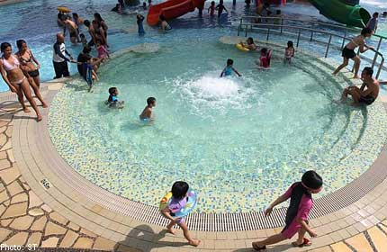
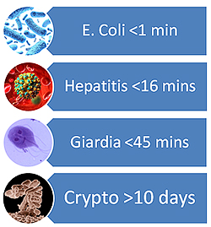
Infectious Agents:
scientists monitor water quality by using bacterial counts, chemical analysis, and indicator organisms
number of colonies of fecal coliform bacteria present in a water sample
drinking water: 0 colonies/100 mL
swimming water: < 200 colonies/100 mL

Slide 5
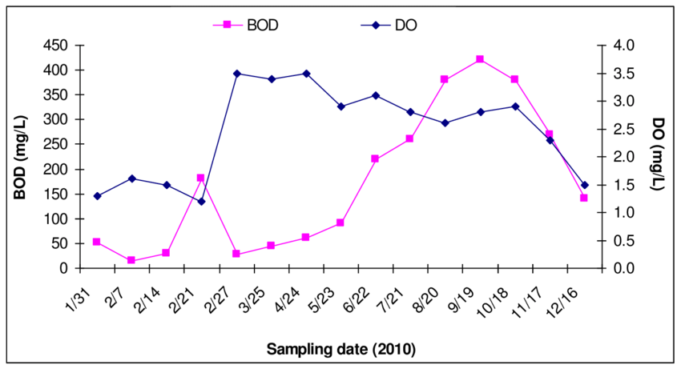
Organic Wastes
Dissolved oxygen (DO) in the water is depleted during decomposition of organic wastes.
Water quality test:
Biochemical oxygen demand (BOD): measure of the amount of organic material.

Slide 6
Chemical Pollutants
Inorganic chemicals
Heavy metals, acids, road salts
Organic chemicals
Petroleum, pesticides, detergents

Slide 7
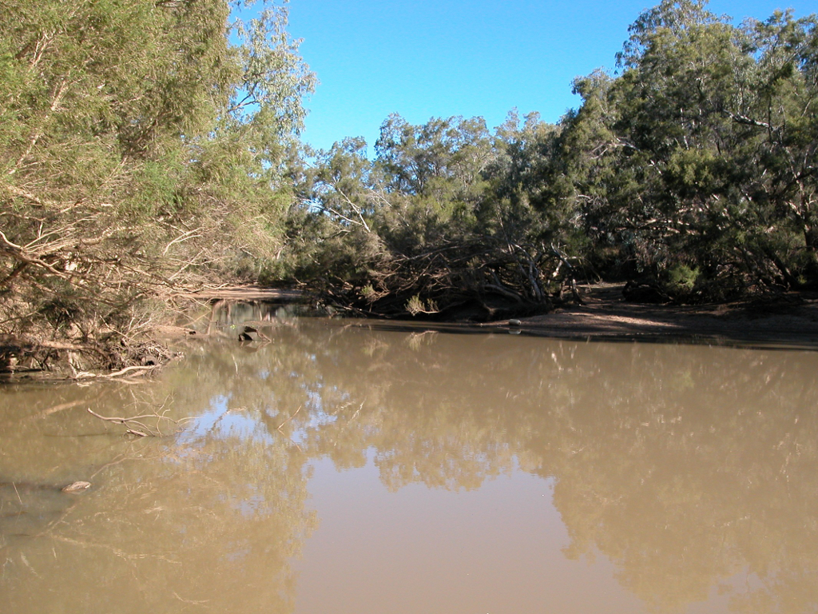
Effect of Sediments on Streams
Loss of hiding/resting places for small fish
Attached aquatic organisms scoured from the rocks and sand
Poor light penetration
(increased turbidity)

Slide 8
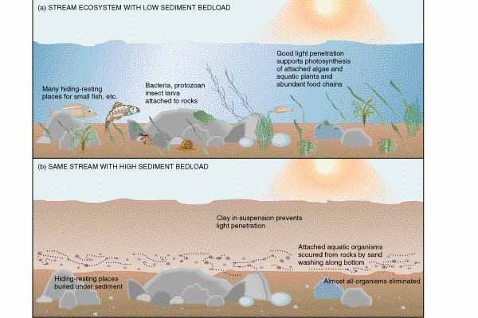

Slide 9
Different Kinds of Aquatic Plants
Benthic plants
Plants rooted underwater
May stick out of the water or be completely submerged
Phytoplankton
Algae & free floating plants
May be single celled or long filaments

Slide 11
The Impacts of Nutrient Enrichment
Oligotrophic: nutrient-poor water
Mostly benthic plants
Eutrophic: nutrient-rich water
Mostly phytoplankton

Slide 13
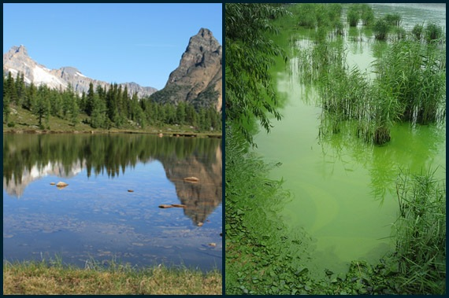
Eutrophication
As nutrients are added from pollution, an oligotrophic condition rapidly becomes eutrophic.
Oligotrophic
Eutrophic

Slide 14
Eutrophic or Oligotrophic?
High dissolved O₂
Deep light penetration
High phytoplankton
Turbid waters
High species diversity
Good recreational qualities
High detritus decomposition

Slide 15
Eutrophic or Oligotrophic?
Low bacteria decomposition
Benthic plants
Warm water
High nutrient concentration
High BOD
High sediments

Slide 16
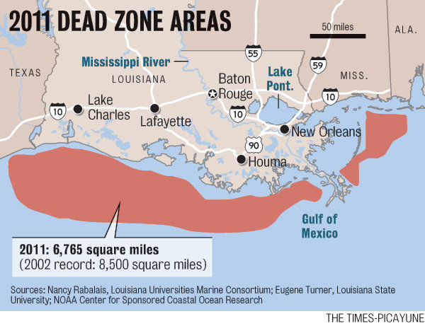
Combating Eutrophication
Attack the symptoms
Chemical treatment
Aeration
Harvesting aquatic weeds
Drawing water down
Getting at root cause
Controlling point sources
Controlling non-point sources

Slide 17
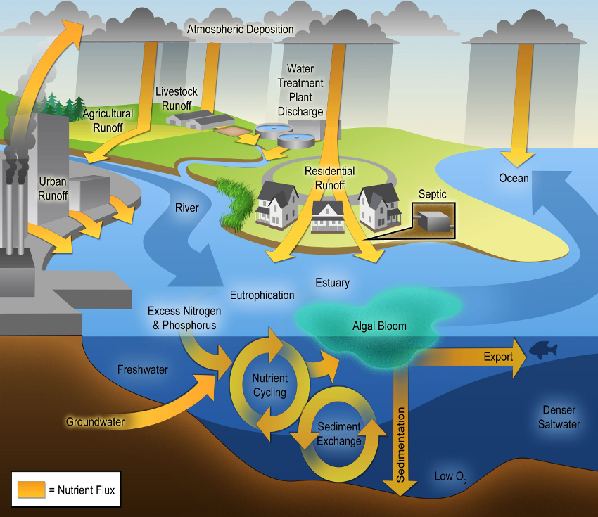

Slide 18
Thermal Pollution: Causes decrease in DO
Coal Powerplants: Heats water to steam to turn turbines then uses cooling tower to condense water. Water is 10ºC hotter when put back into the lake.
Urban Stormwater Runoff: Surfaces like parking lots and sidewalks heat up. When it rains, water absorbs heat and is put into bodies of water
Deforestation: Forests & vegetation reflect back & absorb sun’s heat. Deforestation leaves the water sources directly exposed to sunlight!

Slide 19
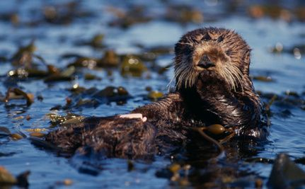
Oil Spills
Can clog the blowholes of whales & dolphins so that they can’t breathe or communicate
Coats the fur of otters and seals which can cause hypothermia
When it washes into coastal marshes, mangrove forests or other wetlands, it damages the plants & makes area unsuitable for wildlife

Slide 20
Radioactive
Relates to Thermal Pollution
Water is used to cool the control rods. Warm water is put back into lake which causes dissolved oxygen to decrease.

Slide 21
Homework
Research a case of eutrophication.
Include:
Source of the pollution
Area (size) affected
Map showing the location
Pictures of the problem
How was it solved

Slide 22
Slide Title
Make Effective Presentations
Using Awesome Backgrounds
Engage your Audience
Capture Audience Attention

Slide 23
Slide Title
Make Effective Presentations
Using Awesome Backgrounds
Engage your Audience
Capture Audience Attention

Slide 24
Slide Title
Product A
Product B
Feature 1
Feature 2
Feature 3
Feature 1
Feature 2
Feature 3

