Slide 1
Water Pollution
Day 3: Source & Impacts

Slide 2
Water Pollution Source

Slide 3
Point Sources
Source can be identified and corrected.
Factory & Sewage Outlets
Mining drainage
Leaking chemical tanks
Broken pipes

Slide 4
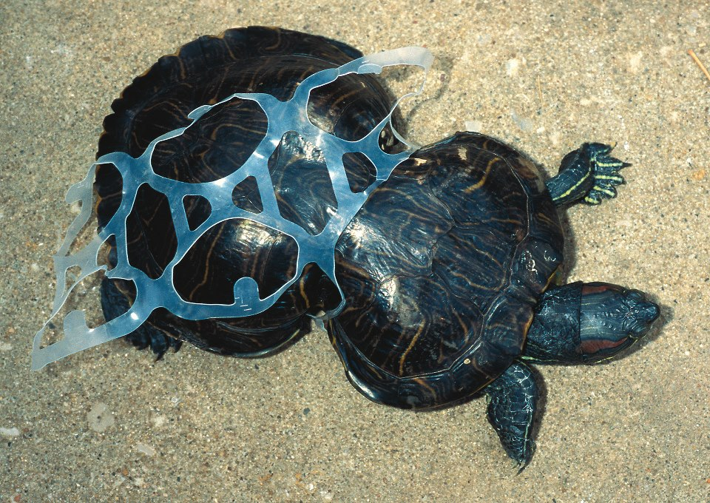
Non-point Sources
Source cannot be narrowed to one responsible person, business, or industry.
Difficult to address runoff pollutants
Urban roads
Agricultural fields
Deforested woodlands
Overgrazed pastures

Slide 5
Controlling Non-point Sources
Best Management Practices (BMP):
Agriculture
Less fertilizer, improve tillage, rotate crops, less chemicals
Construction
Limit it, act to prevent soil erosion
Urban
Use porous pavements, control runoff, street sweeping

Slide 6
Using Insects to Study Stream Health
A sample of stream insects, or macroinvertebrates is collected, identified and counted.
Sensitive invertebrates are killed by low pollution
Tolerant invertebrates are killed by medium pollution
Very tolerant invertebrates are just hard to kill at all.

Slide 7
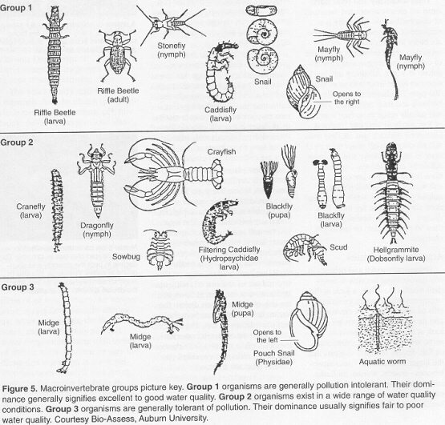

Slide 8
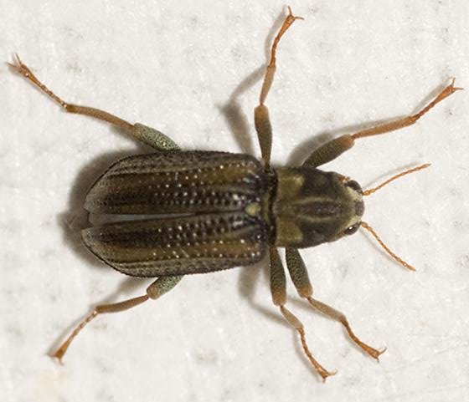
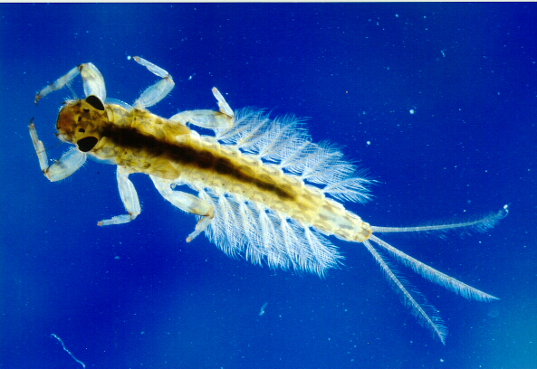
Sensitive Invertebrates
Riffle Beetle
Mayfly Larva

Slide 9
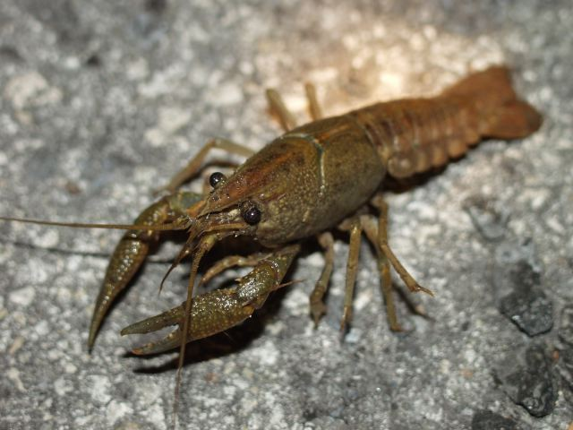
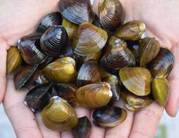
Tolerant Species
Crayfish
Clams

Slide 10
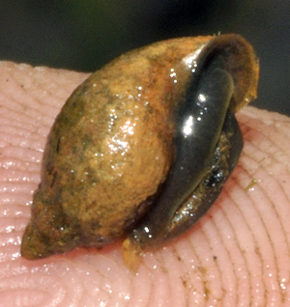
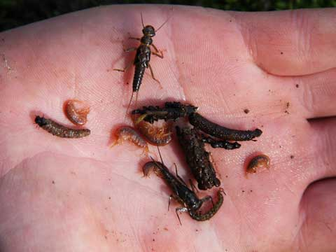
Very tolerant species
Pouch Snail
Midge Larva

Slide 11
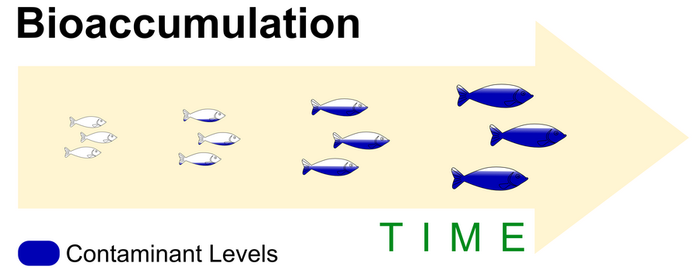
Bioaccumulation
Toxins are absorbed into animals and build up over time in fatty tissue.

Slide 12
Biomagnification
Build up as organisms consume contaminated food.

Slide 13
Case Study: Silent Springs DDT
History of DDT:
DDT a synthetic pesticide invented in 1874
Used with great success in World War II to control mosquitoes and prevent malaria and typhus
After the war, DDT was made available for use as an agricultural insecticide, and soon its production and use skyrocketed.
1948 - Swiss chemist Paul Hermann Müller was awarded the Nobel Prize in Physiology or Medicine "for his discovery of the high efficiency of DDT as a contact poison against several arthropods.“

Slide 14
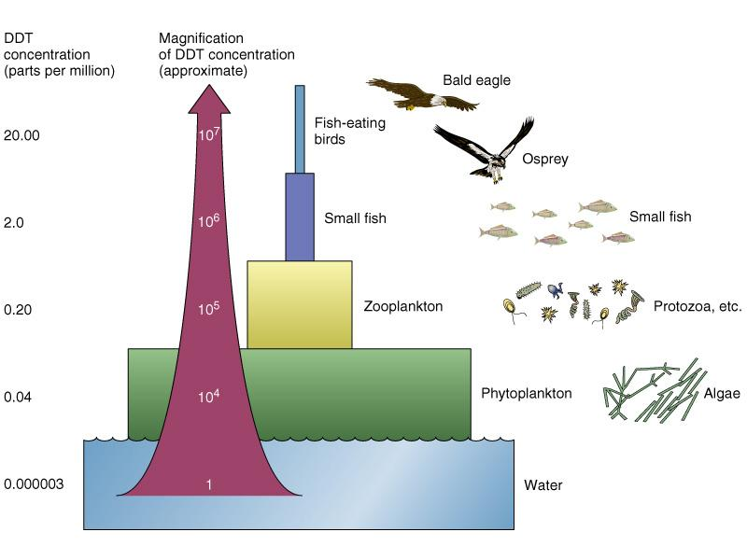
DDT: Part 2
Decline of birds on top of food chain (osprey, eagles)
Eggs breaking before hatched
BIOMAGNIFICATION

Slide 15
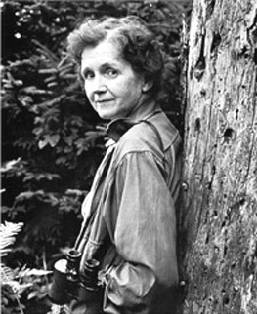
DDT: Part 3
1962, Silent Spring by American biologist Rachel Carson was published. Cataloged the environmental impacts spraying of DDT in the US.
The book suggested that DDT and other pesticides may cause cancer and that their agricultural use was a threat to wildlife, particularly birds.
Its publication was one of the events in the birth of the environmental movement, and resulted in a large public outcry that eventually led to DDT being banned in the US in 1972.
DDT was subsequently banned for agricultural use worldwide under the Stockholm Convention.

Slide 16
Other chemicals prone to biomagnification
PCBs – Polychlorinated Biphenyls
Heavy Metals - Hg, Cu, Cd, Cr, Pb, Zn, Sn, Ni
Cyanide

Slide 17
Homework
At the end of your notes, describe how PCBs are “managed” by the power companies.

