Slide 1
Wind Energy
Wind turbines = devices that harness power from wind
Windmills have been used for 800 years to pump water and grind wheat into flour
Today, wind power produces electricity for the same price as conventional sources

Slide 2
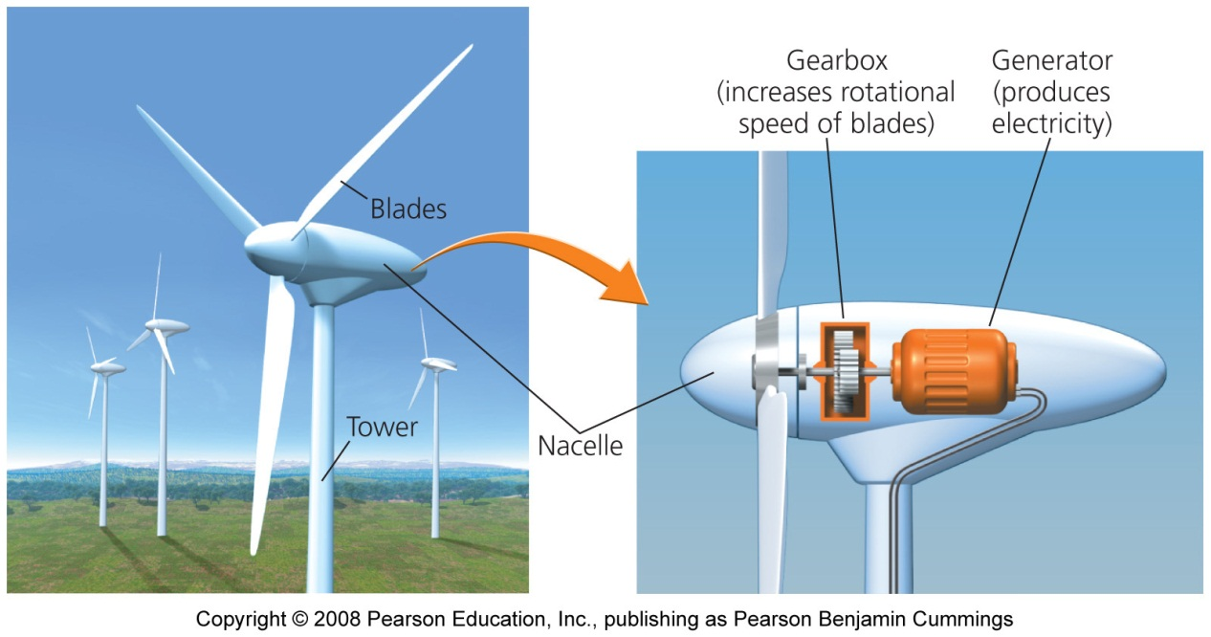
Modern wind turbines
Wind blowing into a turbine turns the blades of the rotor, which rotate machinery inside a compartment (nacelle) on top of a tall tower
Towers are 40 - 100 m (131 - 328 ft) tall
Higher is better to minimize turbulence and maximize wind speed

Slide 3
Wind farms
Wind farms = turbines erected in groups of up to hundreds of turbines
Turbines harness wind as efficiently as possible
Different turbines turn at different speeds
Slight increases in wind velocity yield significant power output

Slide 4
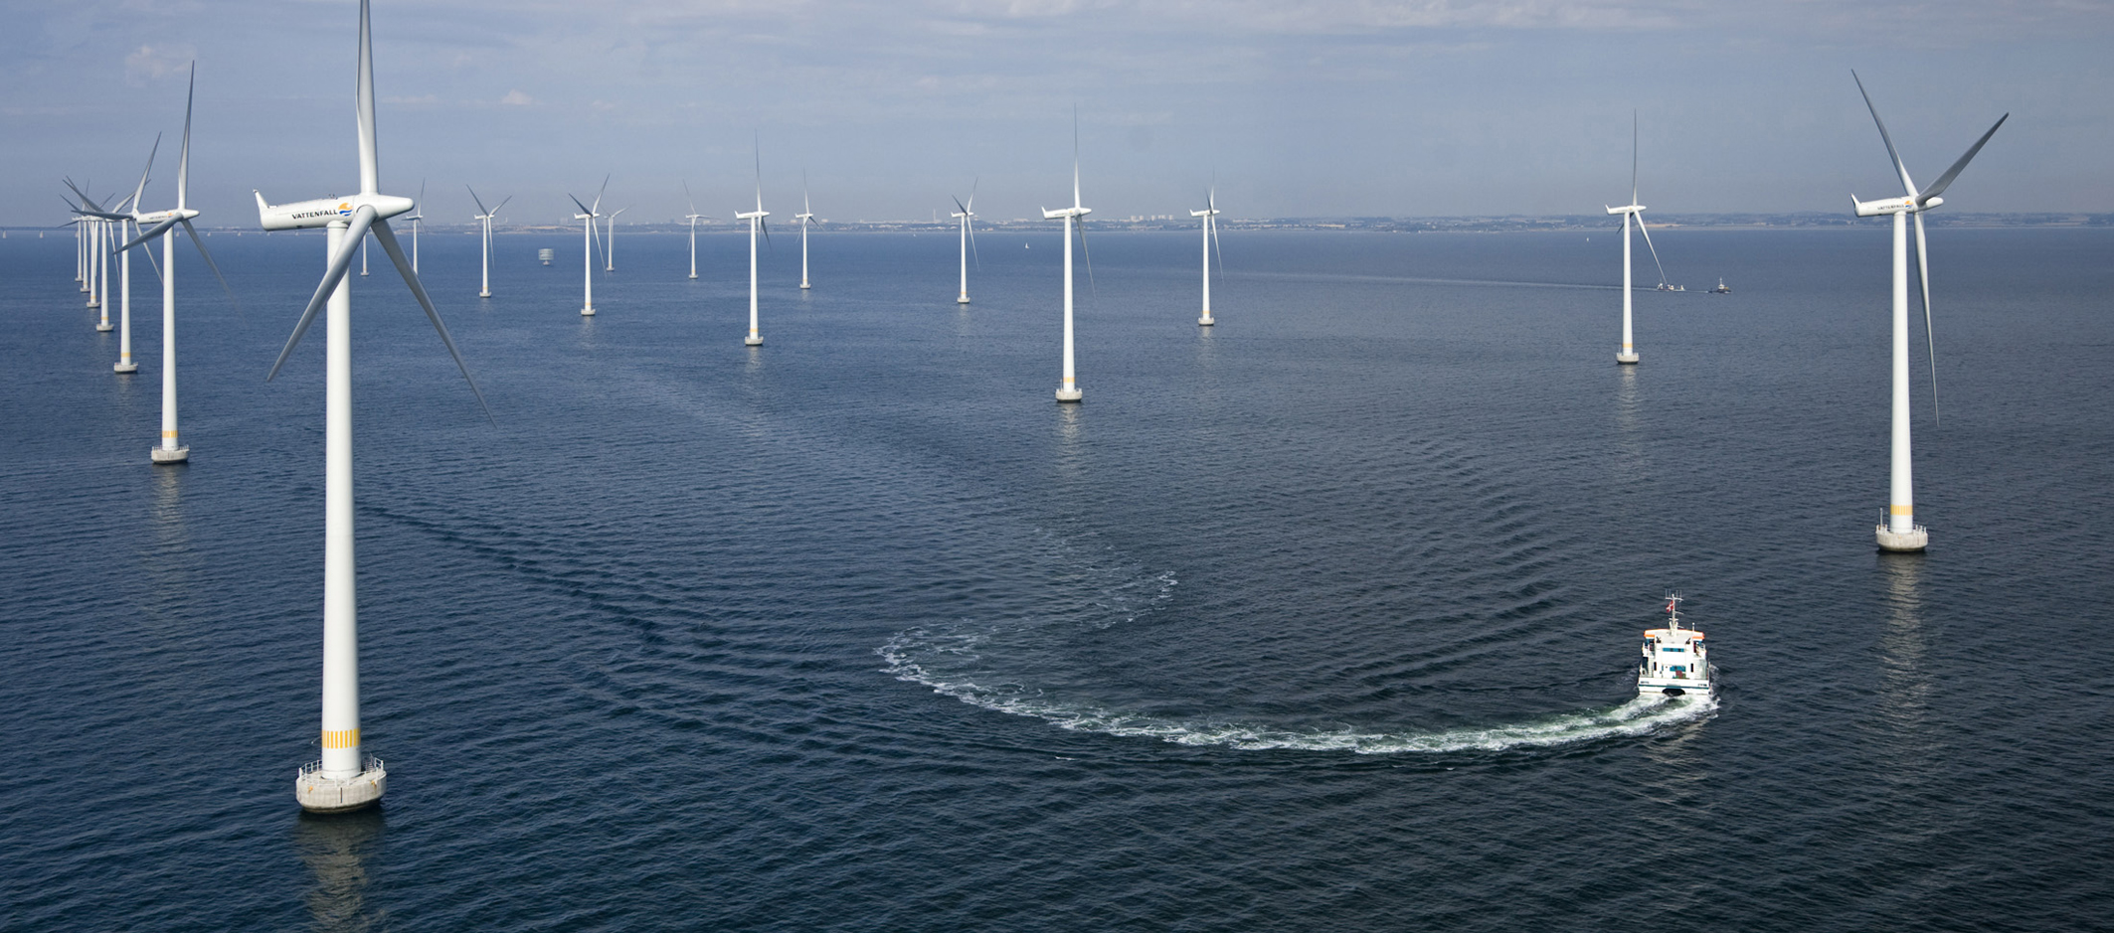
Offshore sites can be promising
Wind speeds are 20% greater over water than over land. Why?
Currently, turbines are limited to shallow water
Many coastal residents do not want wind farms offshore - aesthetics

Slide 5
Wind power benefits
Wind produces no emissions once installed
It prevents the release of CO₂
It is more efficient than conventional power sources
Turbines also use less water than conventional power plants
Farmers and ranchers can lease their land
Produces extra revenue
Landowners can still use their land for other uses
Advancing technology is also driving down the cost of wind farm construction

Slide 6
Wind power drawbacks
We have no control over when wind will occur
Good wind sources are not always near population centers that need energy
When wind farms are proposed near population centers, local residents often oppose them
Wind turbines also pose a threat to birds and bats, which can be killed when they fly into rotating blades

Slide 7
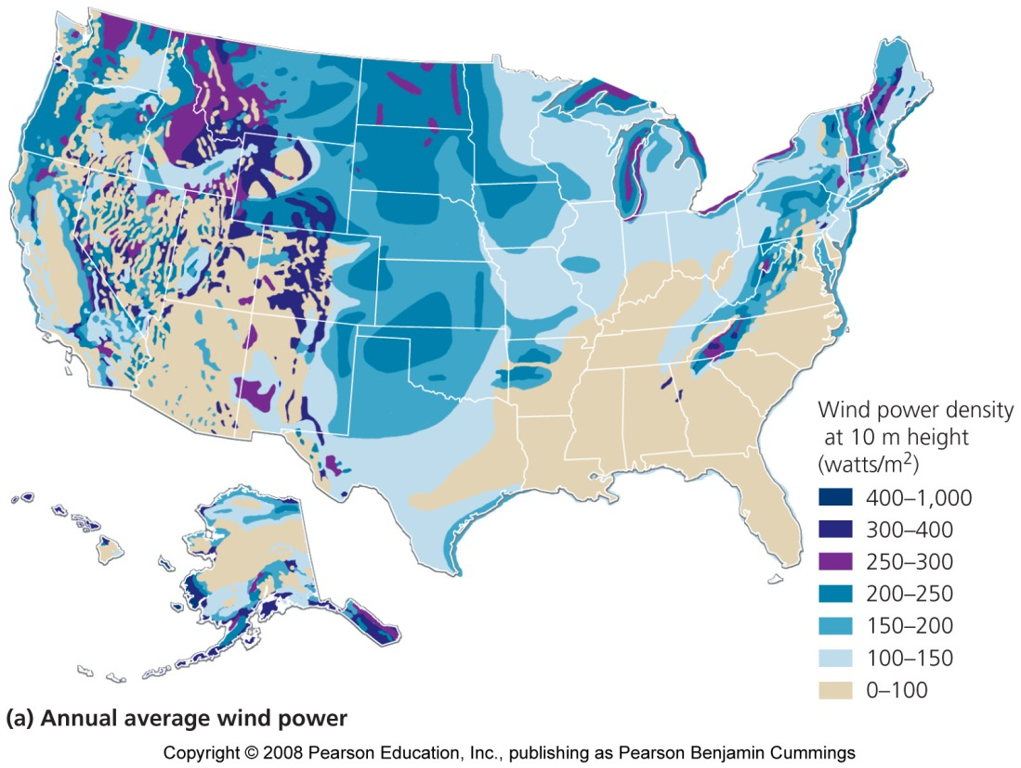
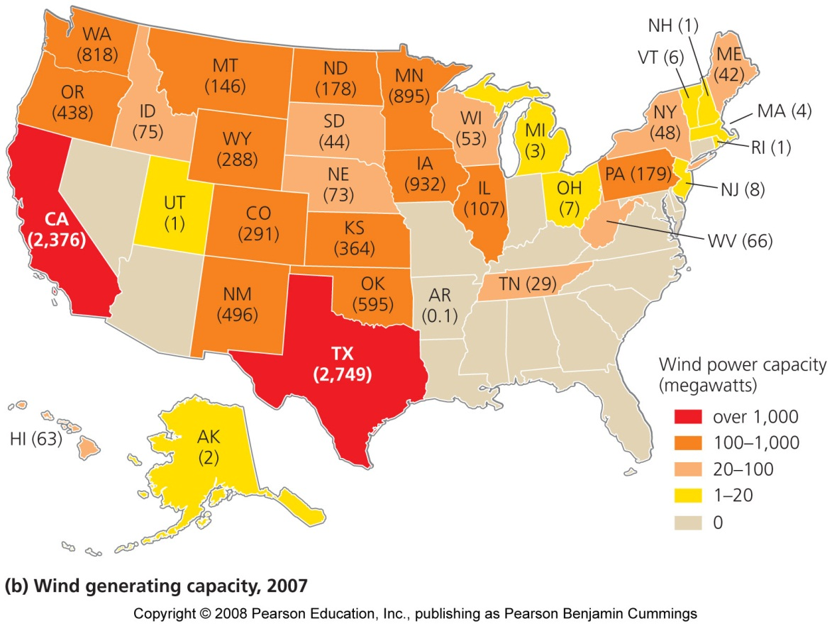
Wind's capacity to generate power varies according to wind speed

Slide 8
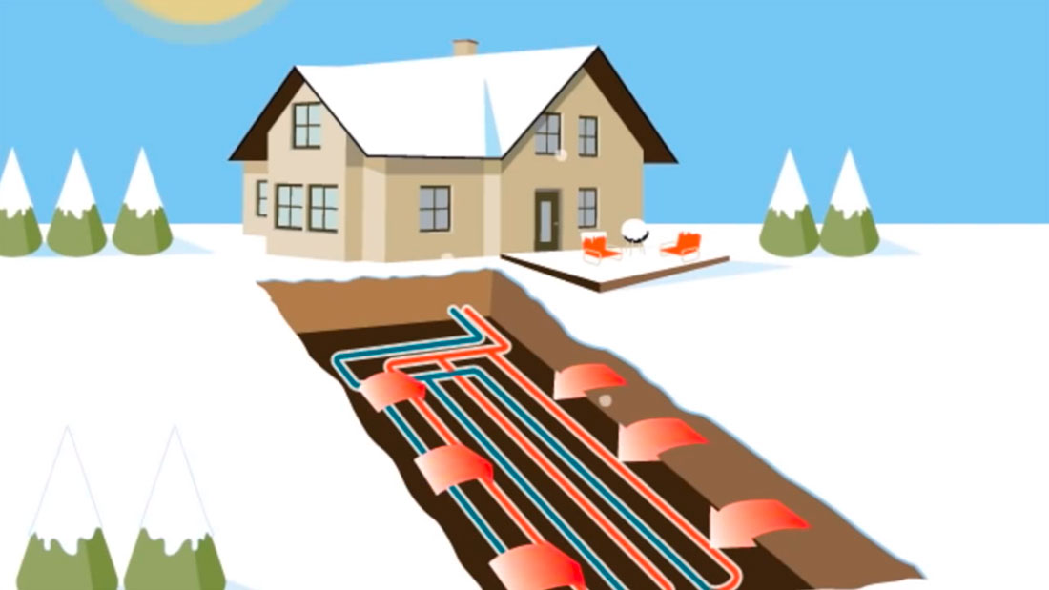
Geothermal energy
Renewable energy that does not originate from the Sun
It is generated using heat from within the Earth
This heat rises through magma, fissures, and cracks
Geothermal power plants use heated water and steam for direct heating and generating electricity

Slide 9
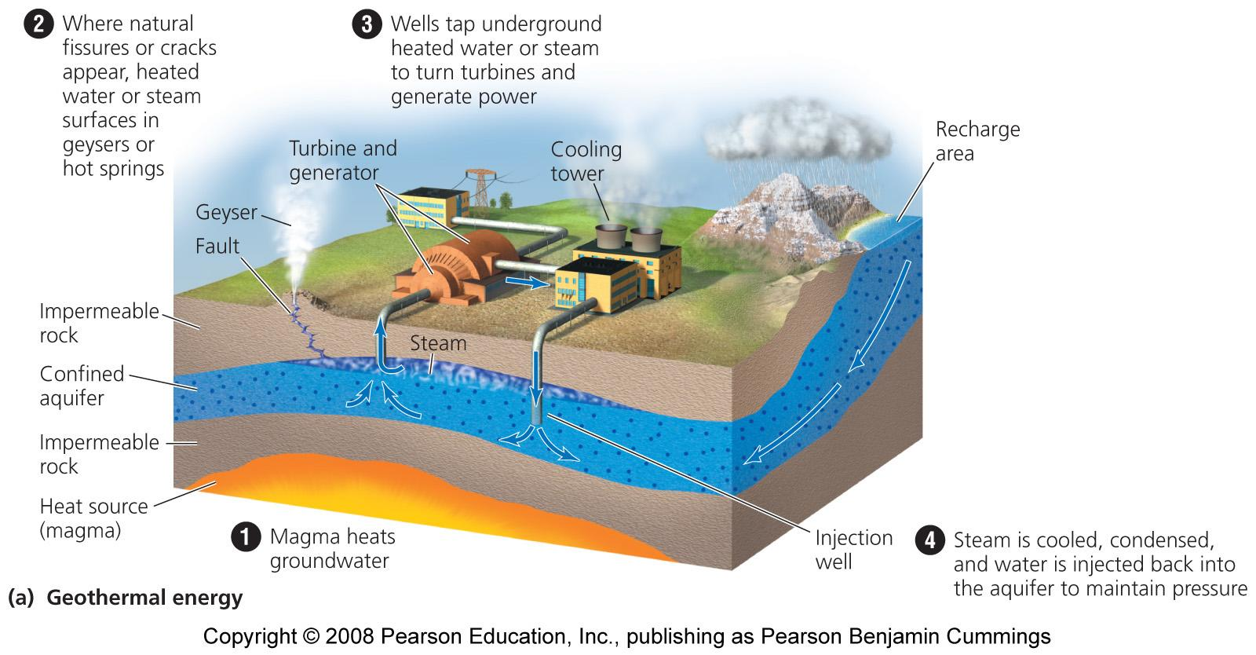

Slide 10
Renewable in principle…..
But if a geothermal plant uses heated water faster than groundwater is recharged, the plant will run out of water
Operators have begun injecting municipal wastewater into the ground to replenish the supply
Patterns of geothermal activity shift naturally
An area that produces hot groundwater now may not always do so

Slide 11
Produces heat and electricity
Most often wells are drilled hundreds or thousands of meters toward heated groundwater
Water at temperatures of 150 – 370 degrees Celsius is brought to the surface and converted to steam, which turns turbines that generate electricity
Hot groundwater can be used directly to heat buildings
Cheap and efficient

Slide 12
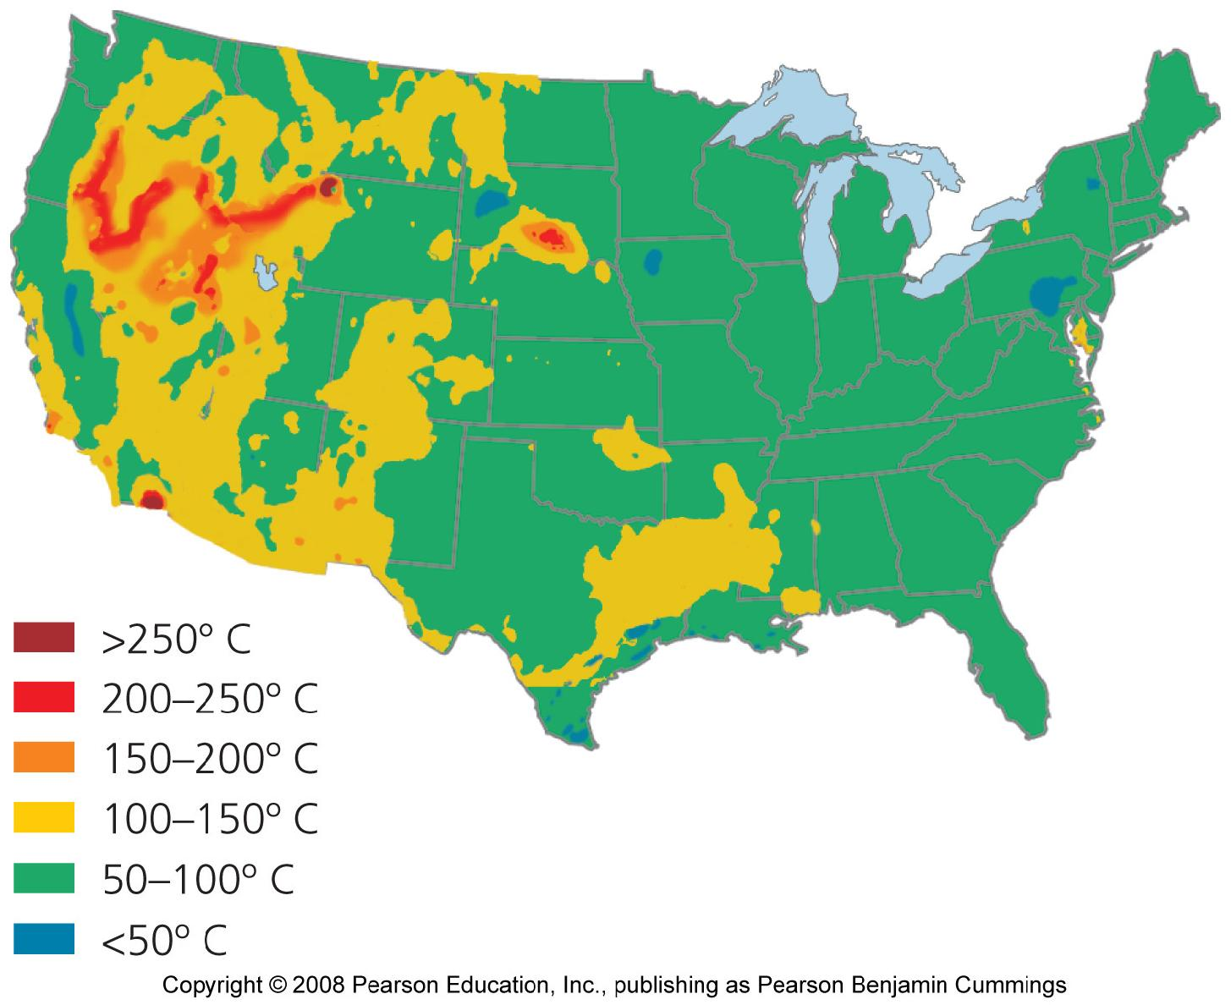
Geothermal energy in the U.S. west

Slide 13
Benefits and Limits
Benefits:
Reduces emissions
It does emit only very small amounts of gases
Drawbacks:
May not be sustainable
Water is laced with salts and minerals that corrode equipment and pollute the air
Limited to areas where the energy can be trapped

Slide 14
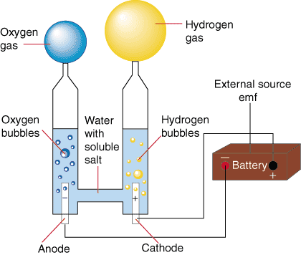
Producing Hydrogen
Electrolysis: When electricity is run through water it splits the H₂O into H₂ and O₂ gas.
The H₂ gas can be used in fuel cells to power cars, homes, and other devices putting out only H₂O as waste.

Slide 15
Other ways of obtaining hydrogen
Hydrogen can also be obtained from biomass and fossil fuels, such as methane (CH₄)
CH₄ + 2H₂O ⇒ 4H₂ + CO₂
Results in emissions of carbon-based pollution

Slide 16
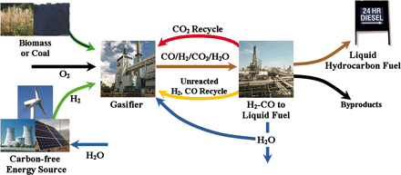

Slide 17
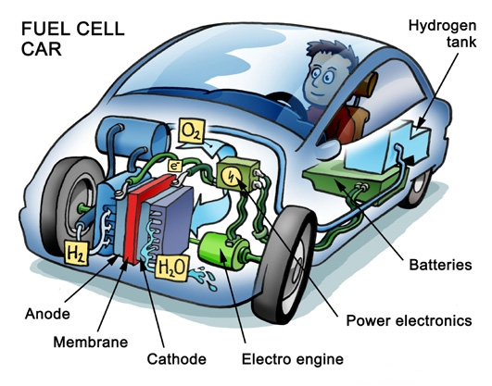
A hydrogen economy
The development of fuel cells and hydrogen fuel shows promise to store large amounts of energy
A hydrogen economy would provide a clean, safe, and efficient energy system

Slide 18
Fuel cells produce electricity
Once isolated, hydrogen gas can be used as a fuel to produce electricity within fuel cells
The chemical reaction involved in that fuel cell is the reverse of electrolysis
2H₂ + O₂ ⇒ 2H₂O
The movement of the hydrogen’s electrons from one electrode to the other creates electricity

Slide 19
Energy based on hydrogen
Electricity generated from renewable sources could be used to produce hydrogen
Vehicles, computers, cell phones, home heating, and countless other applications could be powered
Basing an energy system on hydrogen could alleviate dependence on foreign fuels and help fight climate change
Governments are funding research into hydrogen and fuel cell technology to produce vehicles that run on hydrogen

Slide 20
A hydrogen-fueled bus

Slide 21
Hydrogen and fuel cells benefits
We will never run out; hydrogen is the most abundant element in the universe
Can be clean and nontoxic to use
May produce few greenhouse gases and other pollutants
Can be no more dangerous than gasoline in tanks
Cells are energy efficient
Fuel cells are silent and nonpolluting and won’t need to be recharged

