Slide 1
Soil Nutrients - The Big 13
Come from the soil, are dissolved in water and absorbed through a plant's roots.
There are not always enough of these nutrients in the soil for a plant to grow healthy.
This is why many farmers and gardeners use fertilizers to add the nutrients to the soil.

Slide 2
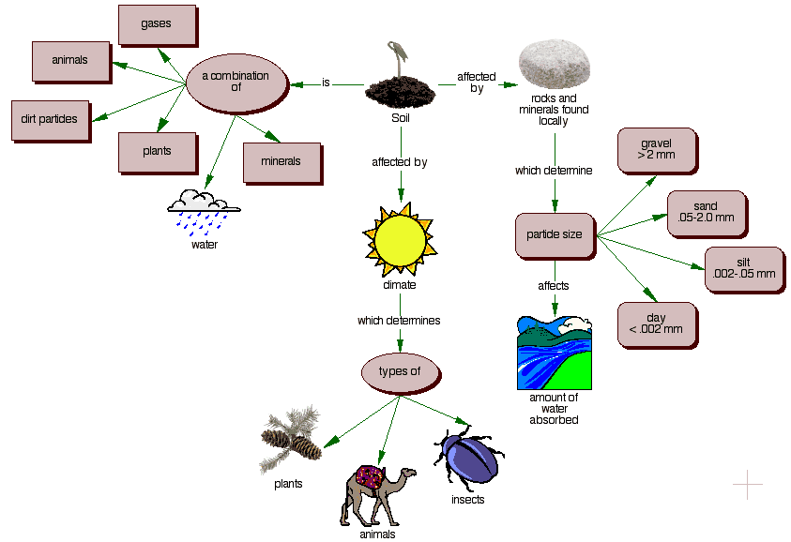

Slide 3
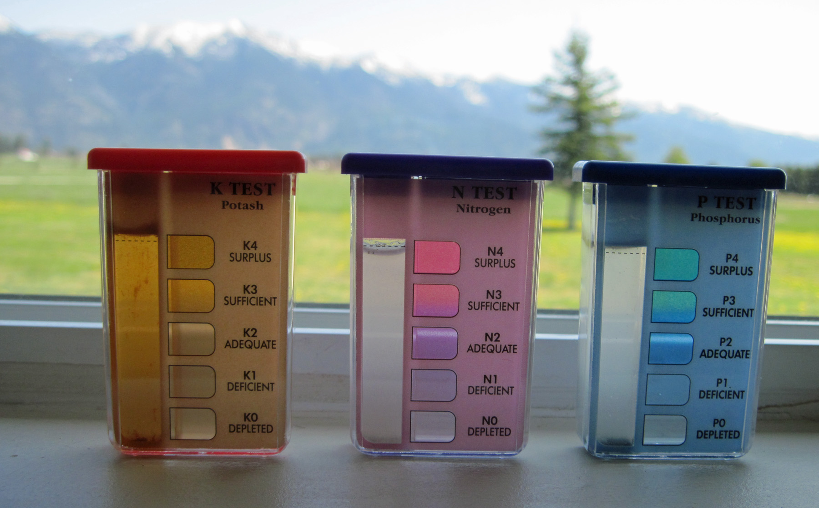
Macronutrients: Primary Nutrients
Plants need large amounts
Nitrogen (N)
Phosphorus
Potassium (K)
Usually the first missing from the soil

Slide 4
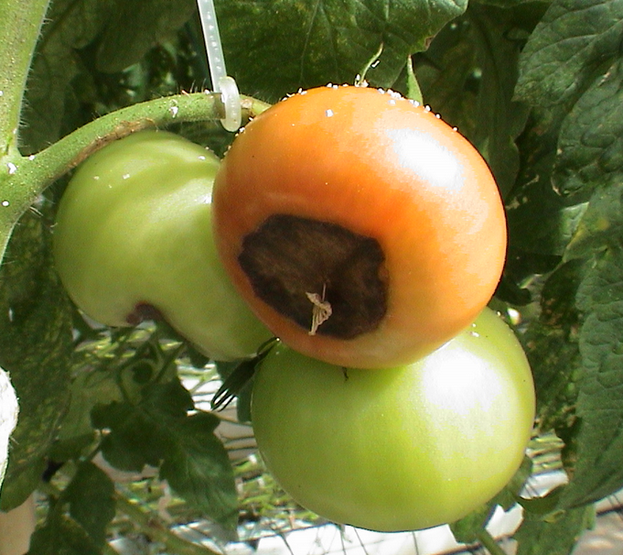
Macronutrients: Secondary Nutrients
Calcium (Ca)
Magnesium (Mg)
Sulfur (S)
There are usually enough of these nutrients in the soil so fertilization is not always needed.
Large amounts of Ca and Mg are added when lime is applied to soils.
In agricultural soils the calcium cation flocculates clay and organic matter particles which results in proper soil porosity. Proper soil porosity insures adequate soil aeration which guarantees proper soil drainage and allows correct root growth. (KNOW THIS)

Slide 5
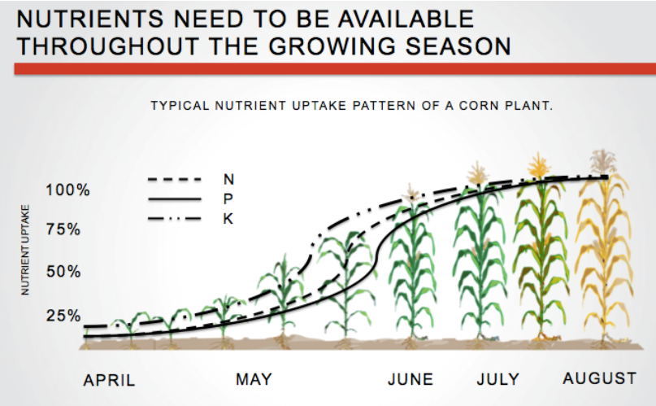
Micronutrients
Essential for growth but only in small amounts.
Boron (B)
copper (Cu)
iron (Fe),
chloride (Cl),
manganese (Mn),
molybdenum (Mo)
zinc (Zn).

Slide 6
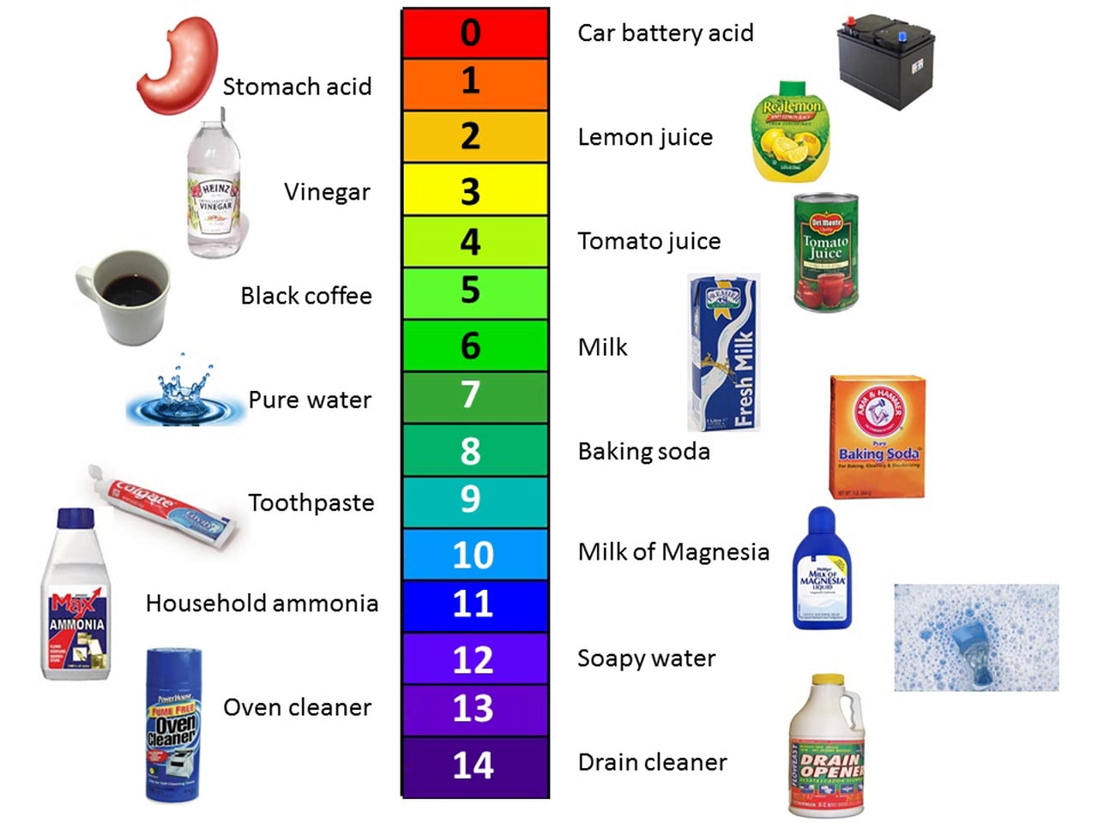
Soil pH is a factor
Soil pH (a measure of the acidity or alkalinity of the soil)
Macronutrients tend to be less available in soils with low pH (more acidic).
Micronutrients tend to be less available in soils with high pH (more basic).

Slide 7
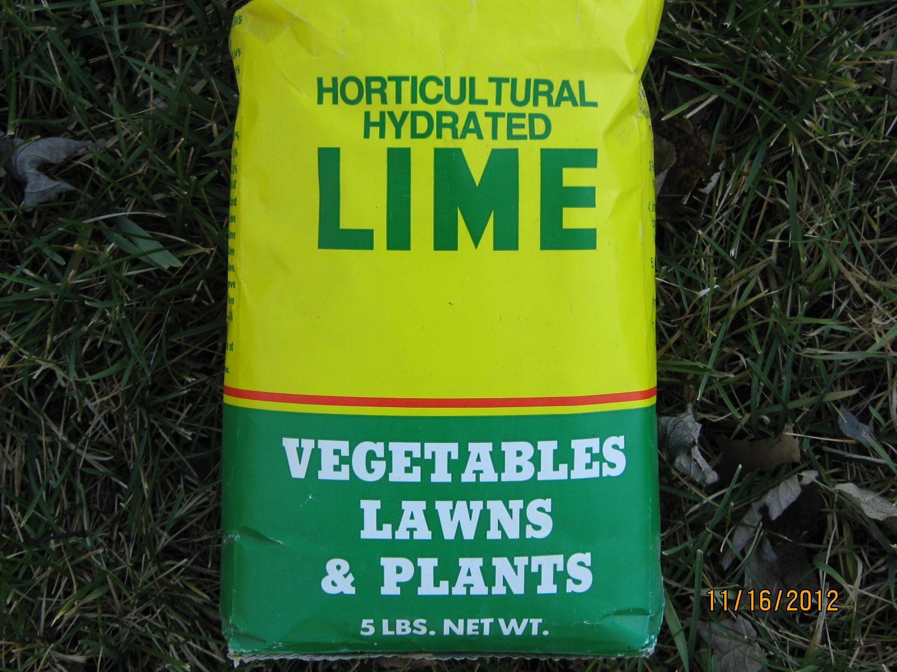
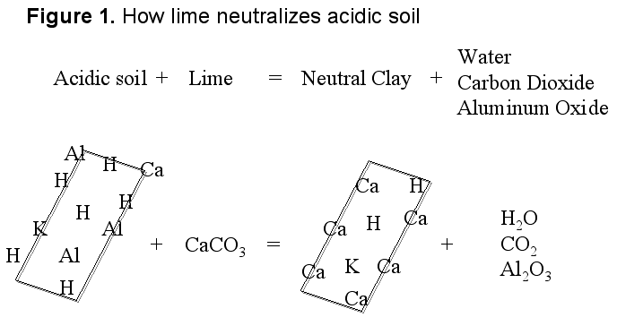
The pH can be changed
Lime is crushed limestone and can be added to the soil to make it less acidic and also supplies calcium and magnesium for plants to use.

Slide 8
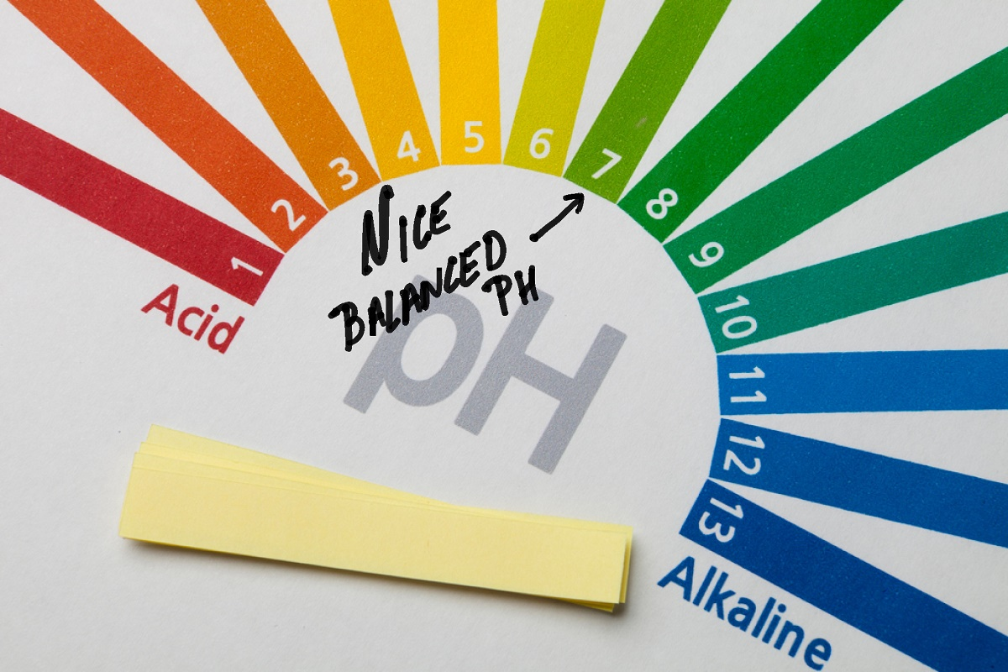
The pH can be changed
Soil acidity can be increased by adding many different supplements or simply laying down pine straw.

